Slide 1
CS203 – Advanced Computer Architecture
Dynamic Instruction Scheduling

Slide 2
Dynamic Scheduling
Hardware rearranges instruction execution to reduce stalls while maintaining data flow and exception behavior
It handles cases when dependences unknown at compile time
  it allows the processor to tolerate unpredictable delays such as cache misses, by executing other code while waiting for the miss to resolve
It allows code thats compiled for one pipeline to run efficiently on a different pipeline
It simplifies the compiler
Hardware speculation, a technique with significant performance advantages, builds on dynamic scheduling (next lecture)

Slide 3
HW Schemes: Instruction Parallelism
Key idea: Allow instructions behind stall to proceed
DIVD F0,F2,F4 Assume DIV takes 10 cycles
ADDD F10,F0,F8
SUBD F12,F8,F14
Enable out-of-order execution and allows out-of-order completion (e.g., SUBD)
  In a dynamically scheduled pipeline, all instructions still pass through issue stage in order (in-order issue)
Note: Dynamic execution creates WAR and WAW hazards and makes exceptions harder

Slide 4
Tomasulo Algorithm
Control & buffers distributed with Function Units (FU)
  FU buffers called “reservation stations”; have pending operands
Registers in instructions replaced by values or pointers to reservation stations(RS); called register renaming ;
  Renaming avoids WAR, WAW hazards
  More reservation stations than registers, so can do optimizations compilers can’t
Results to FU from RS, not through registers, over Common Data Bus that broadcasts results to all FUs
  Avoids RAW hazards by executing an instruction only when its operands are available
Load and Stores treated as FUs with RSs as well
Integer instructions can go past branches (predict taken), allowing FP ops beyond basic block in FP queue

Slide 5
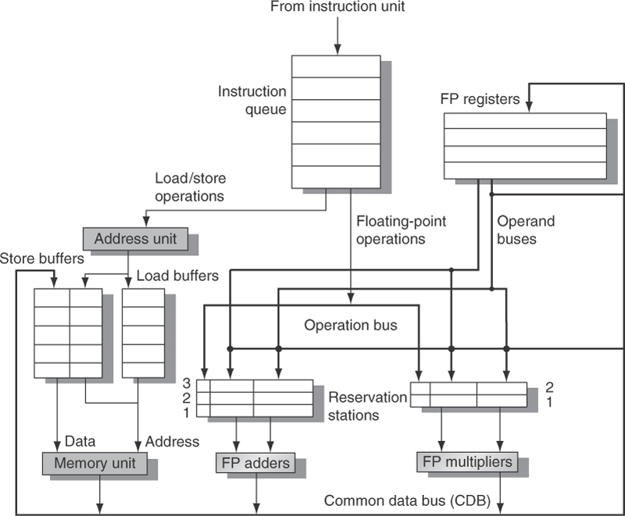
Tomasulo Organization

Slide 6
Three Stages of Tomasulo Algorithm
1. Issue — get instruction from FP Op Queue
  If reservation station free (no structural hazard),
  control issues instr & sends operands (renames registers).
2. Execute — operate on operands (EX)
  When both operands ready then execute; if not ready, watch Common Data Bus for result
3. Write result—finish execution (WB)
  Broadcast on Common Data Bus to all awaiting units; mark reservation station available
Normal data bus: data + destination (“go to” bus)
Common data bus: data + source (“come from” bus)
  64 bits of data + 4 bits of Functional Unit source address
  Write if matches expected Functional Unit (produces result)
  Does the broadcast

Slide 7
Reservation Station Components
Op:
  Operation to perform in the unit (e.g., + or –)
Vj, Vk: Value of Source operands
  Store buffers has V field, result to be stored
Qj, Qk: Reservation stations producing source registers
  I.e, value to be written
  Note: (Qj==0 && Qk==0) => ready
  Store buffers only have Qi for RS producing result
Busy:
  Indicates reservation station or FU is busy
Register result status
  Indicates which functional unit will write each register, if one exists.
  Blank when no pending instructions that will write that register.

Slide 8
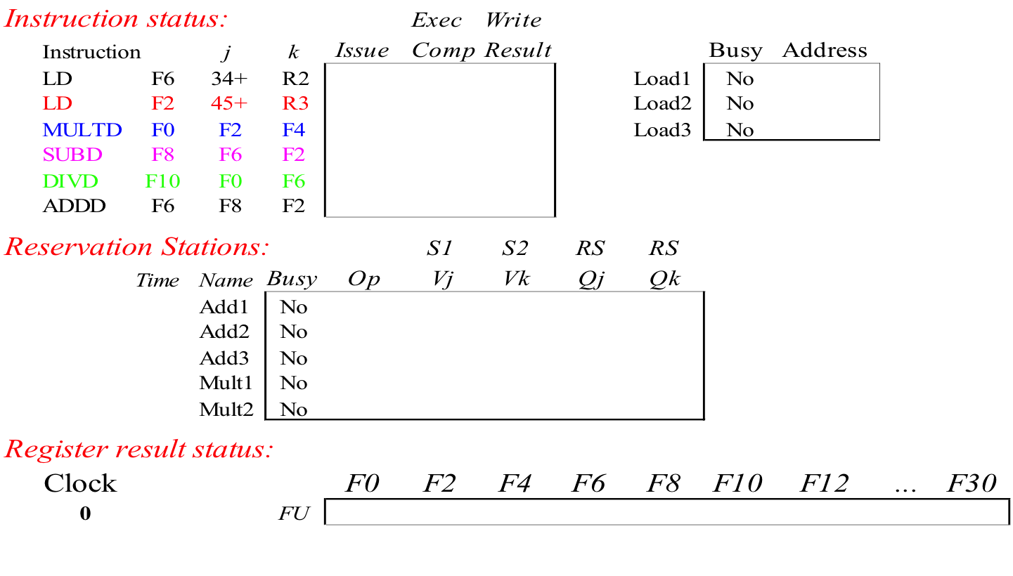
Tomasulo Example
Instruction stream
3 Load/Buffers
FU count
down
3 FP Adder R.S.
2 FP Mult R.S.
Clock cycle
counter

Slide 9
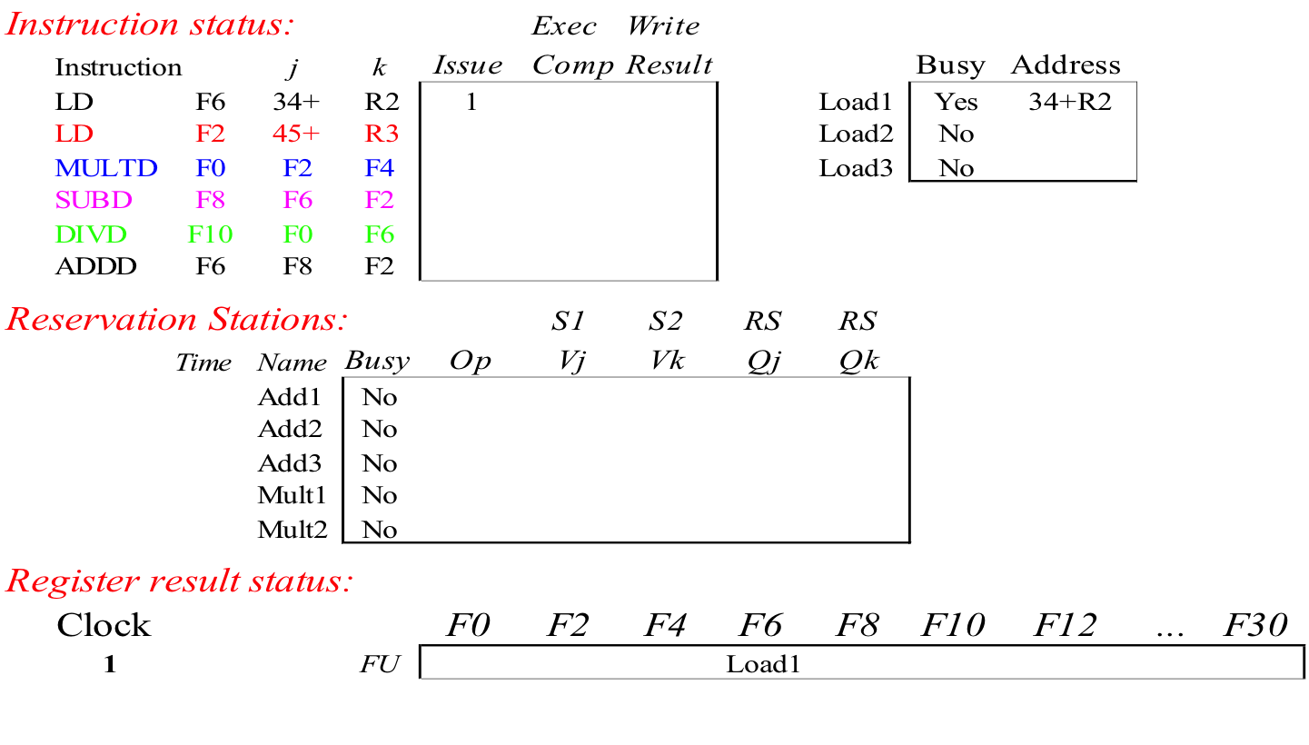
Tomasulo Example Cycle 1

Slide 10
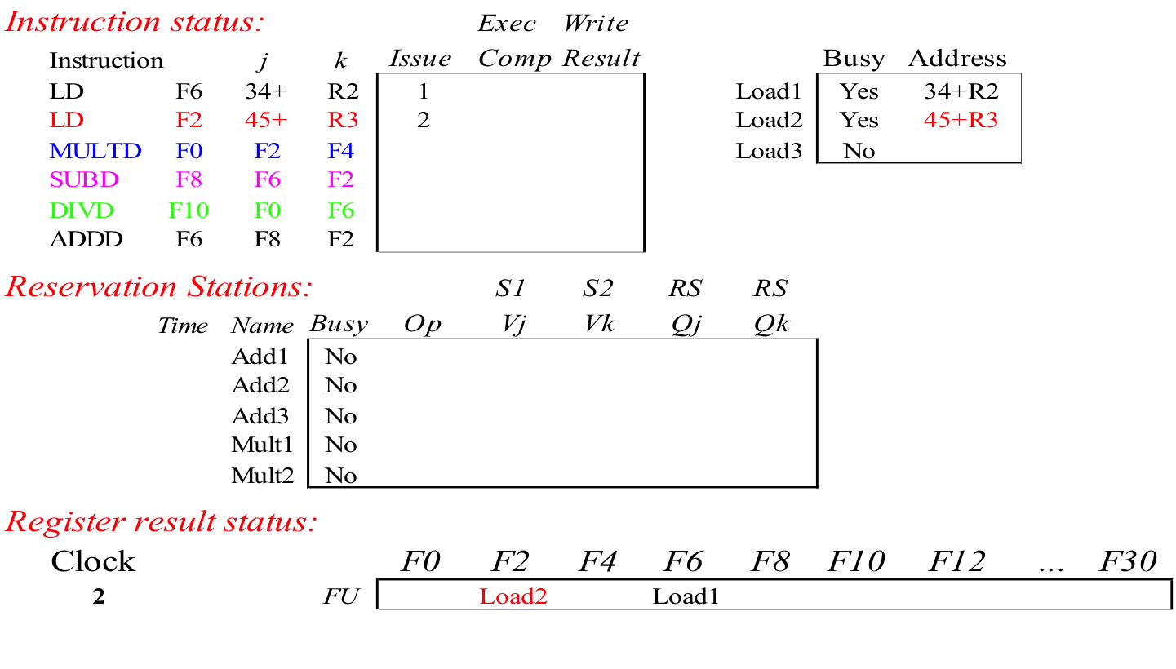
Tomasulo Example Cycle 2
Note: Can have multiple loads outstanding

Slide 11
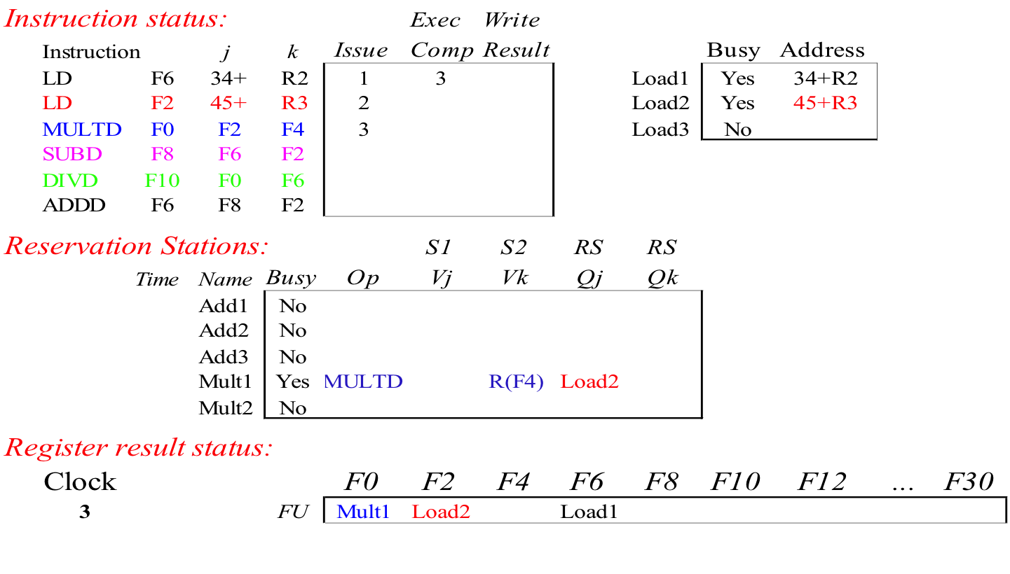
Tomasulo Example Cycle 3
Note: registers names are removed (“renamed”) in Reservation Stations; MULT issued. Load1 completing; what is waiting for Load1?

Slide 12
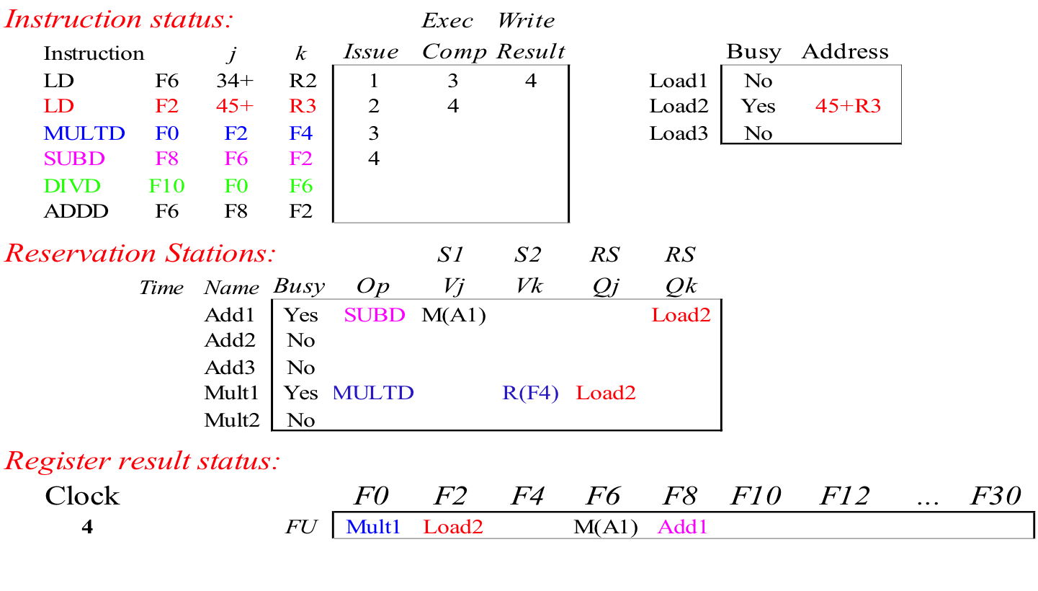
Tomasulo Example Cycle 4
Load2 completing; what is waiting for Load2?

Slide 13
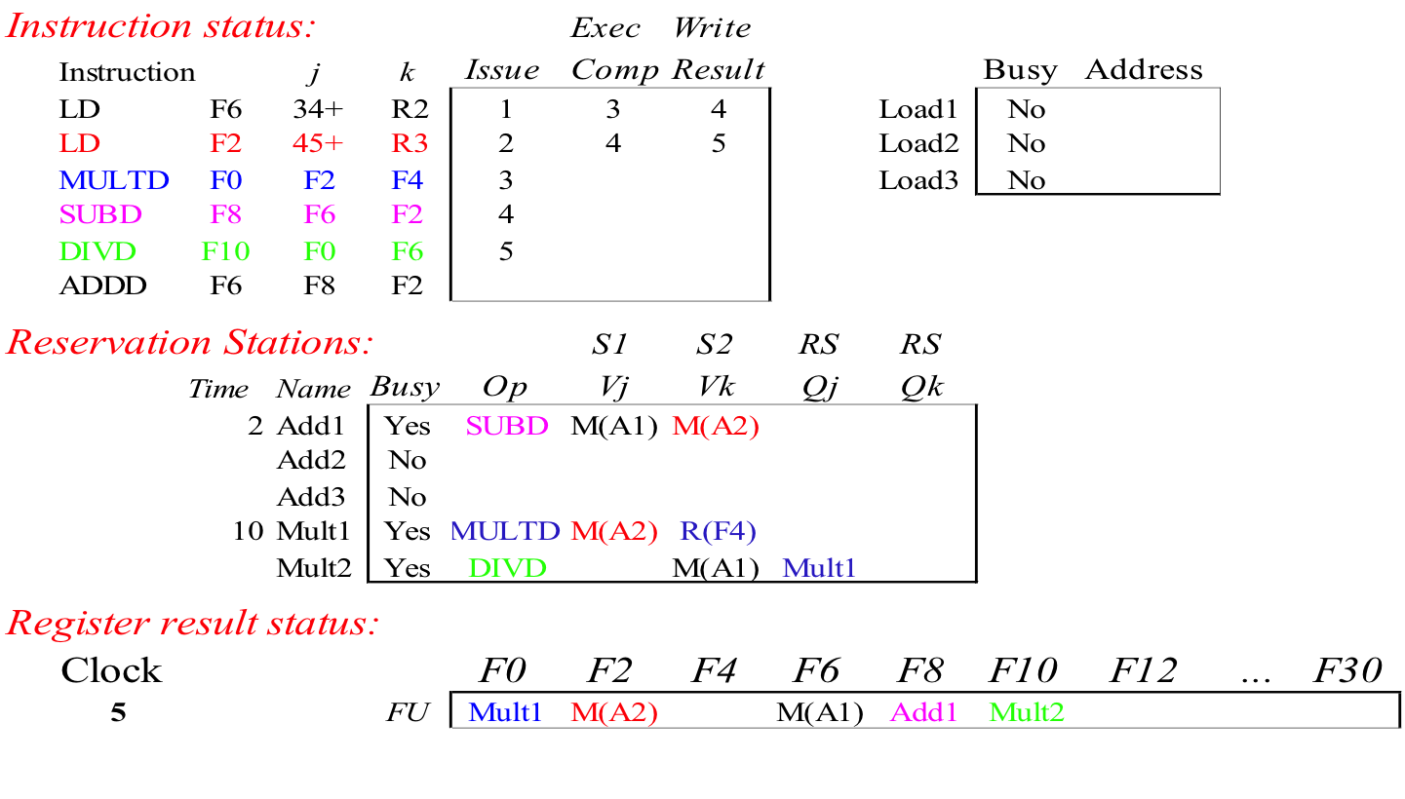
Tomasulo Example Cycle 5
Timer starts down for Add1, Mult1

Slide 14
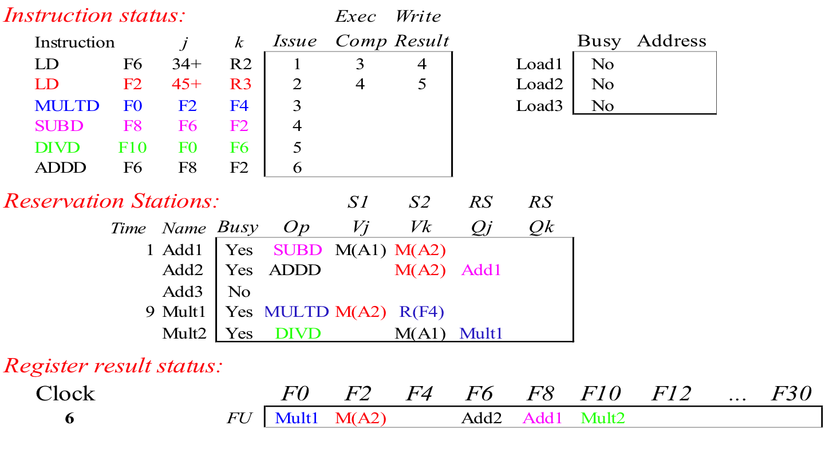
Tomasulo Example Cycle 6
Issue ADDD here despite name dependency on F6?

Slide 15

Tomasulo Example Cycle 7
Add1 (SUBD) completing; what is waiting for it?

Slide 16
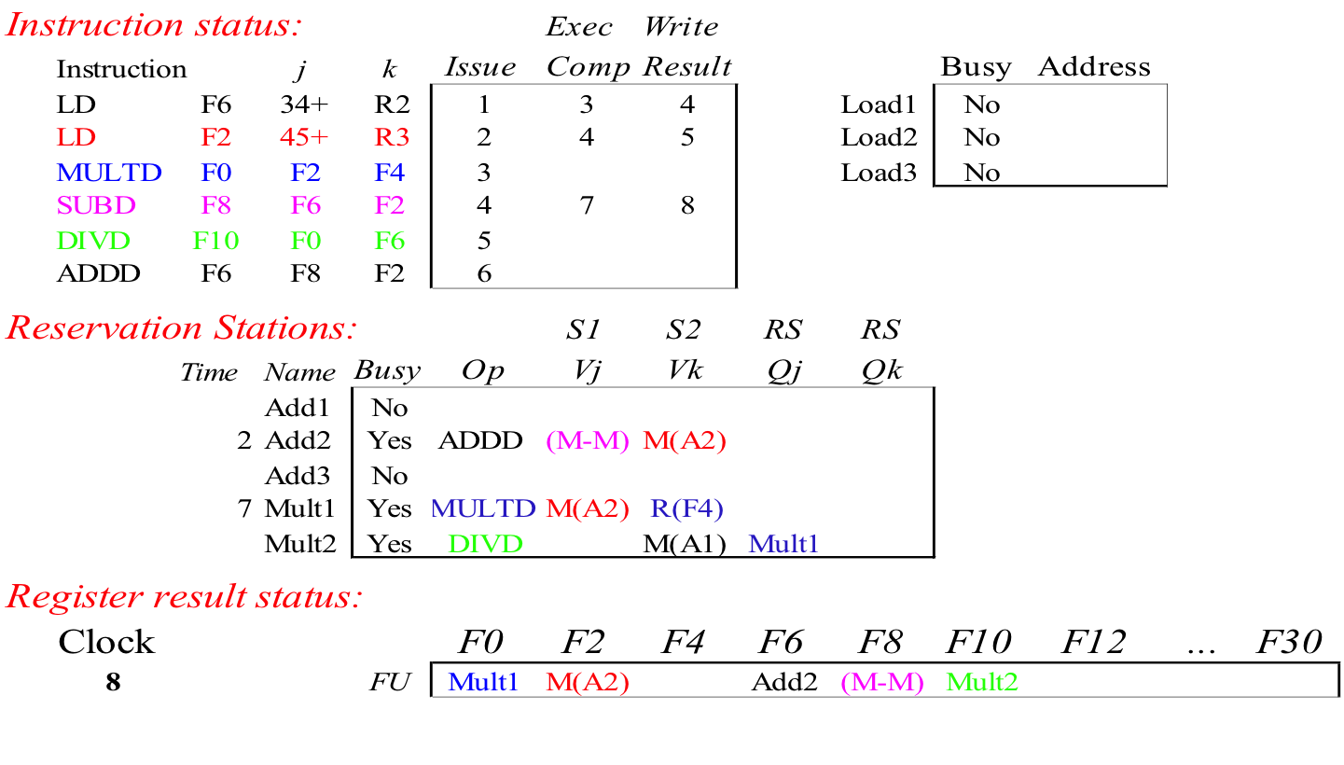
Tomasulo Example Cycle 8

Slide 17

Tomasulo Example Cycle 9

Slide 18

Tomasulo Example Cycle 10
Add2 (ADDD) completing; what is waiting for it?

Slide 19
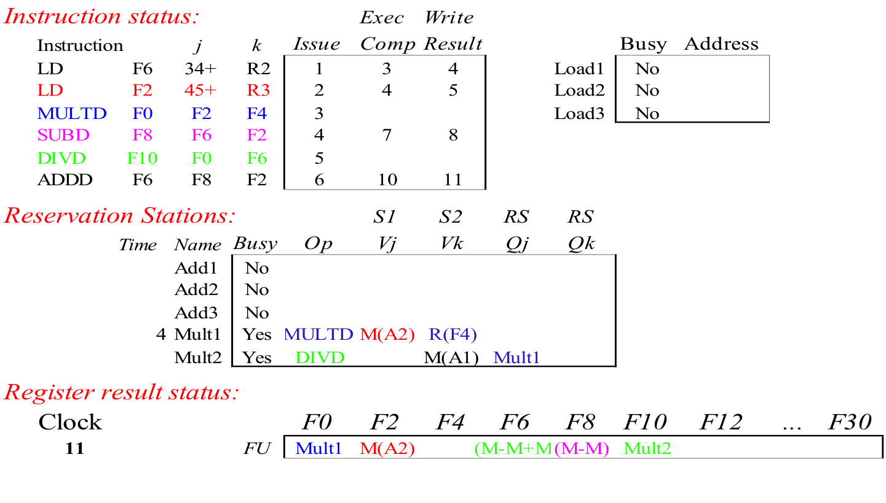
Tomasulo Example Cycle 11
Write result of ADDD here?

Slide 20

Tomasulo Example Cycle 12

Slide 21

Tomasulo Example Cycle 13

Slide 22

Tomasulo Example Cycle 14

Slide 23

Tomasulo Example Cycle 15
Mult1 (MULTD) completing; what is waiting for it?

Slide 24
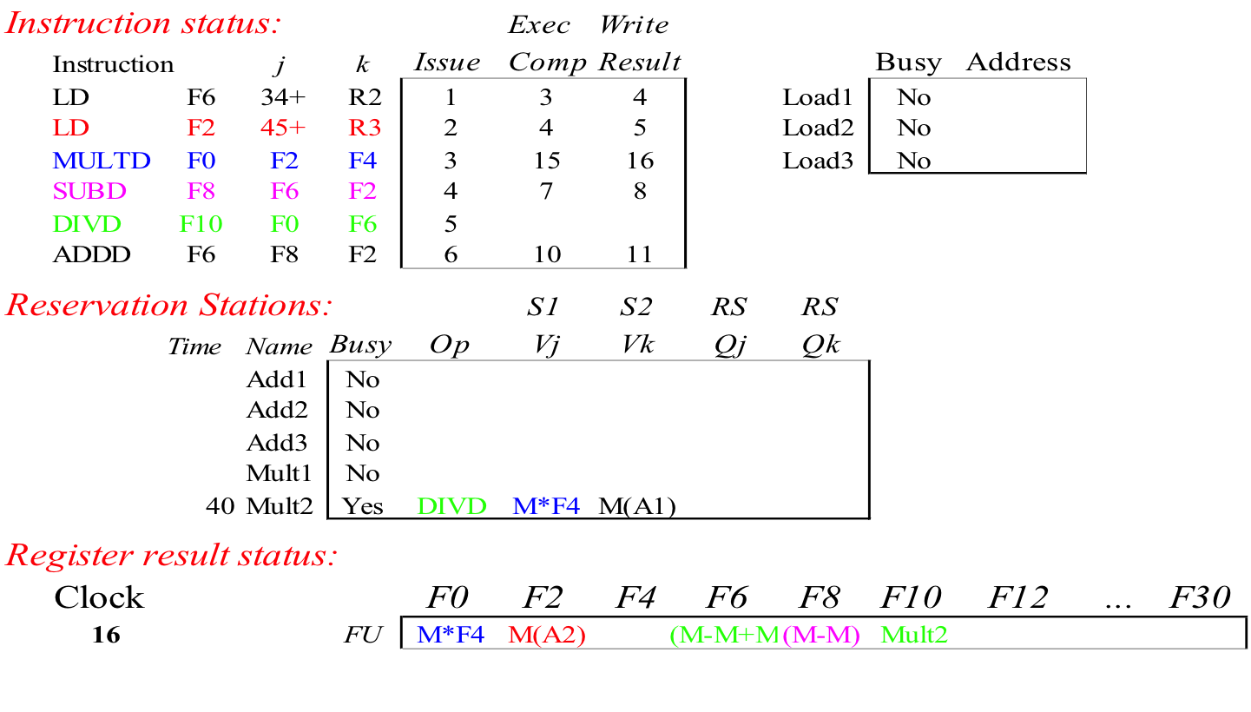
Tomasulo Example Cycle 16
Just waiting for Mult2 (DIVD) to complete

Slide 25
Fast forward……

Slide 26

Tomasulo Example Cycle 55

Slide 27

Tomasulo Example Cycle 56
Mult2 (DIVD) is completing; what is waiting for it?

Slide 28
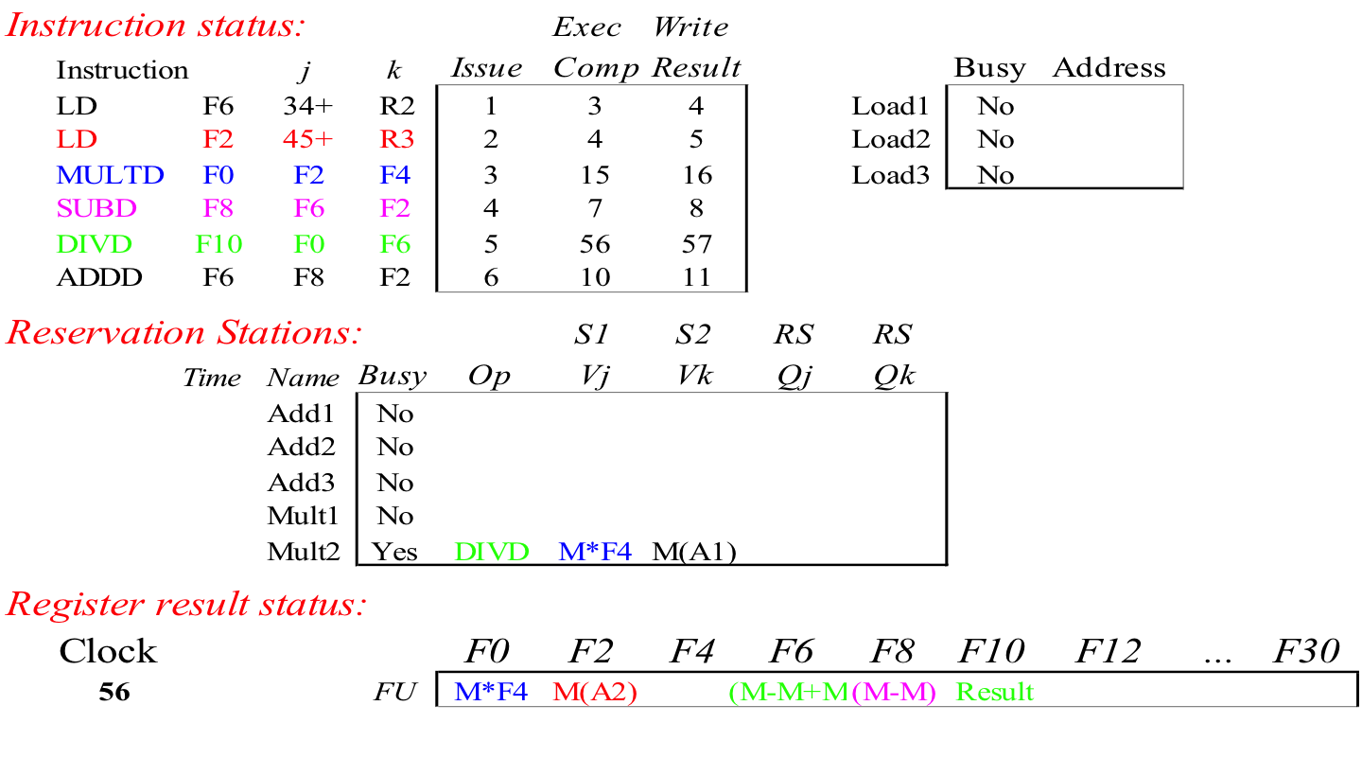
Tomasulo Example Cycle 57
Once again: In-order issue, out-of-order execution and out-of-order completion.

Slide 29
Advantages
Distribution of the hazard detection logic
  distributed reservation stations and the CDB
  If multiple instructions waiting on single result, & each instruction has other operand, then instructions can be released simultaneously by broadcast on CDB
  If a centralized register file were used, the units would have to read their results from the registers when register buses are available
Elimination of stalls for WAW and WAR hazards

Slide 30
Disadvantages
Complexity
Performance limited by Common Data Bus
  Each CDB must go to multiple functional units
  high capacitance, high wiring density
  Number of functional units that can complete per cycle limited to one!
Multiple CDBs  more FU logic for parallel stores
Non-precise interrupts!
  We will address this later

Slide 31
ILP due to Tomasulo’s Algorithm
Overlapped loop iterations
  Register renaming
    Multiple iterations use different physical destinations for registers (dynamic loop unrolling).
  Reservation stations
    Permit instruction issue to advance past integer control flow operations
    Also buffer old values of registers - totally avoiding the WAR stall
Other perspective: Tomasulo building data flow dependency graph on the fly
  Eliminates WAW and WAR dynamically
    Due to register renaming
  Implements RAW dependencies

