Slide 1
CS203 – Advanced Computer Architecture
Branch Prediction

Slide 2
Static Branch Prediction
To reorder code around branches, we need to predict branch statically when compiling
  Always taken / not taken
Can be compiler directed
  Delayed Branch
  Hint bits (branch likely, branch not likely)

Slide 3
Dynamic Branch Prediction
Why does prediction work?
  Underlying algorithm has regularities
  Data that is being operated on has regularities
  Instruction sequence has redundancies that are artifacts of way that humans/compilers think about problems
Is dynamic branch prediction better than static branch prediction?
  Seems to be
  There are a small number of important branches in programs which have dynamic behavior

Slide 4
Dynamic Branch Prediction
Branch Prediction Buffer (BPB) accessed with Instruction on I-Fetch
Also called Branch History Table (BHT),
Branch Prediction Table (BPT)

Slide 5
1-bit Predictor
Each BHT entry is 1-bit
  Bit records last outcome of the branch
  Predicts that next outcome is the same as the last
Loop1: ---
---
Loop2: ---
---
BEZ R2, Loop2
---
BNEZ R3, Loop1
BEZ always mispredicted twice for every loop
  Once on entry and once on exit

Slide 6
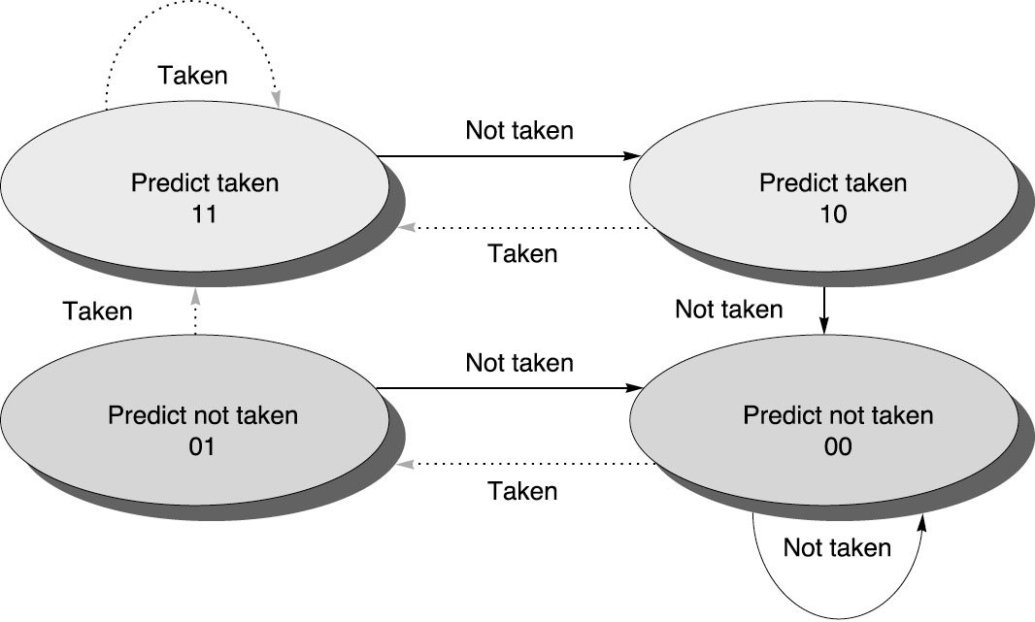
2-bit Predictor
Prediction must miss twice before it is changed
2-bit BHT
Also called 2-bit saturating counter
Can be extended to N-bits (typically N=2)

Slide 7
2-bit predictor
Loop1: ---
---
Loop2: ---
---
BEZ R2, Loop2
---
BNEZ R3, Loop1

Slide 8
BHT Accuracy
Mispredict due to
  Wrong guess for that branch
  Got branch history of wrong branch when index to the table (aliasing)
Example w/ 4k
entries:
Integer
Floating Point

Slide 9
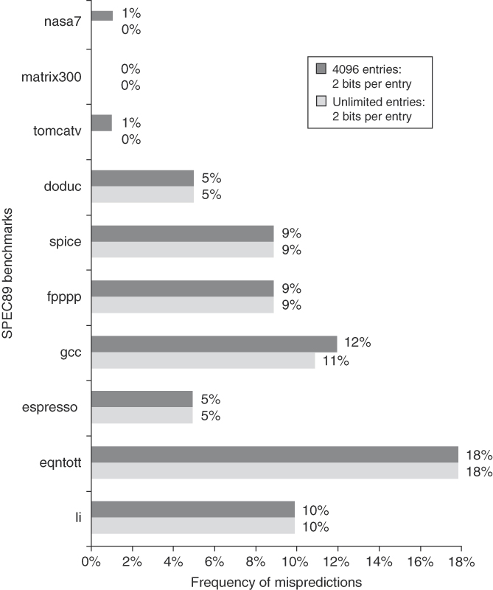
Observations
Misprediction higher for integer programs than floating point programs
Prediction accuracy doesn’t improve beyond 4k entries

Slide 10
Correlating Predictors
Look at other branches for clues
  if (aa==2) -- branch b1
  …
  if (bb==2) -- branch b2
  …
  if(aa!=bb) { … -- branch b3 – Clearly depends on the results of b1 and b2

Slide 11
Correlating Predictors
Record m most recently executed branches as taken / not taken and use that pattern to select proper n-bit branch history table
(m,n) predictor
  Record last m branches to select between 2^{m} BHT
  Each BHT has n-bit counters
    Simple 2-bit BHT is a (0,2) predictor
Global Branch Histroy: m-bit shift register
Also called Two Level predictors
  1st level – global, 2nd level - counters

Slide 12
Correlating Predictors
Example (2,2) predictor
Branch address
4
2-bits per branch predictor
Prediction
2-bit global branch history

Slide 13
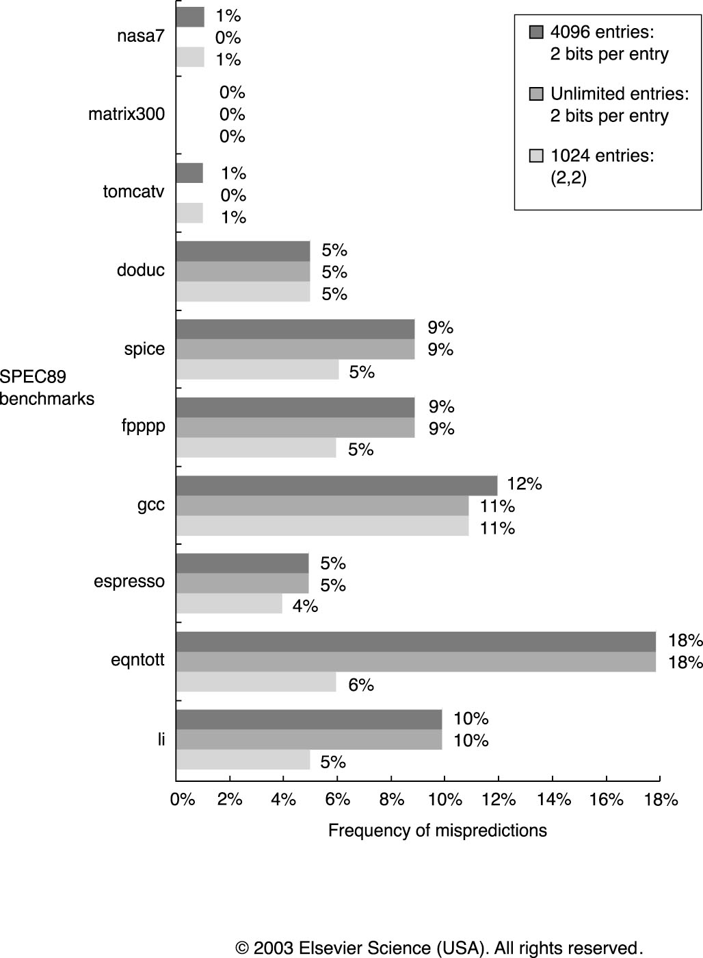
Correlating Predictor Accuracy
With 1k entries,
(2,2) performs
better than 2-bit
predictor with
unlimited entries!

Slide 14
Local Predictor
Previously, Global Branch History captures global behaviors (global predictor)
  Patterns including neighboring branches
Local predictor capture patterns belonging to the branch being predicted
  if (aa==2) -- branch b1
  …
  if (bb==2) -- branch b2
  …
  if(aa!=bb) { … -- branch b3

Slide 15
Local Predictor
Branch PC
1k entries of
2-bit counters
4-bit
10-bit history index
1001010001
16 entries of 10-bit
local branch history

Slide 16
Local Predictor
10-bit
Branch PC
1k entries of
2-bit counters
4-bit
XOR
1001010001
16 entries of 10-bit
local branch history

Slide 17
Tournament Predictors
Problem: Some branches work well with local predictors, while other branches work well with global predictors
Solution: Use multiple predictors.
  One based on global information, one based on local information.
  Add a selector to pick between predictors
Local
MUX
Global
Tournament

Slide 18
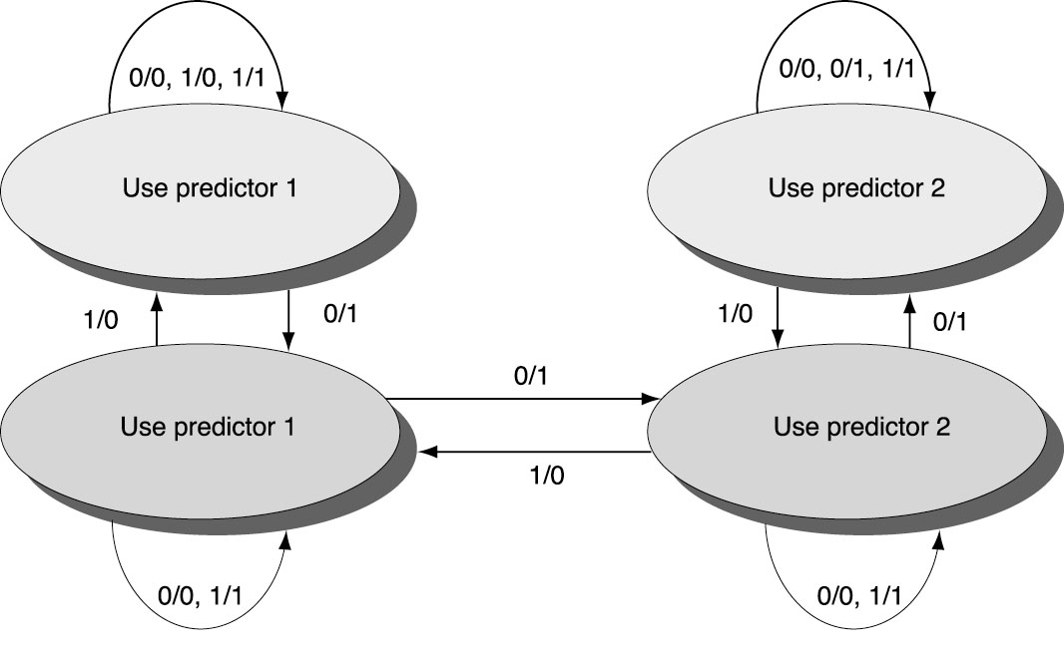
Tournament Predictor
How to pick between local or global predictor?
Use n-bit saturating counter to choose between predictors

Slide 19
Tournament Predictor Accuracy
Advantage of tournament predictor is ability to select the right predictor for a particular branch
    Particularly crucial for integer benchmarks.
    A typical tournament predictor will select the global predictor almost 40% of the time for the SPEC integer benchmarks and less than 15% of the time for the SPEC FP benchmarks
Predictor of Alpha 21264
    Similar to Pentium4 and PPC5
  4K 2-bit predictor to select local or global
  Global predictor
    4K entries indexed by history of last 12 branches, each a 2-bit predictor
  Local predictor: two levels
    Top level 1K 10-bit branch history table
    Each entry index into 1K 3-bit saturating counters

Slide 20
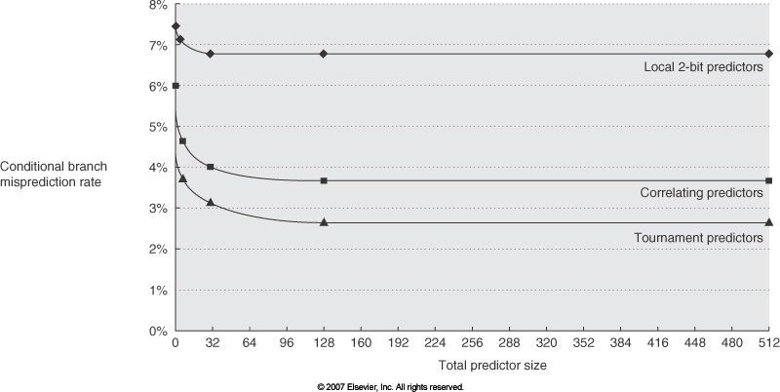
Predictor Accuracy

Slide 21
Branch Target Buffers (BTB)
Branch target calculation is costly and stalls instruction fetch
BTB enable fetching to begin after IF-stage
BTB cache predicted PC value
PC
Branch Target
BTB

Slide 22
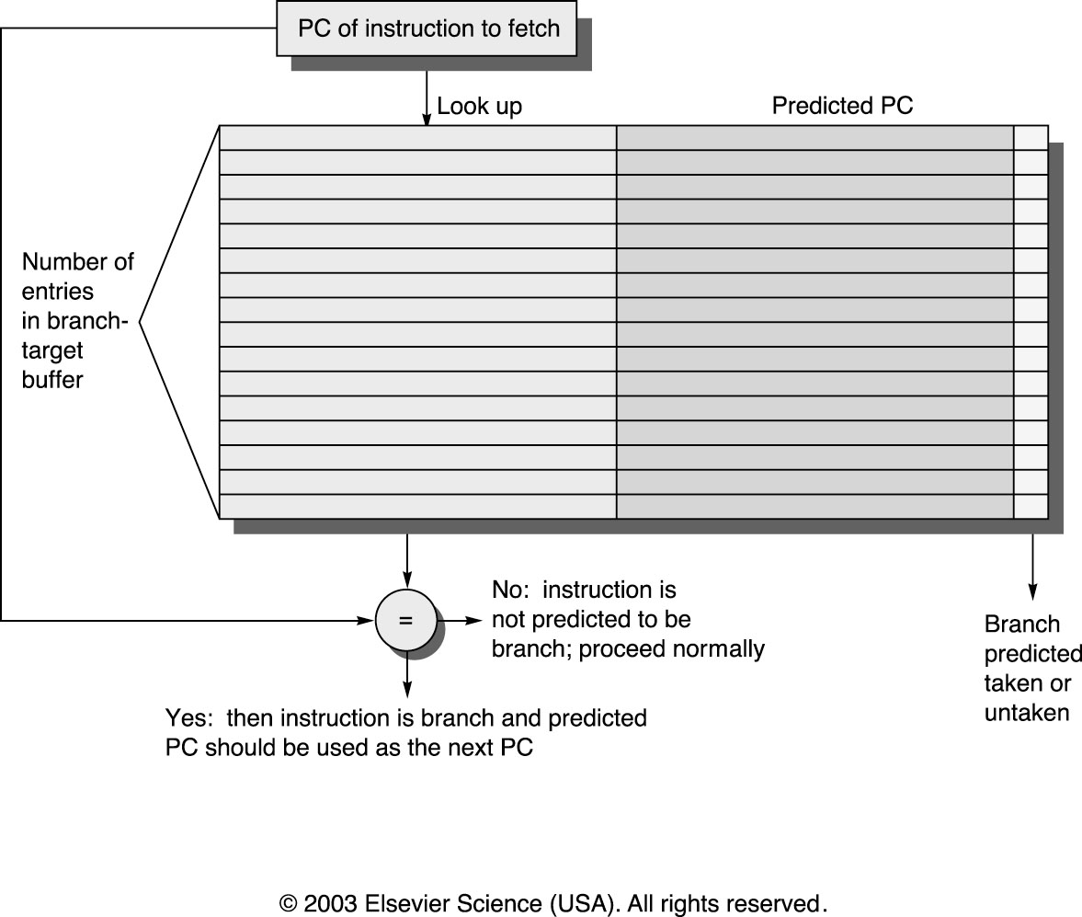
Branch Target Buffers

Slide 23
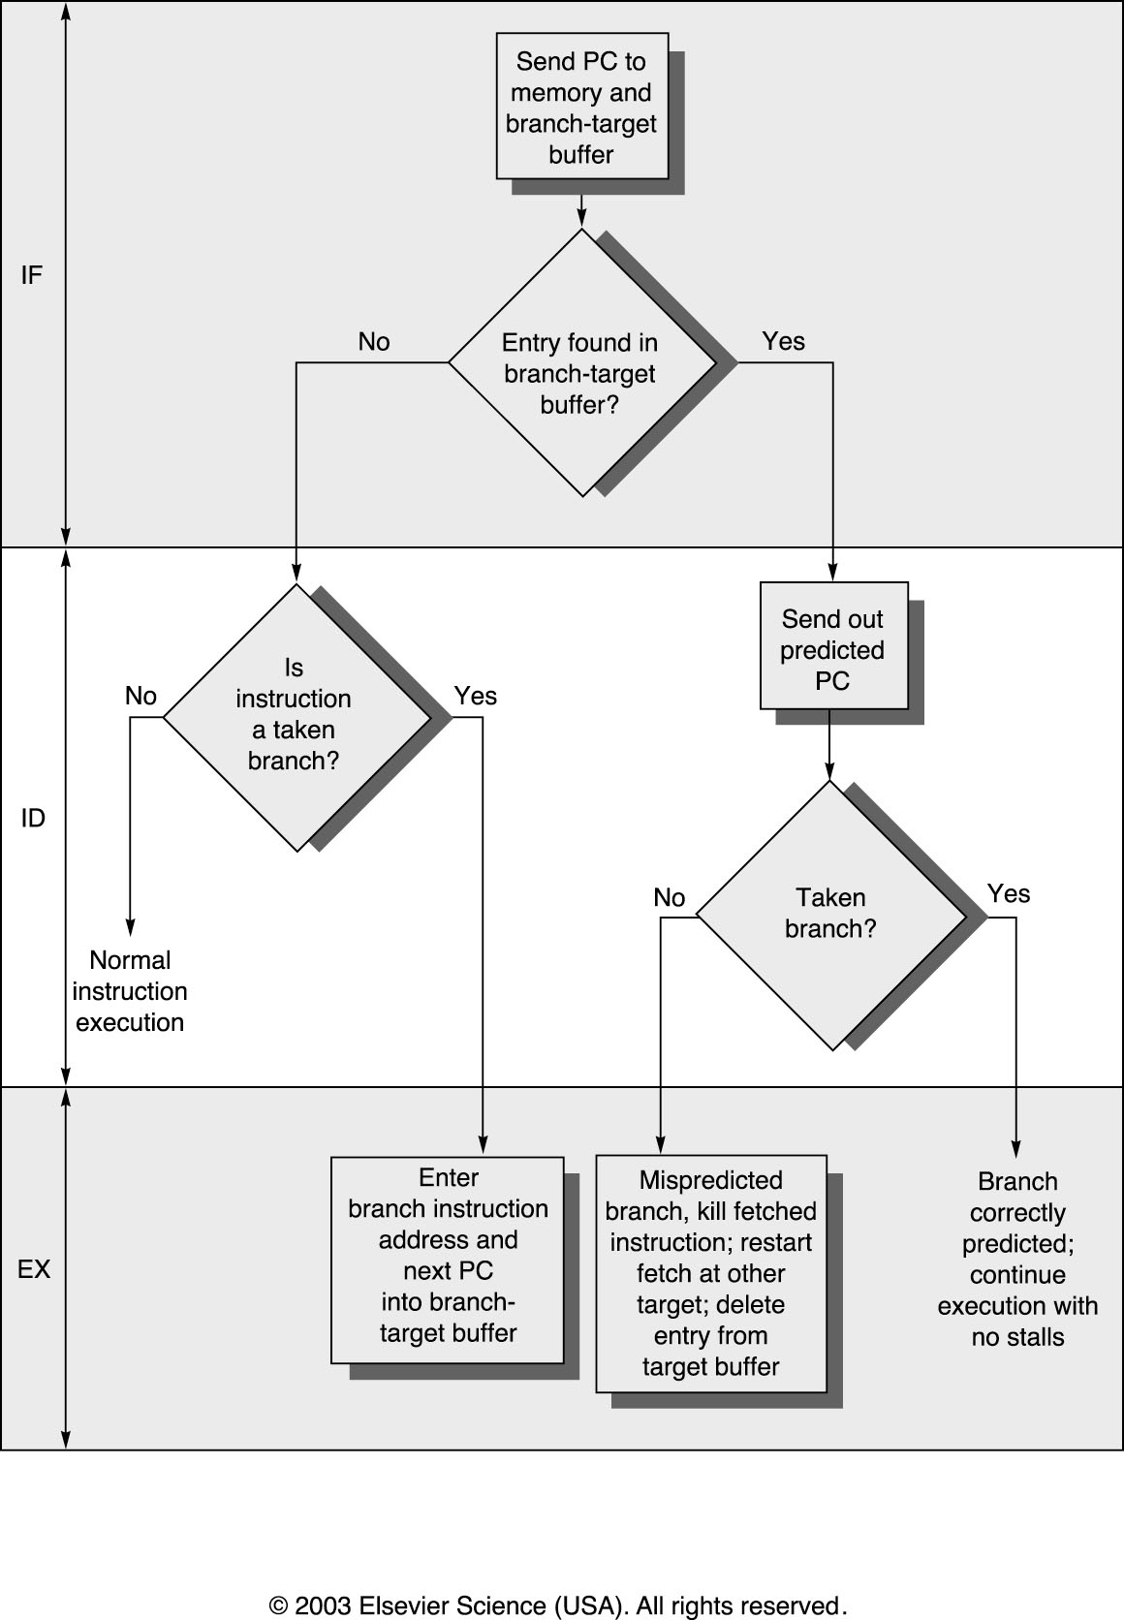
BTB Algorithm
BTB hit
predicted taken
= 0 cycle delay
BTB hit
misprediction
= 2 cycle penalty
Correct BTB
BTB miss
= 1 cycle penalty
Add entry to BTB

Slide 24
BTB Performance
Two things can go wrong
  BTB miss (misfetch)
  Mispredicted a branch (mispredict)
Ex. Suppose for branches, BTB hit rate of 85% and predict accuracy of 90%, misfetch penalty of 2 cycles and mispredict penalty of 5 cycles. What is the average branch penalty?
  2*(15%) + 5*(85%*10%)
Branch prediction and BTB can be used together to perform better prediction

Slide 25
Summary
Branch Prediction Buffer – 1-bit and 2-bit
Correlating Predictor (Two-level)
  Incorporates global branch information
Tournament Predictor
  Incorporates local branch and global branch info.
  Selector picks between predictors
Branch Target Buffers
  Predicts if instruction is fetch, and branch target address.
  No more stalls on taken branches!

