Slide 1
CS203 – Advanced Computer Architecture
Instruction Level Parallelism

Slide 2
Instruction Level Parallelism
Instruction-Level Parallelism (ILP): overlap the execution of instructions to improve performance
2 approaches to exploit ILP: Dynamic and Static
Dynamic
  Rely on hardware to help discover and exploit the parallelism dynamically (e.g., Pentium 4, AMD Opteron, IBM Power)
  Out-of-Order execution, superscalar architectures
Static:
  Rely on software technology to find parallelism, statically at compile-time (e.g., Itanium 2)

Slide 3
Instruction-Level Parallelism (ILP)
Basic Block (BB) ILP is quite small
  BB: a straight-line code sequence with no branches in except to the entry and no branches out except at the exit
  average dynamic branch frequency 15% to 25%
  => 4 to 7 instructions execute between a pair of branches
  Plus instructions in BB likely to depend on each other
To obtain substantial performance enhancements, we must exploit ILP across multiple basic blocks
  Implies predicting branches!
Simplest form of ILP
  loop-level parallelism to exploit parallelism among iterations of a loop. E.g.,
for (i=1; i<=1000; i=i+1)
x[i] = x[i] + y[i];

Slide 4
Loop-Level Parallelism
Exploit loop-level parallelism to parallelism by “unrolling loop” either by
  dynamic via branch prediction and/or dataflow µarchitectures
  static via loop unrolling by compiler
  another way is vectors, to be covered later
Determining instruction dependence is critical to Loop Level Parallelism
If 2 instructions are
  parallel, they can execute simultaneously in a pipeline of arbitrary depth without causing any stalls (assuming no structural hazards)
  dependent, they are not parallel and must be executed in order, although they may often be partially overlapped

Slide 5
ILP and Data Dependencies,Hazards
HW/SW must preserve program order:
  Order instructions would execute as if executed sequentially as determined by original source program
  Dependences are a property of programs
Opportunities for dynamic ILP constrained by
  Dynamic dependence resolution
  Resources available
  Ability to predict branches
Data dependence, as seen before
  RAW, WAR, WAW

Slide 6
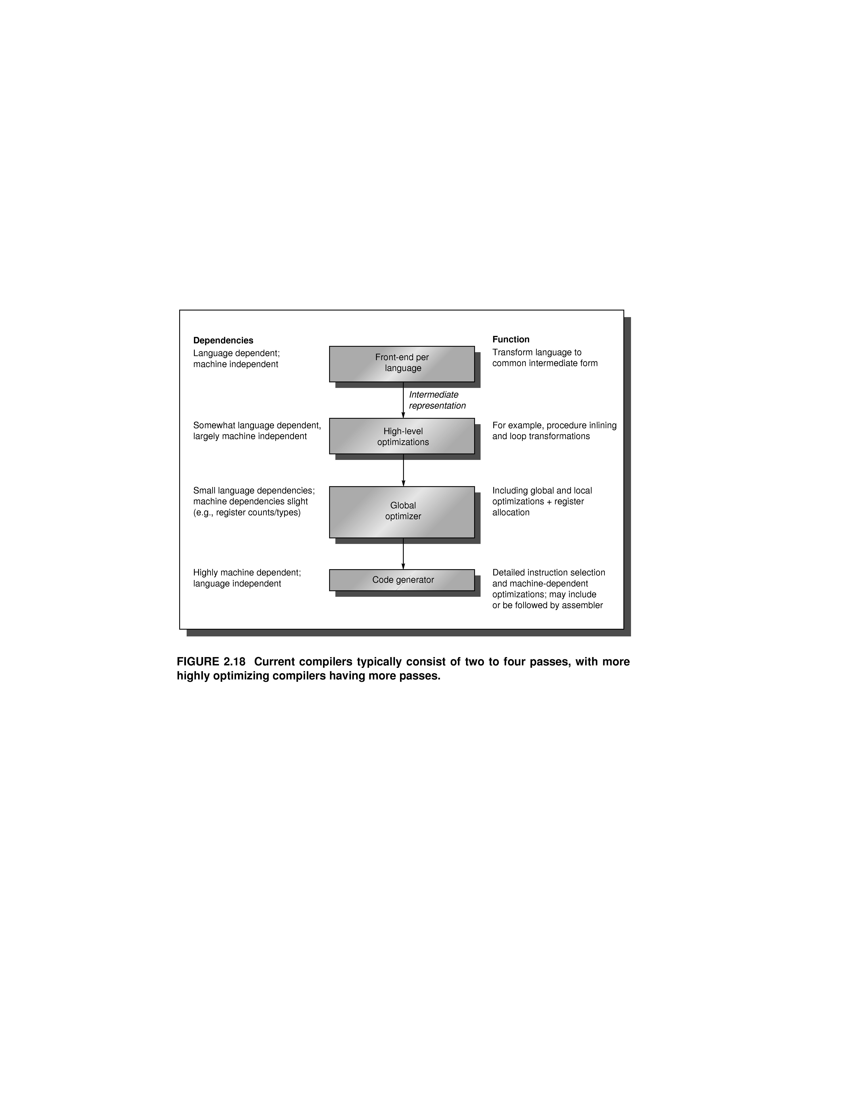
Structure of Compilers

Slide 7
Compiler Optimizations
Goals:
  (1) correctness, (2) speed.
Optimizations
  High level: at source code level
    procedure integration
  Local: within a basic block
    common sub-expression elimination (cse)
    constant propagation
    stack height reduction
  Global: across basic blocks
    global cse
    copy propagation
    invariant code motion
    induction variable elimination
  Machine dependent
    strength reduction
    pipeline scheduling
    load delay slot filling
Impact of optimizations
  Dramatic impact on fp code
  Most reduction in integer and load/store operations.
  Some reduction in branches

Slide 8
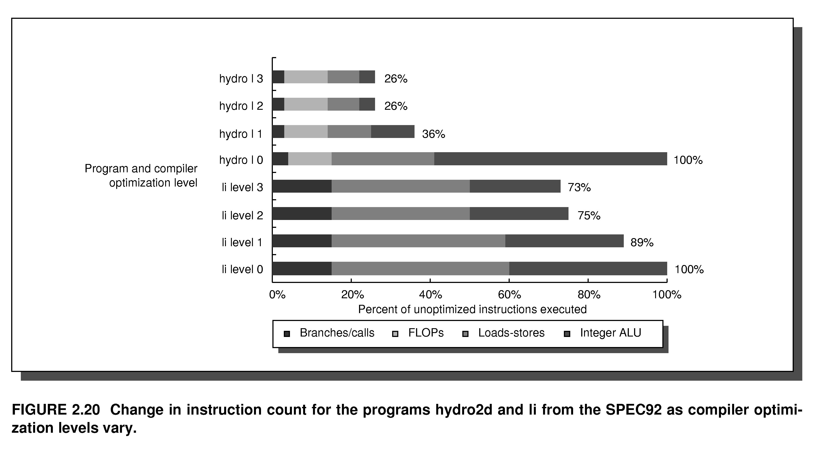
Effects of Compiler Optimizations

Slide 9
Compilers and ISA
How ISA design can help compilers
  Regularity:
    keep data types and addressing modes orthogonal whenever reasonable.
  Provide primitives not solutions:
    do not attempt to match high-level language constructs in the ISA.
  Simplify trade-off among alternatives:
    make it easier to select best code sequence.
  Allow the binding of compile time known values.

Slide 10
Example: Expression Execution
Sum = a + b + c + d;
The semantic is
  Sum = (((a + b) + c) + d);
Parallel (associative) execution
  Sum = (a + b) + (c + d);
Add fs, fa,fb 0 3
Add fs, fs, fc 3 6
Add fs, fs, fd 6 9 cycles
Add f1, fa,fb 0 3
Add f2, fc, fd 1 4
Add fs, f1, f2 4 7

Slide 11
Compiler Support for ILP
Dependency Analysis
Loop Unrolling
Software Pipelining

Slide 12
ILP in Loops
Example 1
for (j=1; j<=N; j++) X[j] = X[j] + a;
    Dependence within same iteration on X[j].
    Loop-carried dependence on j, but j is an induction variable.
Example 2
for (j=1; j<=N; j++) {
A[j+1] = A[j] + C[j]; /* S1 */
B[j+1] = B[j] + A[j+1]; /* S2 */
    Loop carried dependence on S1.
    Data flow dependence from S1 to S2.
Notes:
Induction variable = variable that gets incremented or decremented by a fixed amount on every iteration of a loop

Slide 13
ILP in Loops (2)
Example 3
for (j=1; j<=N; j++) {
A[j] = A[j] + B[j]; /* S1 */
B[j+1] = C[j] + D[j]; /* S2 */
    Loop carried dependence from S2 to S1; but no circular dependencies.
    Parallel version
A[1] = A[1] + B[1];
for (j=1; j<=N-1; j++) {
B[j+1] = C[j] + D[j];
A[j+1] = A[j+1] + B[j+1];
}
B[N+1] = C[N+1] + D[N+1];

Slide 14
Dependence Analysis
Dependency detection algorithms:
  Determine whether two references to an array element (one write and one read) are the same.
    assume all arrays indices to be affine X(a.i + b) and X(c.i +d)
    dependency can exist iff two affine functions have the same value for different indices within the loop bounds: let l <= j, k <= u
    if (a.j + b = c.k + d) then there is a dependency.
    But a, b, c, d may not be known at compile time.
GCD test
  sufficient condition for the existence of dependency: if dependency exists then GCD test is true.
    GCD(c,a) must divide (d-b).

Slide 15
Dependence Analysis (2)
  GCD Example: X(a.i + b) and X(c.i +d)
  for(int i=0;i<100;i++)
  {
  A[6*i]=B[i]; /*s1*/
  C[i]=A[4*i+1]; /*s2*/
  }
  GCD test: a=6, b=0, c=4, d=1, GCD(c,a) = 2 & (d-b) = 1
  There are no dependencies between the accesses to array A.

Slide 16
Dependence Analysis (3)
In the general case
  Determining whether a dependency exists is NP-complete.
  Exact tests exist for limited cases.
  A hierarchy of tests in increasing generality and cost is used.
Drawback of dependency analysis:
  Applies only to references within single loop nests
    with affine index functions.
  Where it fails:
    pointer references opposed to index;
    indirect indexing (e.g. A[B[I]]) used in sparse matrix computations;
    when dependency can potentially exist statically but never does in practice (at run time);
    when optimization depends on knowing which write of a variable a read depends on.

Slide 17
Software Techniques - Example
This code, add a scalar to a vector:
for (i=1000; i>0; i=i–1)
x[i] = x[i] + s;
Assume following latencies for all examples
  Ignore delayed branch in these examples
Instruction Instruction Latency stalls between
producing result using result in cycles in cycles
FP ALU op Another FP ALU op 4 3
FP ALU op Store double 3 2
Load double FP ALU op 1 1
Load double Store double 1 0
Integer op Integer op 1 0

Slide 18
FP Loop: Where are the Hazards?
First translate into MIPS code:
  To simplify, assume 8 is lowest address
for (i=1000; i>0; i=i–1)
x[i] = x[i] + s;
Loop: L.D F0,0(R1) ; F0 <= x[I]
ADD.D F4,F0,F2; add scalar from F2
S.D 0(R1),F4 ; store result; x[I] <= F4
DADDUI R1,R1,-8; decrement pointer 8B (DW)
BNEZ R1,Loop; branch R1 != 0

Slide 19
FP Loop Showing Stalls
1 Loop: L.D F0,0(R1) ;F0=vector element
2 stall
3 ADD.D F4,F0,F2 ;add scalar in F2
4 stall
5 stall
6 S.D 0(R1),F4 ;store result
7 DADDUI R1,R1,-8 ;decrement pointer 8B (DW)
8 stall ;assumes can’t forward to branch
9 BNEZ R1,Loop ;branch R1!=zero
Instruction Instruction stalls between
producing result using result clock cycles
FP ALU op Another FP ALU op 3
FP ALU op Store double 2
Load double FP ALU op 1
overall 9 clock cycles

Slide 20
Revised FP Loop Minimizing Stalls
1 Loop: L.D F0,0(R1)
2 DADDUI R1,R1,-8
3 ADD.D F4,F0,F2
4 stall
5 stall
6 S.D 8(R1),F4 ;altered offset when move DSUBUI
7 BNEZ R1,Loop
Swap DADDUI and S.D by changing address of S.D
7 clock cycles, but just 3 for execution (L.D, ADD.D,S.D), 4 for loop overhead.
Can we make it faster?
Notes:
3 clocks doing work, 3 overhead (stall, branch, sub)

Slide 21
Unroll Loop Four Times
1 cycle stall
1 Loop: L.D F0,0(R1)
3 ADD.D F4,F0,F2
6 S.D 0(R1),F4 ;drop DSUBUI & BNEZ
7 L.D F6,-8(R1)
9 ADD.D F8,F6,F2
12 S.D -8(R1),F8 ;drop DSUBUI & BNEZ
13 L.D F10,-16(R1)
15 ADD.D F12,F10,F2
18 S.D -16(R1),F12 ;drop DSUBUI & BNEZ
19 L.D F14,-24(R1)
21 ADD.D F16,F14,F2
24 S.D -24(R1),F16
25 DADDUI R1,R1,#-32 ;alter to 4*8
26 BNEZ R1,LOOP
27 clock cycles, or 6.75 per iteration
Rewrite loop to minimize stalls?
2 cycles stall

Slide 22
Unrolled Loop That Minimizes Stalls
1 Loop: L.D F0,0(R1)
2 L.D F6,-8(R1)
3 L.D F10,-16(R1)
4 L.D F14,-24(R1)
5 ADD.D F4,F0,F2
6 ADD.D F8,F6,F2
7 ADD.D F12,F10,F2
8 ADD.D F16,F14,F2
9 S.D 0(R1),F4
10 S.D -8(R1),F8
11 S.D -16(R1),F12
12 DSUBUI R1,R1,#32
13 S.D 8(R1),F16 ; 8-32 = -24
14 BNEZ R1,LOOP
14 clock cycles, or 3.5 per iteration

Slide 23
Loop Unrolling Decisions
Understanding dependencies between instructions
  and how the instructions can be reordered
Determine loop unrolling usefulness
  by finding that loop iterations were independent (except for maintenance code)
Use different registers
  to avoid unnecessary constraints forced by using same registers for different computations
Eliminate the extra test and branch instructions
  and adjust the loop termination and iteration code
Determine that loads and stores in unrolled loop are independent
  by observing that loads and stores from different iterations are independent: requires analyzing memory addresses and finding that they do not refer to the same address
Schedule the code,
  preserving any dependences needed to yield the same result as the original code

Slide 24
3 Limits to Loop Unrolling
Decrease in amount of overhead amortized with each extra unrolling
  Amdahl’s Law
Growth in code size
  For larger loops, concern it increases the instruction cache miss rate
Register pressure: potential shortfall in registers created by aggressive unrolling and scheduling
  If not be possible to allocate all live values to registers, may lose some or all of its advantage
Loop unrolling reduces impact of branches on pipeline; another way is branch prediction

Slide 25
Software Pipelining
Software Pipelining:
Loop: X[i] = X[i] + a; % 0 <= i < N
  Loop: LD F0, 0(R1)
  ADDD F4, F0, F2
  SUBI R1, R1, #8
  SD 8(R1), F4
  BNEZ R1, Loop
Cycles
  Assume LD is 2 cycles and ADDD is 3 cycles
  Total 7 cycles per iteration
Interleaves instructions from different iterations without loop unrolling.

Slide 26
Software Pipeline Example
  LD F0, 0(R1) % load X[0]
  ADDD F4, F0, F2 % add X[0]
  SUBI R1, R1, #8
  LD F0, 0(R1) % load X[1]
Loop SD 8(R1), F4 % store X[I]
ADDD F4, F0, F2 % add X[I-1]
LD F0, 0(R1) % load X[I-2]
SUBI R1, R1, #8
BNEZ R1, Loop
SD 0(R1), F4 % store X[N-2]
ADDD F4, F0, F2 % add X[N-1]
SD -8(R1), F4 % store X[N-1]
Symbolic loop unrolling
prologue
Body: no
dependencies
epilogue

Slide 27
Software Pipelining (2)
Needs startup code before loop and finish code after:
  Prologue: LD for iterations 1 and 2, ADDD for iteration 1
  Epilogue: ADDD for last iteration and SD for last 2 iterations.
Software equivalent of Tomasulo.
  Interleaves instructions from different iterations without loop unrolling.
Pros and Cons
  Makes register allocation and management difficult.
  Advantage over loop unrolling: less code space used.
    SP reduces loop idle time, loop unrolling reduces loop overhead.
    Best use combination of both.
  Limitations: loop carried dependencies

