Slide 1
CS203 – Advanced Computer Architecture
More Pipelining

Slide 2
Review: 5-stage MIPS Pipeline
F
D
X
M
W
Stages
  Instruction fetch
  Decode & read registers
  Execute
  Memory
  Write-back
Assume
  All ALU ops in 1 cycle
  All memory accesses in 1 cycle
  Branches resolved in D stage
SAXPY (Y=A*X+Y)
  int i;
  float X[N], Y[N];
  for (i-0; i<N; i++){ y[i] += a*X[i];}
loop
  l.s f1, 0(r2) // &X in r2
  l.s f2, 0(r3) // &Y in r3
  mult.s f1, f1, f0 // a in f0
  addi r2, r2, 4
  add.s f2, f2, f1
  addi r3, r3, 4
  bneq r2, r1, Loop // N+4 in r1
  s.s f2, -4(r3) // in br delay slot
No stalls, 8 cycles per iteration

Slide 3
How to improve the basic pipeline?
  CPUtime = InstCnt * CPI * ClkCycleTime
  CPI = ideal CPI + stalls per instruction
Ideas?

Slide 4
Wide Pipelines (Superscalar)
N instructions each clock cycle
  ideal CPI = 1/N
Resources needed
  wider path to I$
  multi-ported register file
  detect dependencies & implement forwarding,.
F
D
X
M
W
F
D
X
M
W
F
D
X
M
W

Slide 5
Wide Pipelines (2)
Simplify: one integer and one floating-point per cycle
  separate register files, no forwarding between them
  load/store are integer
Issues
  branch hazards & delay slots
  forwarding
SAXPY
l.s f1, 0(r2) -
l.s f2, 0(r3) -
addi r2, r2, 4 mult.s f1, f1, f0
addi r3, r3, 4 add.s f2, f2, f1
bneq r2, r1, Loop -
s.s f2, -4(r3) -
6 cycles per iteration, 33% better
F
D
X
M
W
F
D
X
M
W

Slide 6
Deep Pipelines
Deeper pipeline, smaller CCT
  ideal CCT = 1/k, k stages
Motivations for deep pipelines
  variable latencies of ALU, FPU, cache etc.
  CCT = max{all latencies}
Intel’s pipelines
P5: 5 stages, Pentium, < 500MHz
P6: 12 stages, Pentium 2, 3 & M,
> 2GHz
Netburst: 20 stages, Pentium 4, > 3GHz

Slide 7
Limits to Pipelining
Cost/Performance tradeoffs (Peter Kogge, 1981)
  Non-pipelined:
    let T be latency and C be logic area cost
  Pipelined:
    d is latch delay, p is clock period, p =T/k + d;
    pipelined frequency f = 1/p
    pipelined area cost = C + k*h (h is latch area cost)
  Performance/Cost Ratio: PCR
    PCR is max at k₀
    Optimum # pipeline stages

Slide 8
Limits to Pipelining (2)
Overhead introduced at each pipeline stage
  pipeline latches
  uneven distribution of work per stage
  clock skew
    clock may take longer to arrive at different stages
Eventually overhead dominates, diminishing returns
k-stage pipeline where
  overhead per stage is O (time)
  instructions are spaced by S
  CCT = T/k + O
  CPI = ideal CPI + stalls = 1 + Sk/T
  CPU time = (1+Sk/T).(T/k + O)
  T=60, O=2, S=10
    k=5, CPUtime = 25.6
    k=10, CPUtime = 21.3
    k=15, CPUtime = 21.0
    k=20, CPUtime = 21.65

Slide 9
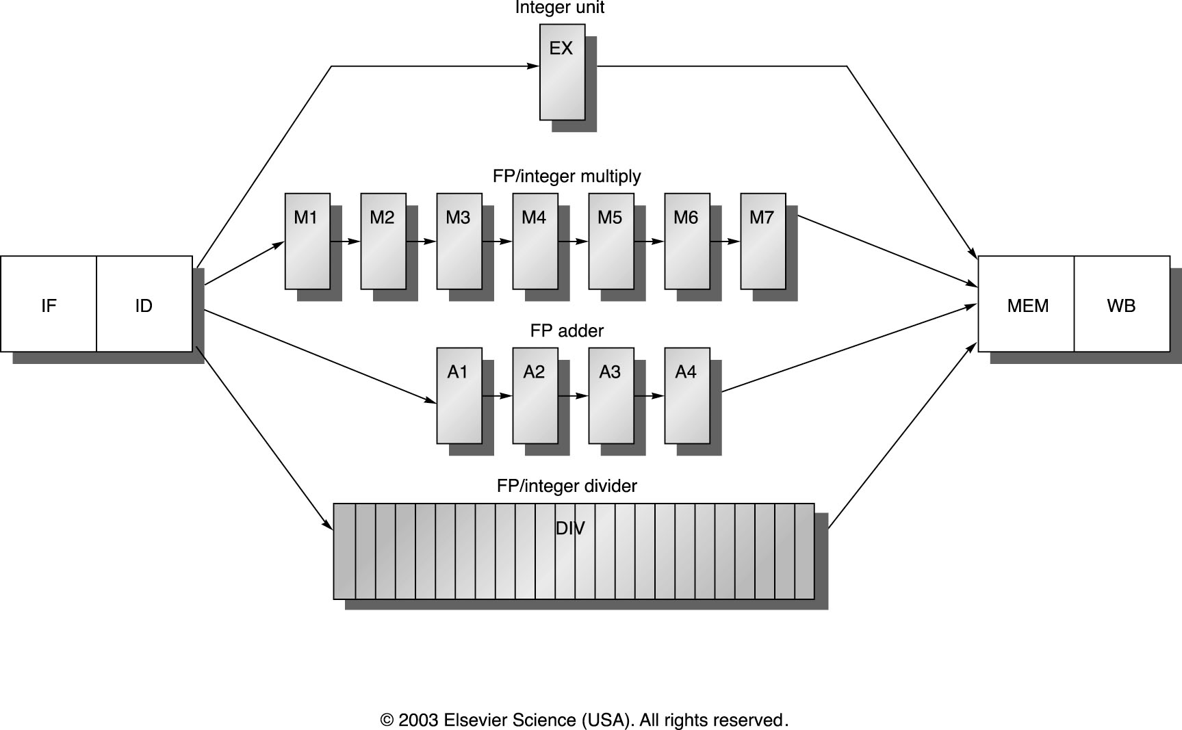
MIPS R4000 pipeline
Causes of Stalls?
Load
Branch
FP Results
FP Structural

Slide 10
MIPS R400 Performance

Slide 11
Pipelined CPU speedup
For simple RISC pipeline, CPI = 1:

Slide 12
Multiple pipelines
In-order execution
  in-order issue and completion of instructions
X
integer
X1
X2
fp add
F
D
R
X1
X2
X3
fp mult
W
X
M1
M2
ld, st
DIV

Slide 13
Multiple pipelines - Tomasulo
In-order issue
  out of order completion
register renaming through reservation stations and CDB: eliminates WAW & WAR
dynamic loop unrolling: loop level parallelism
COMMON DATA BUS
X
integer
X1
X2
fp add
F
D
R
X1
X2
X3
fp mult
W
X
M1
M2
ld, st
DIV

Slide 14
Multiple pipelines - ROB
In-order issue
  out of order completion
  in order commit: supports speculation
    through branch prediction
ROB eliminates the CDB bottleneck
separates completion from commit stages
X
integer
X1
X2
fp add
F
D
R
X1
X2
X3
fp mult
W
ld, st
ROB
X
M1
M2
DIV

