Slide 1
CS203 – Advanced Computer Architecture
Pipelining Review

Slide 2
Pipelining Analogy
Laundry steps:
  Wash
  Dry
  Fold
  Put it away – Closet / Dresser / Neat pile on floor

Slide 3
Pipelining Analogy
Assuming each step take 1 hour,
4 loads would take 16 hours!
1
2
3
4

Slide 4
Pipelining Analogy
To speed things up, overlap steps
4 loads of laundry now only takes 7 hours!
1
2
3
4

Slide 5
Speedup of Pipelining
k stages pipeline, t time per stage, n jobs
Non-pipelined time = n*k*t
Pipelined time = (k+n-1)*t
This is an ideal case:
No job depends on a previous job
All jobs behave exactly the same
Not realistic.

Slide 6
Simple 5 stage pipeline

Slide 7
MIPS Pipeline
Five stages, one step per stage
  IF: Instruction fetch from memory
  ID: Instruction decode & register read
  EX: Execute operation or calculate address
  MEM: Access memory operand
  WB: Write result back to register

Slide 8
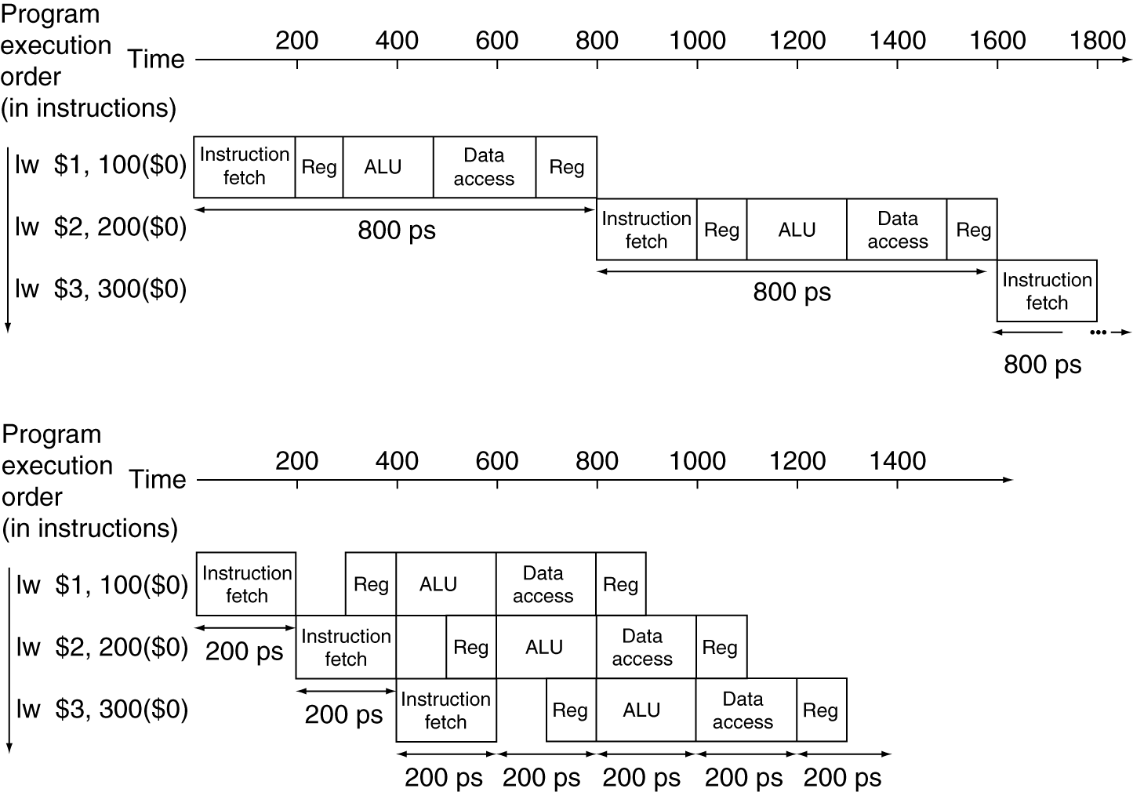
Pipeline Performance
Single-cycle (T_{c}= 800ps)
Pipelined (T_{c}= 200ps)

Slide 9
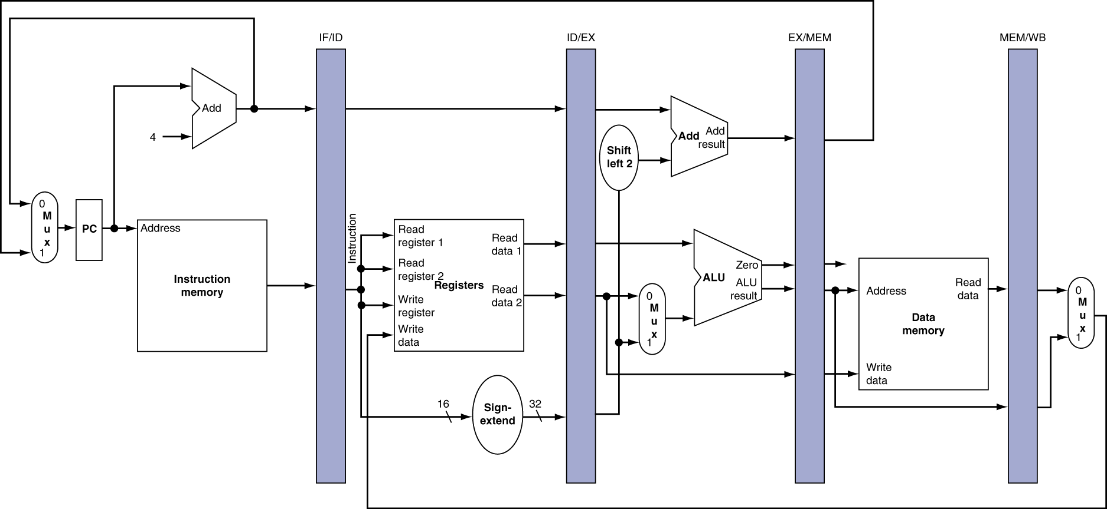
Simplified Pipeline
Need registers between stages
  To hold information produced in previous cycle

Slide 10
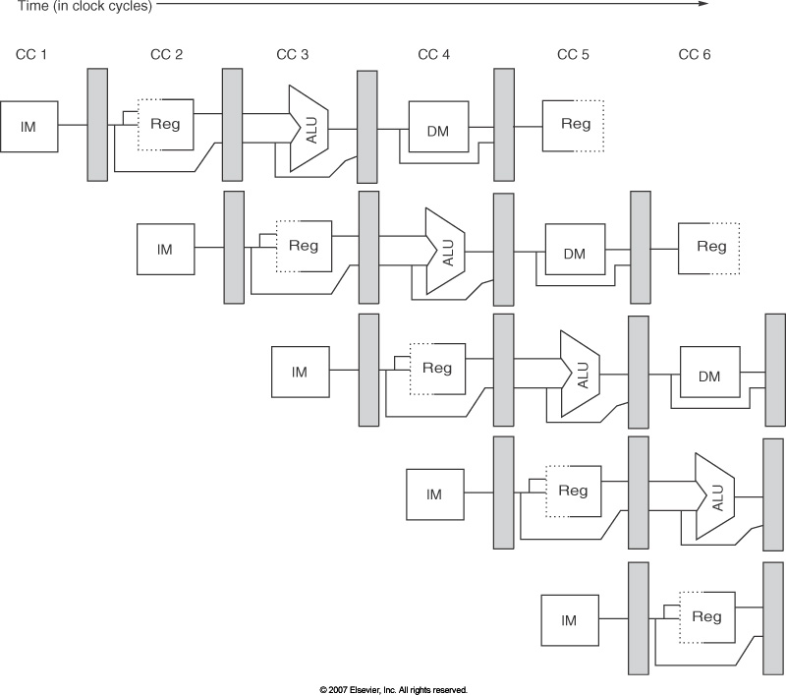
Representation of pipeline

Slide 11
Pipelining
What makes it easy
  all instructions are the same length
  just a few instruction formats
  memory operands appear only in loads and stores
What makes it hard?
  structural hazards: suppose we had only one memory
  control hazards: need to worry about branch instructions
  data hazards: an instruction depends on a previous instruction
What makes it really hard:
  exception handling
  trying to improve performance with out-of-order execution, etc.

Slide 12
hazards

Slide 13
Hazards
Situations that prevent starting the next instruction in the next cycle
Structure hazards
  A required resource is busy
Data hazard
  Need to wait for previous instruction to complete its data read/write
Control hazard
  Deciding on control action depends on previous instruction

Slide 14
Structure Hazards
Conflict for use of a resource
In MIPS pipeline with a single memory
  Load/store requires data access
  Instruction fetch would have to stall for that cycle
    Would cause a pipeline “bubble”
Hence, pipelined datapaths require separate instruction/data memories
  Or separate instruction/data caches

Slide 15
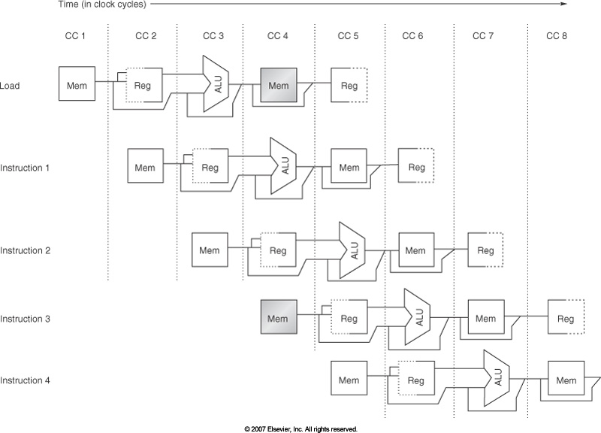
Structural hazard
two memory accesses in cc4,
use Harvard architecture
separate data and code memories

Slide 16
Data hazards

Slide 17
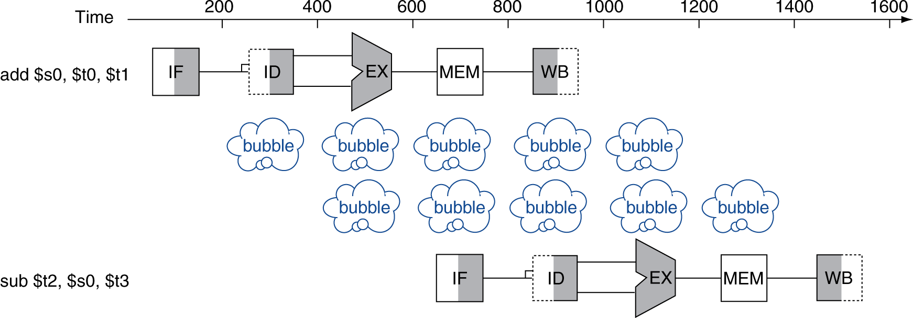
Data Hazards
An instruction depends on completion of data access by a previous instruction
  add $s0, $t0, $t1
  sub $t2, $s0, $t3

Slide 18
Types of data hazards
Read After Write (RAW), true, or dataflow, dependence
    i1: add r1, r2, r3
    i2: add r4, r1, r5
Write After Read (WAR), anti dependence
    i1: add r1, r2, r3
    i2: add r2, r4, r5
Write After Write (WAW), output dependence
    i1: add r1, r2, r3
    i2: add r1, r4, r5

Slide 19
WAR & WAW
WAR & WAW are name dependencies
  Dependence is on the container’s name not on the value contained.
  Can be eliminated by renaming, static (in software) or dynamic (in hardware)
WAW & WAR cannot occur in the 5-stage MIPS pipeline
  All the writing happens in WB stage, in issue order of instructions
IF
ID
EX
MEM
WB
IF
ID
EX
MEM
WB
IF
ID
EX
MEM
WB

Slide 20
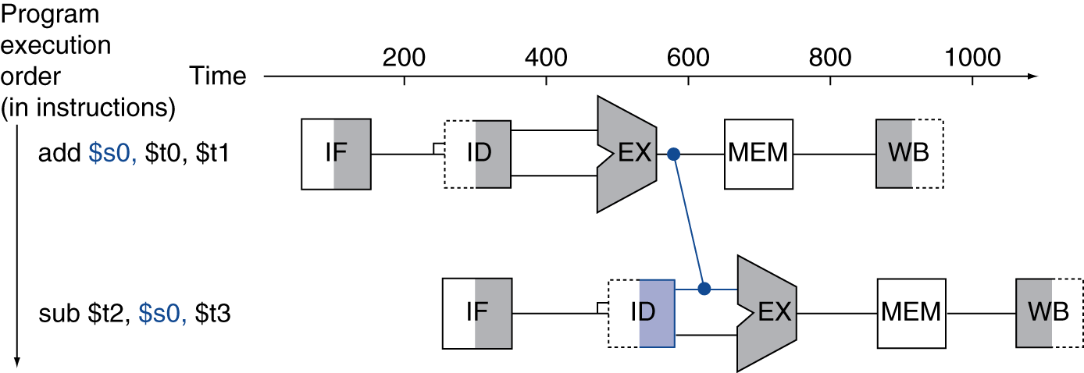
Forwarding (aka Bypassing)
Use result when it is computed
  Don’t wait for it to be stored in a register
  Requires extra connections in the datapath

Slide 21
Examples of Dependencies

Slide 22
Control hazards

Slide 23
Control Hazards
Branch problem:
  branches are resolved in EX stage → 2 cycles penalty on taken branches
  Ideal CPI =1. Assuming 2 cycles for all branches and 32% branch instructions → new CPI = 1 + 0.32*2 = 1.64

Slide 24
Branches are resolved in EX stage
Ex. Branch Not Taken
B = Branch instr. i = instr after Br. j = instr branch to
IF ID EXE MEM WB

Slide 25
Branches are resolved in EX stage
Ex. Branch Not Taken
B = Branch instr. i = instr after Br. j = instr branch to
IF ID EXE MEM WB
i B
i+1 i B

Slide 26
Branches are resolved in EX stage
Ex. Branch Taken
B = Branch instr. i = instr after Br. j = instr branch to
IF ID EXE MEM WB

Slide 27
Branches are resolved in EX stage
Ex. Branch Taken
B = Branch instr. i = instr after Br. j = instr branch to
IF ID EXE MEM WB
i B
j B

Slide 28
Control Hazards
Branch problem:
  branches are resolved in EX stage → 2 cycles penalty on taken branches
  Ideal CPI =1. Assuming 2 cycles for all branches and 32% branch instructions → new CPI = 1 + 0.32*2 = 1.64
Solutions:
  Reduce branch penalty: change the datapath – new adder needed in ID stage.
  Fill branch delay slot(s) with useful instruction(s).
  Predict branch (Taken/Not Taken).
    Static branch prediction: same prediction for every instance of that branch
    Dynamic branch prediction: prediction based on path leading to that branch

Slide 29
Branches are resolved in ID stage
Ex. Branch Not Taken
B = Branch instr. i = instr after Br. j = instr branch to
IF ID EXE MEM WB

Slide 30
Branches are resolved in ID stage
Ex. Branch Not Taken
B = Branch instr. i = instr after Br. j = instr branch to
IF ID EXE MEM WB
i B
i+1 i B

Slide 31
Branches are resolved in ID stage
Ex. Branch Taken
B = Branch instr. i = instr after Br. j = instr branch to
IF ID EXE MEM WB

Slide 32
Branches are resolved in ID stage
Ex. Branch Taken
B = Branch instr. i = instr after Br. j = instr branch to
IF ID EXE MEM WB
i B
j B

Slide 33
Filling branch delay slots
Branch delay slot filling
  move a useful instruction into the slot right after the branch, hoping that its execution is necessary.
  Limitations: restrictions on which instructions can be rescheduled, compile time prediction of taken or untaken branches; serious impact on program semantics & future architectures.

Slide 34
Scheduling Branch Delay Slots
A. From before branch
B. From branch target
C. From fall through
add $1,$2,$3
if $2=0 then
sub $4,$5,$6
add $1,$2,$3
if $1=0 then
delay slot
delay slot
add $1,$2,$3
if $1=0 then
delay slot
sub $4,$5,$6
becomes
becomes
becomes
if $2=0 then
add $1,$2,$3
if $1=0 then
add $1,$2,$3
sub $4,$5,$6
add $1,$2,$3
if $1=0 then
sub $4,$5,$6
Notes:
Limitations on delayed-branch scheduling come from 1) restrictions on the instructions that can be moved/copied into the delay slot and 2) limited ability to predict at compile time whether a branch is likely to be taken or not.
In B and C, the use of $1 prevents the add instruction from being moved to the delay slot
In B the sub may need to be copied because it could be reached by another path. B is preferred when the branch is taken with high probability (such as loop branches

Slide 35
Branch Prediction
Predict the outcome of a branch in the IF stage
  Idea: doing something is better than waiting around doing nothing
  Gains might outweigh losses
  Heavily researched area in the last 20 years
Fixed branch prediction.
  applied to all branch instructions indiscriminately.
  Predict not-taken (47% actually not taken):
    continue to fetch instruction without stalling;; do not change any state (no register write);
    if branch is taken turn the fetched instruction into no-op, restart fetch at target address: 1 cycle penalty. Assumes branch detection at the ID stage.
  Predict taken (53%): more difficult, must know target before branch is decoded; no advantage in our simple 5-stage pipeline even if we move the branch to ID stage.

Slide 36
Branch Prediction
Static branch prediction.
  Opcode-based: prediction based on opcode itself and related condition. Examples: MC 88110, PowerPC 601/603.
  Displacement based prediction: if d < 0 (LOOP) predict taken, if d >= 0 predict not taken. Examples: Alpha 21064 (as option), PowerPC 601/603 for regular conditional branches.
  Compiler-directed prediction: compiler sets or clears a predict bit in the instruction itself. Examples: AT&T 9210 Hobbit, PowerPC 601/603 (predict bit reverses opcode or displacement predictions), HP PA 8000 (as option).
Dynamic branch prediction
  Later in this course; tons of it!
  Why is it SO important? For what?

