Slide 1
CS203 – Advanced Computer Architecture
Dependability & Reliability

Slide 2
Failures in Chips
Transient failures (or soft errors)
  Charge q = c*v if c and v decrease then it is easier to flip a bit
  Sources are cosmic rays and alpha particles and electrical noise
  Device is still operational but value has been corrupted
Intermittent/temporary failures
  Last longer
  Due to
    Temporary: environmental variations (eg, temperature)
    Intermittent: aging
Permanent failures
  Means that the device will never function again
  Must be isolated and replaced by spare
Process variations increase the probability of failures

Slide 3
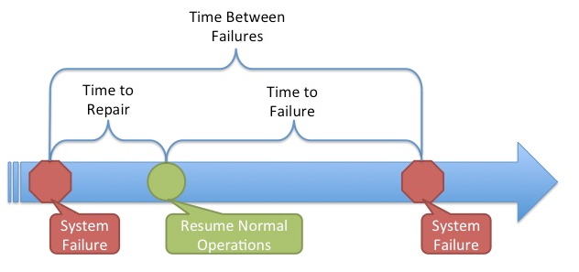
Define and quantify dependability
Reliability =
  measure of continuous service accomplishment (or time to failure).
Metrics
  Mean Time To Failure (MTTF) measures reliability
  Failures In Time (FIT) = 1/MTTF, the rate of failures
    Traditionally reported as failures per 10⁹ hours of operation
    Ex. MTTF = 1,000,000 FIT = 10⁹/10⁶ = 1000
  Mean Time To Repair (MTTR) measures Service Interruption
  Mean Time Between Failures (MTBF) = MTTF+MTTR

Slide 4
Define and quantify dependability
Availability =
  measures service as alternate between the 2 states of accomplishment and interruption (number between 0 and 1, e.g. 0.9)
  Module availability = MTTF / ( MTTF + MTTR)

Slide 5
Fault-Tolerance
How to measure a system’s ability to tolerate faults?
  Reliability = Probability[no failure @ time t] = R(t)
  Availability = Probability[system operational]
    E.g. AT&T ESS-1, one of the first computer-controlled telephone exchange (deployed in 1960s) was designed for less than two hours of downtime over its lifetime: 40 years. Availability = 99.9994%
Failure rate
  Fraction of samples that fail per unit time
  Is NOT constant, changes over time
  R(t) = N(t)/N(0), where N(t) is the number of operational units at time t.

Slide 6
Example calculating reliability
If modules have exponentially distributed lifetimes (age of module does not affect probability of failure),
  Overall failure rate is the sum of failure rates of all the modules
  Calculate FIT and MTTF for 10 disks (1M hour MTTF per disk), 1 disk controller (0.5M hour MTTF), and 1 power supply (0.2M hour MTTF):

Slide 7
The “Bathtub” Curve
1
3
Failure Rate
2
Early Life
Region
Wear-Out
Region
Constant Failure Rate Region
0
Time t

Slide 8
The “Bathtub” Curve
Burn-in is a test performed to screen or eliminate marginal components with inherent defects or defects resulting from manufacturing process.
1
Failure Rate
Early Life
Region
0
Time t

Slide 9
The “Bathtub” Curve
An important assumption for effective maintenance is that components will eventually have an Increasing Failure Rate. Maintenance can return the component to the Constant Failure Region.
Failure Rate
2
Constant Failure Rate Region
0
Time t

Slide 10
The “Bathtub” Curve
Components will eventually enter the Wear-Out Region where the Failure Rate increases, even with an effective Maintenance Program. You need to be able to detect the onset of Terminal Mortality
3
Failure Rate
Wear-Out
Region
0
Time t

Slide 11
Derivation of R(t)
  Probability[no failure @ time t] = R(t)
Assuming a constant failure rate λ, N is the number of units
Integrating with R(0) = 1 boundary:
R(t) = e^{-λt}

Slide 12
System Reliability
Series system
Parallel system
R1
R1
R2
Rn
R2
Rn

Slide 13
Triple Modular Redundancy
TMR: Triple Modular Redundancy
  three concurrent devices plus a voter (assume no voter failure)
  R_{TMR}(t) = R³(t) + 3R²(t)(1 – R(t)) = 3R²(t) – 2R³(t)
  Let R(t) = e^{-λt}, then R_{TMR} = 3e^{-2λt} – 2e^{-3λt}
Voter
Result

Slide 14
Simplex v/s TMR Reliability
TMR has higher reliability
for short mission times
Reliability
After 1st failure,
TMR equivalent to
2 component in series
λt

Slide 15
MTTF - Mean-Time To Failure
Let F(t) = 1 – R(t), the failure probability (cdf)
and f(t) = dF(t)/dt, the failure probability density
Expected working life of a unit with an exponentially distributed reliability is the inverse of its failure rate

Slide 16
MTBF
The MTBF is widely used as the measurement of equipment's reliability and performance.
This value is often calculated by dividing the total operating time of the units by the total number of failures encountered.
This metric is valid only when the data is exponentially distributed.
This is a poor assumption which implies that the failure rate is constant if it is used as the sole measure of equipment's reliability.

Slide 17
Summary
How to define dependability
How to quantify dependability
How to measure Reliability of a system

