Slide 1
CS203 – Advanced Computer Architecture
Technology Trends

Slide 2
Trends in Technology - Density
Integrated circuit technology
  Transistor density: 35%/year
  Die size: 10-20%/year
  Integration overall: 40-55%/year
DRAM capacity: 25-40%/year (slowing)
Flash capacity: 50-60%/year
  15-20X cheaper/bit than DRAM
Magnetic disk technology: 40%/year
  15-25X cheaper/bit then Flash
  300-500X cheaper/bit than DRAM

Slide 3
Bandwidth and Latency Trends
Bandwidth or throughput
  Total work done in a given time
  10,000-25,000X improvement for processors
  300-1200X improvement for memory and disks
Latency or response time
  Time between start and completion of an event
  30-80X improvement for processors
  6-8X improvement for memory and disks

Slide 4
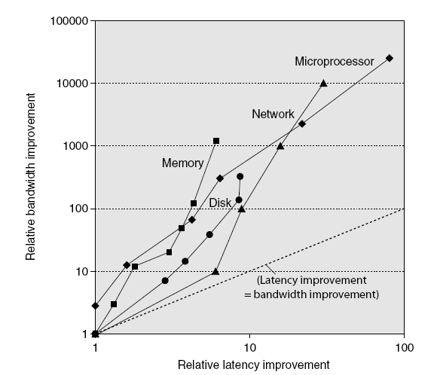
Bandwidth and Latency
Log-log plot of bandwidth and latency milestones

Slide 5
Transistors

Slide 6
Transistors and Wires
Feature size
  Minimum size of transistor or wire in x or y dimension
  10 microns in 1971 to .032 microns in 2011
  32nm → 22nm (‘12) → 14nm (‘14) → 10nm (?)
  Transistor performance scales linearly
    Wire delay does not improve with feature size!
  Integration density scales quadratically

Slide 7
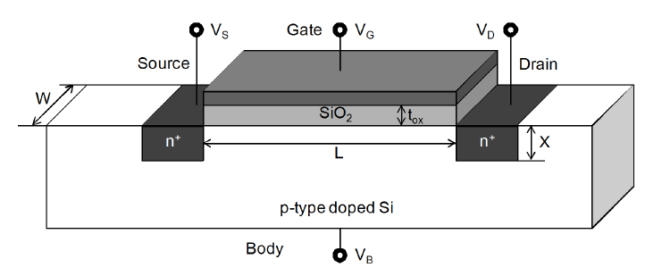
Technology Scaling
Moore’s Law:
All these features scale by 1/S,
S=SQRT(2) every 2 years

Slide 8
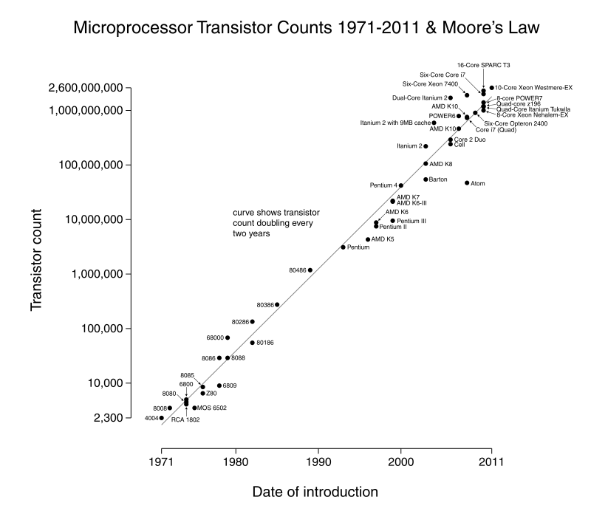
Moore’s Law

Slide 9
Impact of Scaling on Characteristics
Device Characteristics | Feature Dependence | Scaling
Transistor Gain (β) | W/(L. t_{ox}) | S
Current (I_{ds}) | β(V_{dd}-V_{th})² | S
Resistance | V_{dd}/I_{ds} | 1
Gate Capacitance | (W.L)/t_{ox} | 1/S
Gate delay | R.C | 1/S
Clock Frequency | 1/(R.C) | S
Circuit Area | W.L | 1/S²
Wire Resistance | 1/(w.h) | S²
Wire Capacitance | h/s | 1

Slide 10
Effects of Technology Scaling
  Scaling dimensions doubles device density
  Frequency increases by 41%
  Scaling voltage simultaneously keep the power constant
  If voltage is not scaled then clock frequency can scale even faster but dynamic power grows!
  Threshold voltage scaling causes gate leakage power growth!

Slide 11
Technology Trends
Wire delays don’t scale like logic delays
  Processor structures must expand to support more instructions
  Thus wire delays dominate the cycle time; slow wires must be local
Design complexity
  Processors are becoming so complex that a large fraction of the development of a processor or system is dedicated to verification
  Chip density is increasing much faster than the productivity of verification engineers (new tools, speed of systems)
CMOS endpoint
  CMOS is rapidly reaching the limits of miniaturization
  Feature sizes will reach atomic dimensions in less than 15 years
Options????
  Quantum computing
  Nanotechnology
  Analog computing
Performance remains a critical design factor

Slide 12
Power and energy

Slide 13
Power
Total power: dynamic + static (leakage)
P_{dynamic} = αCV²f
P_{static} = VI_{sub} ≈ Ve^{-KVt/T}
Power/energy are critical problems
  Power (immediate energy dissipation) must be dissipated
    Otherwise temperature goes up (affects performance, correctness and may possibly destroy the circuit, short term or long term)
    Effect on the supply of power to the chip
  Energy (depends on power and speed)
    Costly; global problem
    Battery operated devices

Slide 14
Power and Energy
Problem: Get power in, get power out
Thermal Design Power (TDP)
  Characterizes sustained power consumption
  Used as target for power supply and cooling system
  Lower than peak power, higher than average power consumption
Clock rate can be reduced dynamically to limit power consumption
Energy per task is often a better measurement

Slide 15
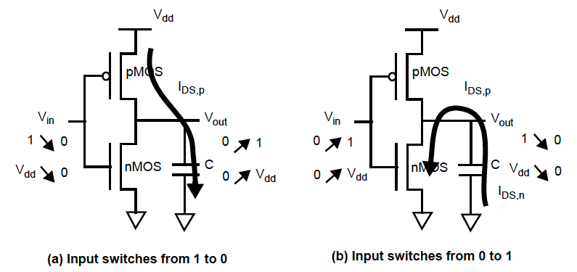
Dynamic Energy and Power
Dynamic power
  P_{dynamic} = αCV²f
  α = fraction of clock period where output 0 → 1 (at most ½)
Dynamic energy
  Transistor switch from 0 → 1 or 1 → 0
  E_{dynamic} = αCV²
Reducing clock rate reduces power, not energy

Slide 16
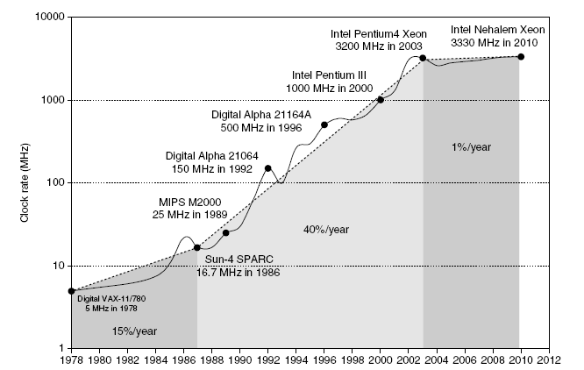
Power Trends
Intel 80386 consumed ~ 2 W
3.3 GHz Intel Core i7 consumes 130 W
Heat must be dissipated from 1.5 x 1.5 cm chip
This is the limit of what can be cooled by air

Slide 17
Why multi-core?
P_{dynamic} = αCV²f
Dynamic power favors parallel processing over higher clock rate
  Dynamic power roughly proportional to f³
  Take a proc. and replicate it 4 times: 4x speedup & 4x power
  Take a proc and clock it 4 times faster: 4x speedup but 64x dynamic power!

Slide 18
Example of quantifying power
Suppose 15% reduction in voltage results in a 15% reduction in frequency. What is impact on dynamic power?

Slide 19
Static Power
Because leakage current flows even when a transistor is off, now static power important too
Leakage current increases in processors with smaller transistor sizes
Increasing the number of transistors increases power even if they are turned off
Very low power systems gate voltage to inactive modules to control loss due to leakage

Slide 20
Reducing Power
Techniques for reducing power:
  Do nothing well (Idle low power modes)
  Dynamic Voltage-Frequency Scaling
  Low power state for DRAM, disks
  Overclocking, turning off cores

Slide 21
Cost

Slide 22
Trends in Cost
Cost driven down by learning curve
  Yield
DRAM: price closely tracks cost
Microprocessors: price depends on volume
  10% less for each doubling of volume

Slide 23



Integrated Circuit Cost
Integrated circuit
Defects per unit area = 0.016-0.057 defects per square cm (2010)
N = process-complexity factor = 11.5-15.5 (40 nm, 2010)

