Slide 1
CS203 – Advanced Computer Architecture
Performance Evaluation

Slide 2
Performance trends

Slide 3
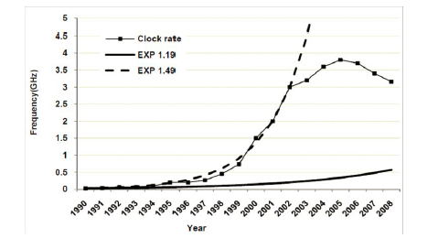
Clock Rate
Historically the clock rates of microprocessors have increased exponentially
  Highest clock rate of intel processors in every year from 1990 to 2008
    Due to process improvements
    Deeper pipeline
    Circuit design techniques
If trend kept up, today’s clock rate would be > 30GHz!
Arch. & Circuit
Improvement
Process
Improvement
Notes:
1.19 curve corresponds to process improvements alone. All other improvement due to architecture and circuits.

Slide 4
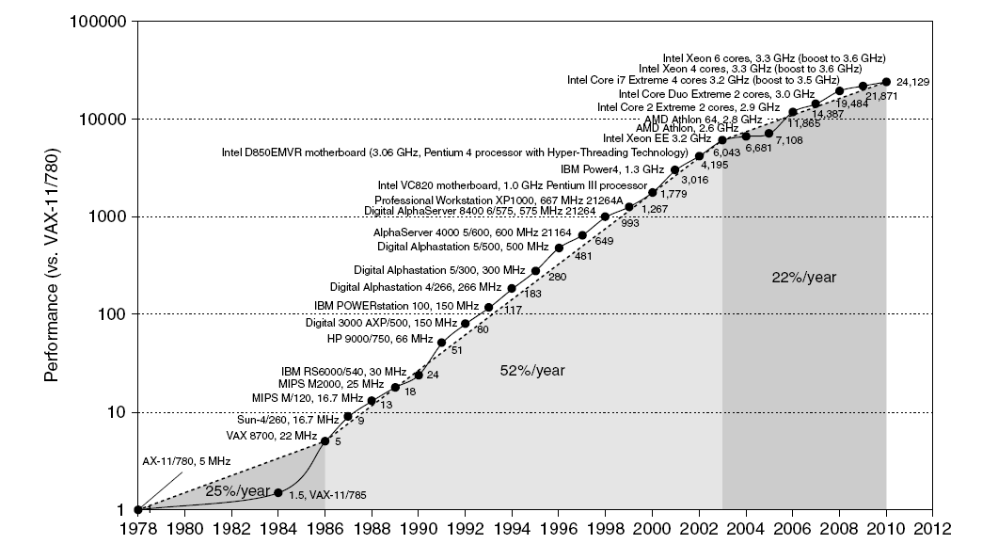
Single Processor Performance
Move to multi-processor
(Power Wall)
RISC
Instruction Level Parallelism (ILP)
Multicore processor

Slide 5
Classes of Computers
Personal Mobile Device (PMD)
  e.g. start phones, tablet computers
  Emphasis on energy efficiency and real-time
Desktop Computing
  Emphasis on price-performance
Servers
  Emphasis on availability, scalability, throughput
Clusters / Warehouse Scale Computers
  Used for “Software as a Service (SaaS)”
  Emphasis on availability and price-performance
  Sub-class: Supercomputers, emphasis: floating-point performance and fast internal networks
Embedded Computers
  Emphasis: price

Slide 6
Current Trends in Architecture
Cannot continue to leverage Instruction-Level parallelism (ILP)
  Single processor performance improvement ended in 2003 due to the power wall
New models for performance:
  Data-level parallelism (DLP)
  Thread-level parallelism (TLP)
  Request-level parallelism (RLP)
These require explicit restructuring of the application

Slide 7
Parallelism
Classes of parallelism in applications:
  Data-Level Parallelism
  Task-Level Parallelism
Classes of architectural parallelism:
  Instruction-Level Parallelism (ILP)
  Vector architectures/Graphic Processor Units (GPUs)
  Thread-Level Parallelism (Multi-processors)
  Request-Level Parallelism (Server clusters)

Slide 8
Flynn’s Taxonomy
Single instruction stream, single data stream (SISD)
Single instruction stream, multiple data streams (SIMD)
  Vector architectures
  Multimedia extensions
  Graphics processor units
Multiple instruction streams, single data stream (MISD)
  No commercial implementation
Multiple instruction streams, multiple data streams (MIMD)
  Tightly-coupled MIMD
  Loosely-coupled MIMD

Slide 9
Measuring performance

Slide 10
Measuring Performance
Typical performance metrics:
  Response time
  Throughput
Speedup of X relative to Y
  Execution time_{Y} / Execution time_{X}
Execution time
  Wall clock time: includes all system overheads
  CPU time: only computation time
Benchmarks
  Kernels (e.g. matrix multiply)
  Toy programs (e.g. sorting)
  Synthetic benchmarks (e.g. Dhrystone)
  Benchmark suites (e.g. SPEC06fp, TPC-C, SPLASH)

Slide 11


Fundamental Equations of Performance
We typically use IPC (instructions per cycle)

Slide 12

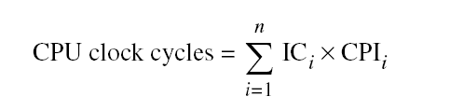
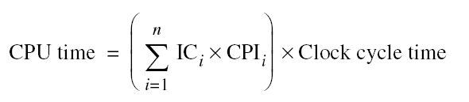
More equations
Different instruction types having different CPIs

Slide 13
Benchmarks

Slide 14
What to use as a Benchmark?
Real programs:
  Porting problem; too complex to understand.
Kernels
  Computationally intense piece of real program.
Benchmark suites
  Spec: standard performance evaluation corporation
    Scientific/engineeing/general purpose
    Integer and floating point
    New set every so many years (95,98,2000,2006)
  Tpc benchmarks:
    For commercial systems
    Tpc-b, tpc-c, tpc-h, and tpc-w
  Embedded benchmarks
  Media benchmarks
Others, poor choices
  Toy benchmarks (e.g. quicksort, matrix multiply)
  Synthetic benchmarks (not real)

Slide 15
Aggregate performance measures
For a group of programs, test suite
Execution time: weighted arithmetic mean
  Program with longest execution time dominates
Speedup: geometric mean

Slide 16
Geometric Mean Example
Comparison independent of
reference machine
 | Program A | Program B | Arithmetic Mean
Machine 1 | 10 sec | 100 sec | 55 sec
Machine 2 | 1 sec | 200 sec | 100.5 sec
Reference 1 | 100 sec | 10000 sec | 5050 sec
Reference 2 | 100 sec | 1000 sec | 550 sec
 |  | Program A | Program B | Arithmetic | Geometric
Wrt Reference 1 (speedup) | Machine 1 | 10 | 100 | 55 | 31.6
 | Machine 2 | 100 | 50 | 75 | 70.7
Wrt Reference 2 (speedup) | Machine 1 | 10 | 10 | 10 | 10
 | Machine 2 | 100 | 5 | 52.5 | 22.4
Notes:
Geometric mean of speedup comparison are independent of reference machine

Slide 17
Principles of Computer design

Slide 18
Principles of Computer Design
Take Advantage of Parallelism
  e.g. multiple processors, disks, memory banks, pipelining, multiple functional units
Principle of Locality
  Reuse of data and instructions
Focus on the Common Case
  Amdahl’s Law

Slide 19

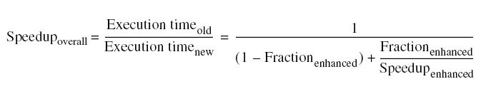
Amdahl’s Law
Speedup is due to enhancement(E)
  Let F be the fraction where enhancement is applied
    Also, called parallel fraction and (1-F) as the serial fraction

Slide 20
Amdahl’s Law
Law of diminishing returns
  Program with execution time T
  Fraction f of the program can be sped up by a factor s
  New execution time, enhanced, is T_{e}
Optimize the common case!
  Execute rare case in software (e.g. exceptions)

Slide 21
Gustafson’s Law
As more cores are integrated, the workloads are also growing!
  Let s be the serial time of a program and p the time that can be done in parallel
  Let f = p/(s+p)
s
C cores
p

