Slide 1
CS203 – Advanced Computer Architecture
Research

Slide 2
Reponses
FPGA
Energy efficiency
GPGPU
Memory architecture /
Emerging Non-volatile Memories

Slide 3
FPGA / Accelerators

Slide 4
References
A. Putnam et al., "A reconfigurable fabric for accelerating large-scale datacenter services," Computer Architecture (ISCA), 2014 ACM/IEEE 41st International Symposium on, 2014

Slide 5


Slide 6
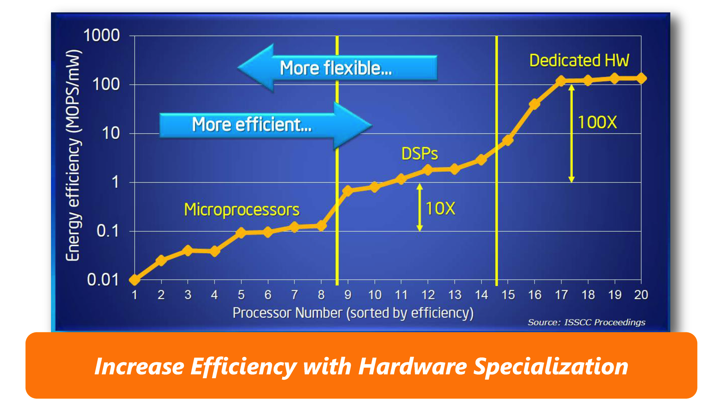

Slide 7
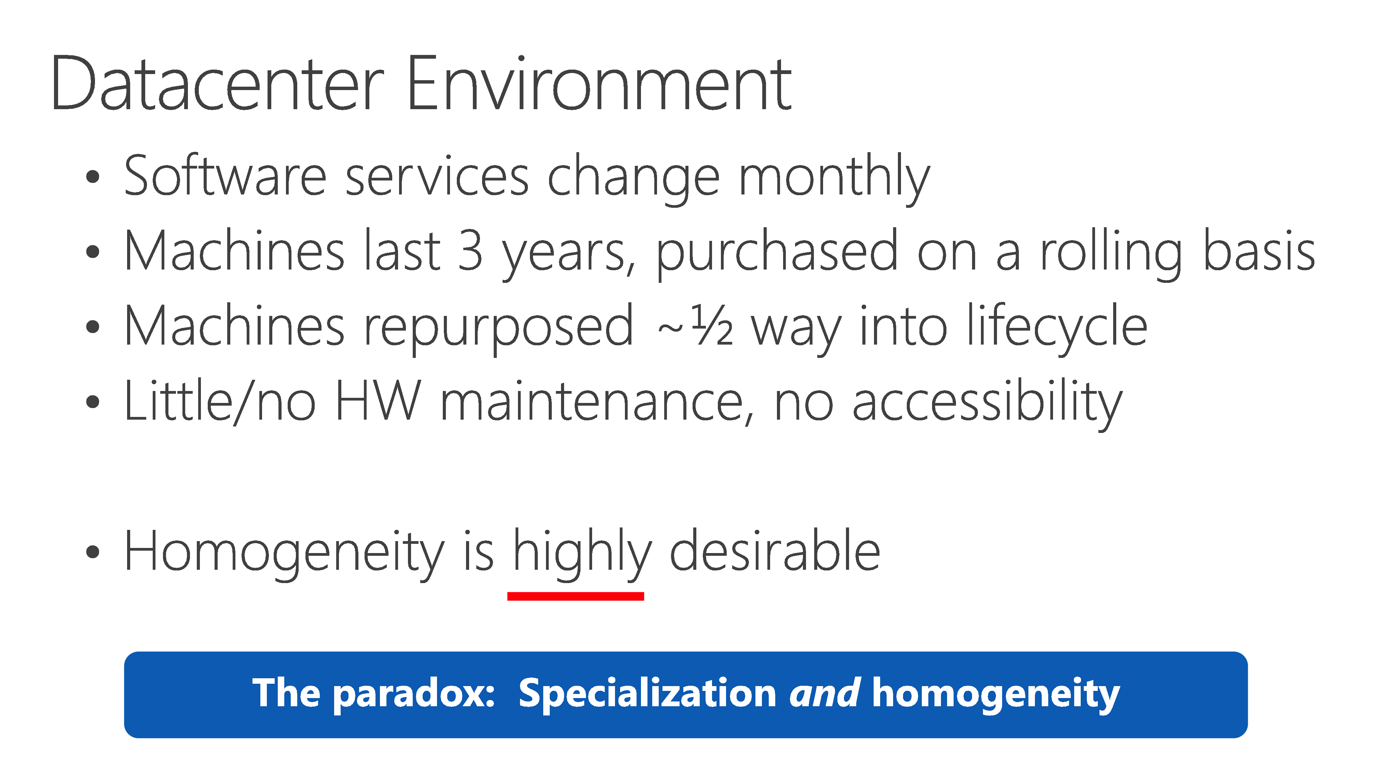

Slide 8
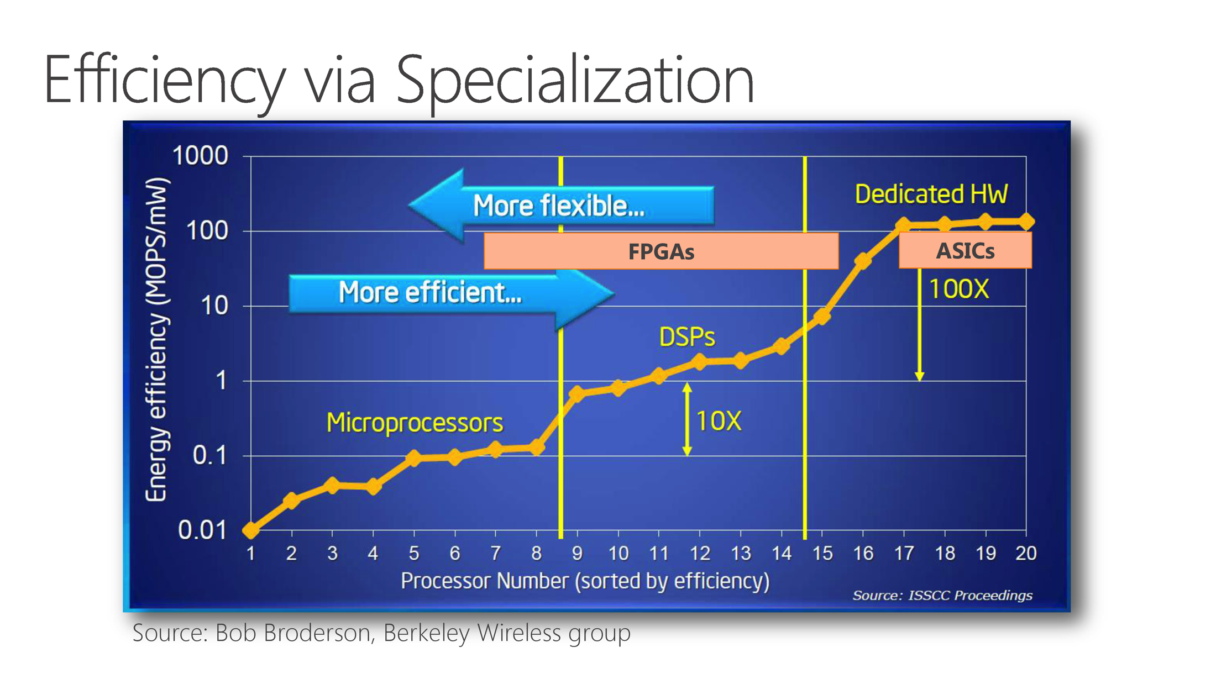

Slide 9
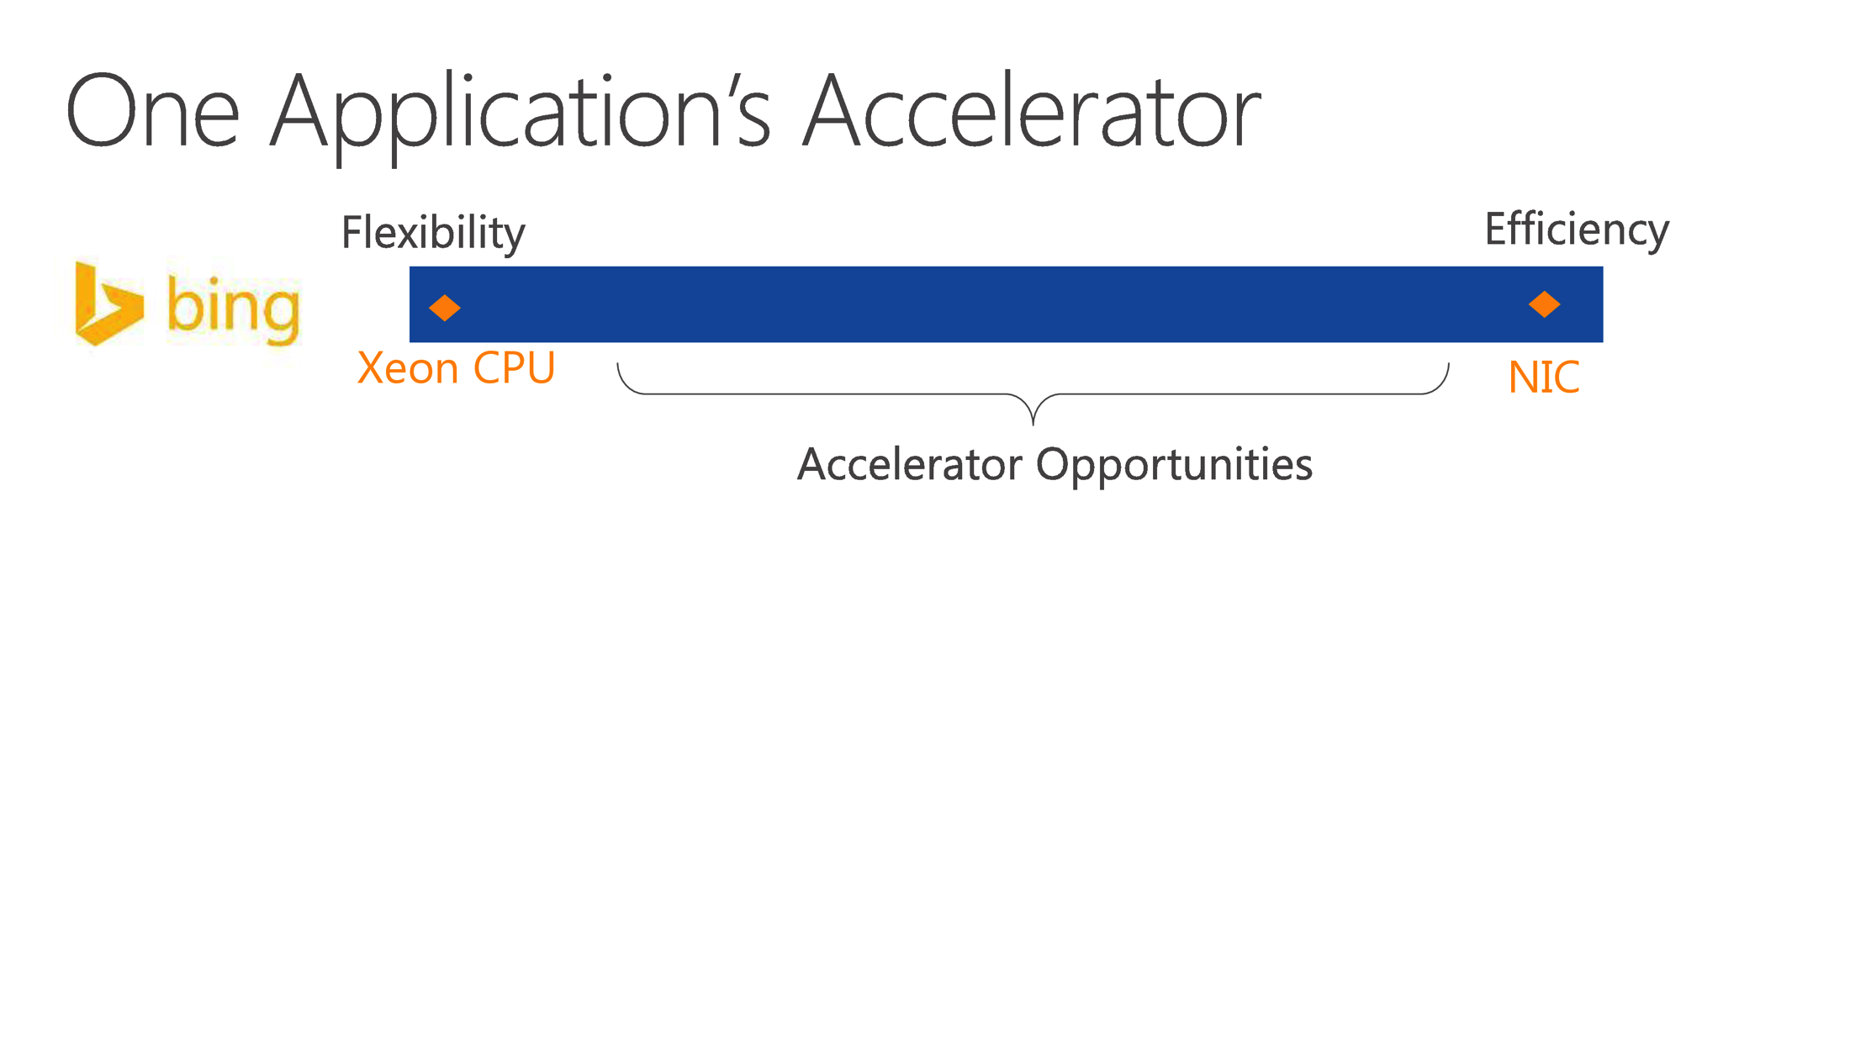

Slide 10
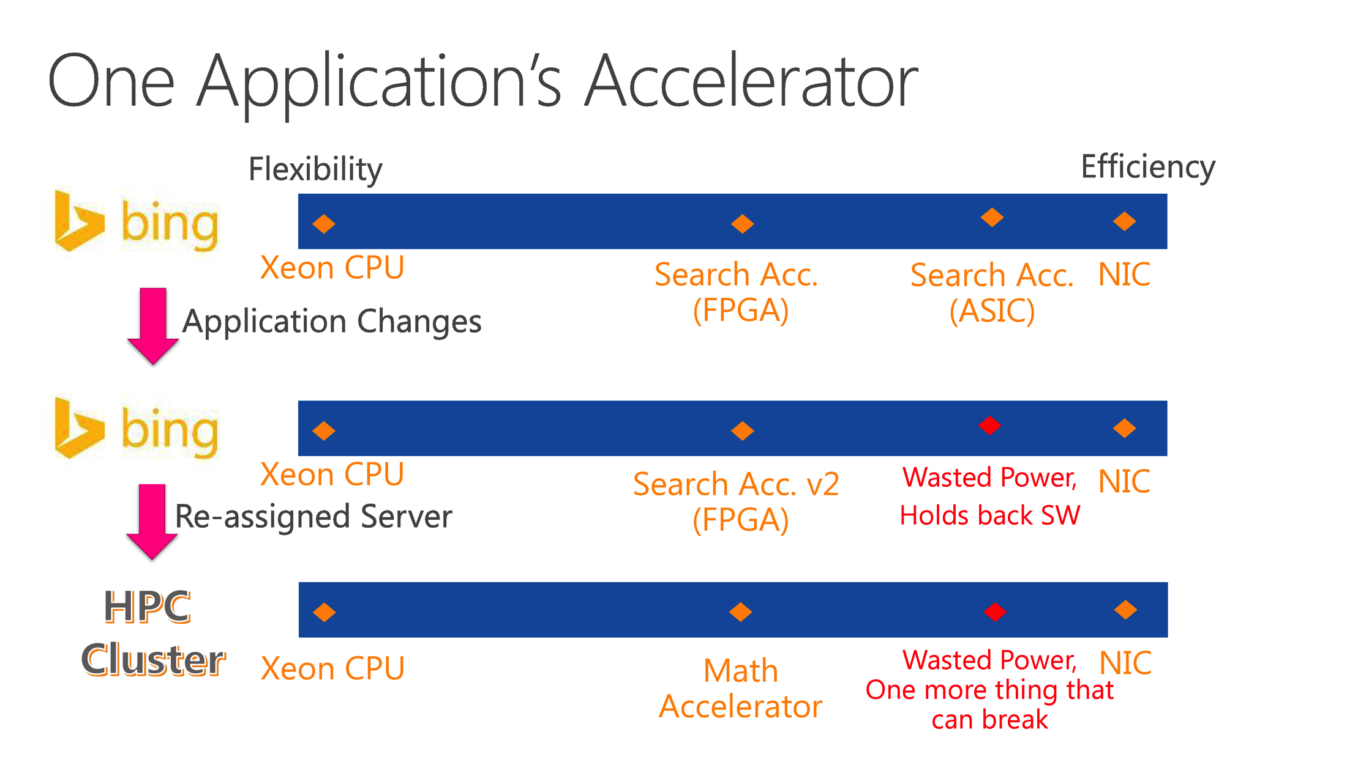

Slide 11
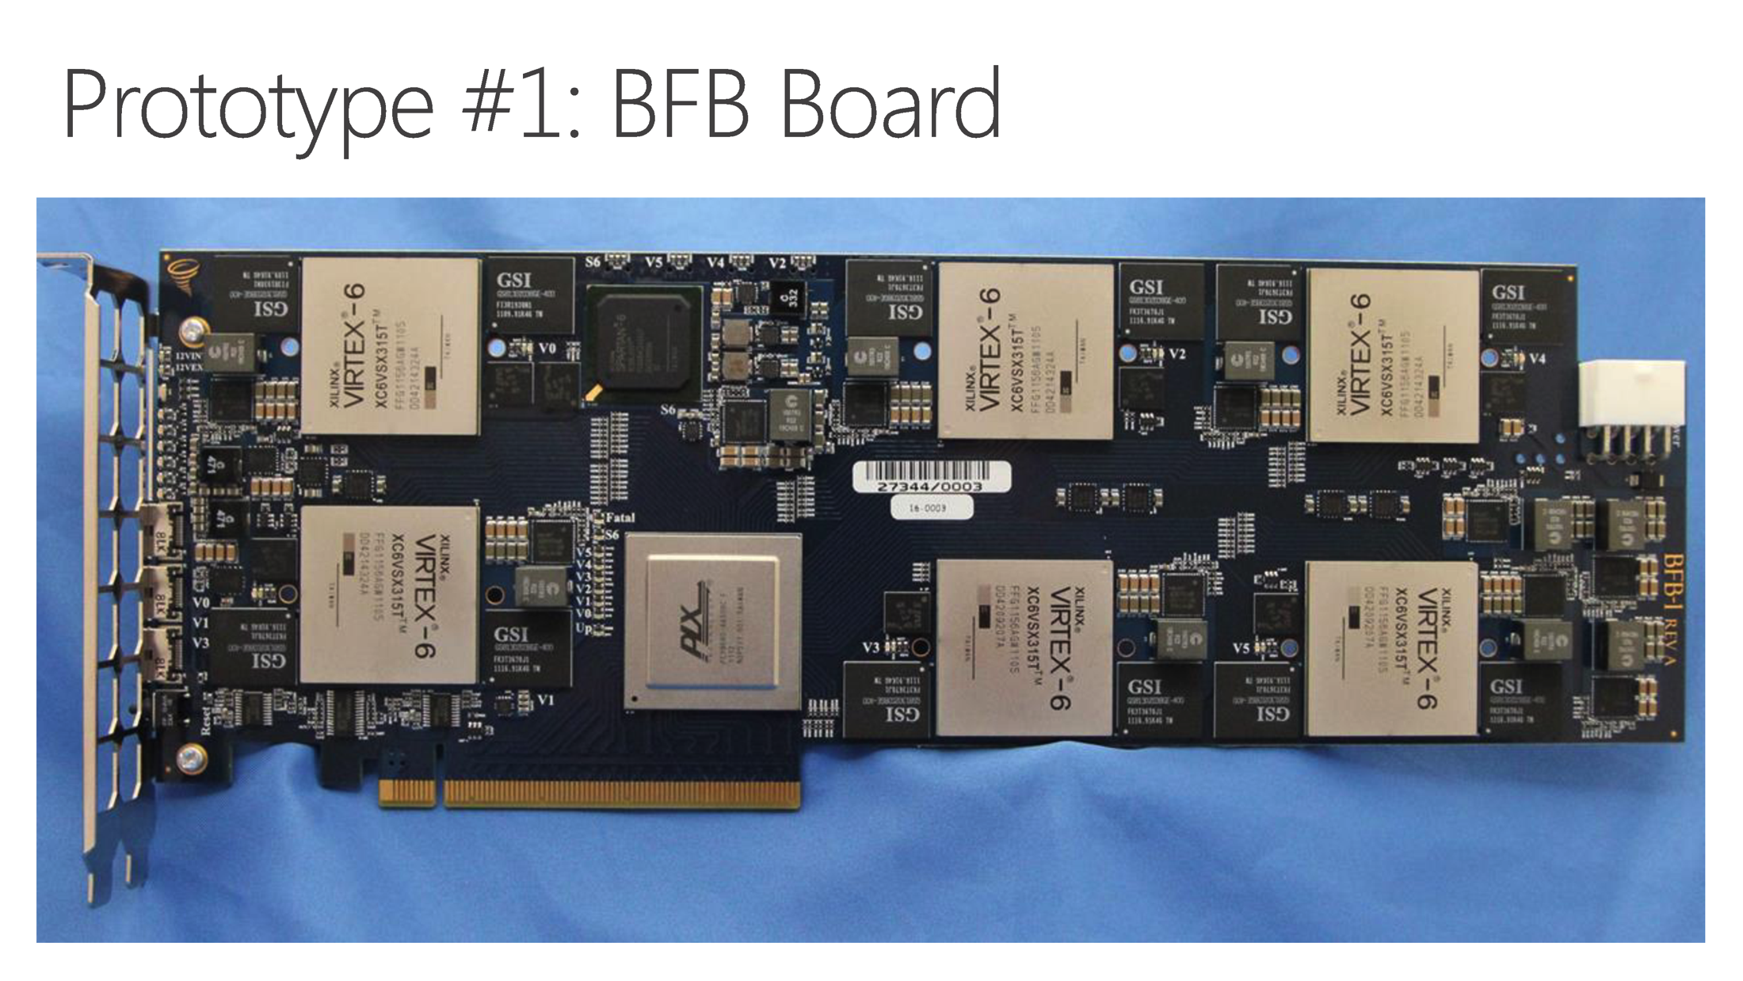

Slide 12
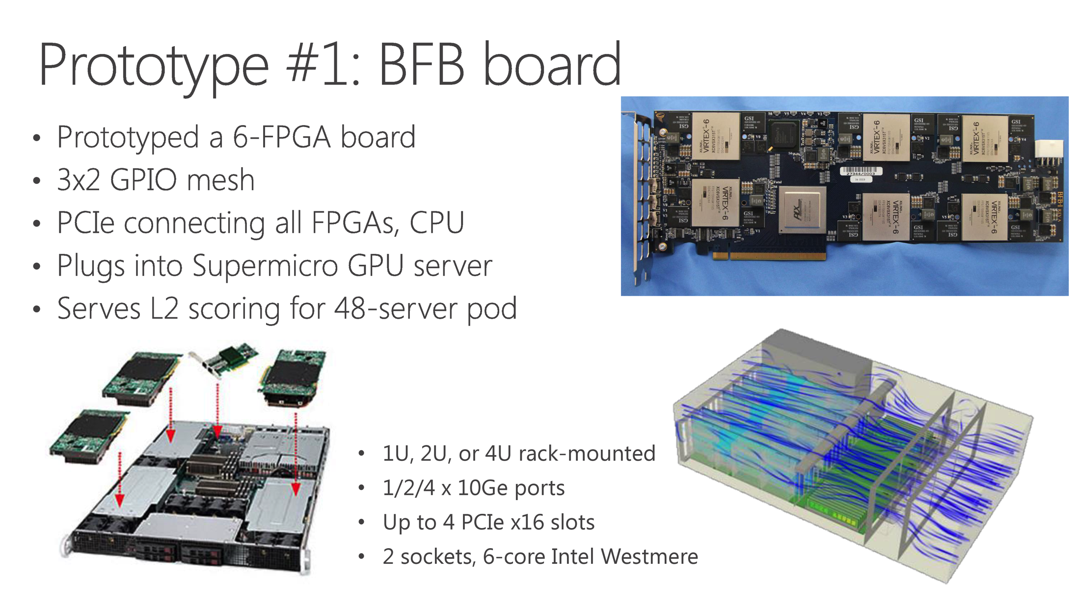

Slide 13


Slide 14
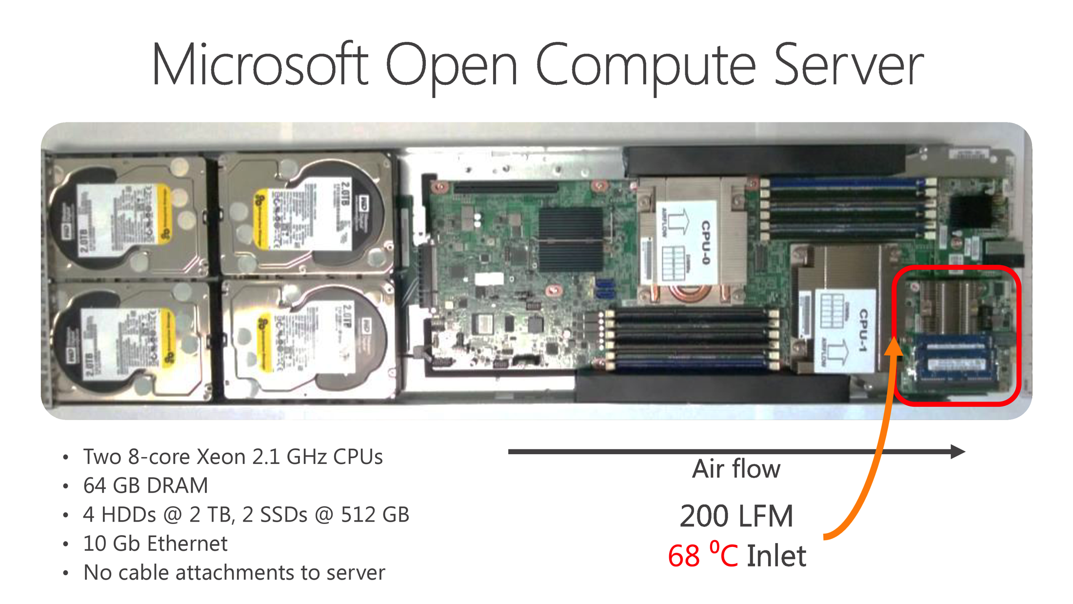

Slide 15


Slide 16
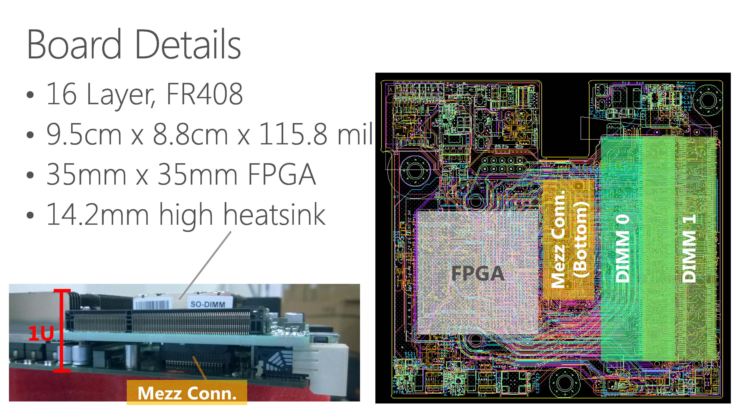

Slide 17
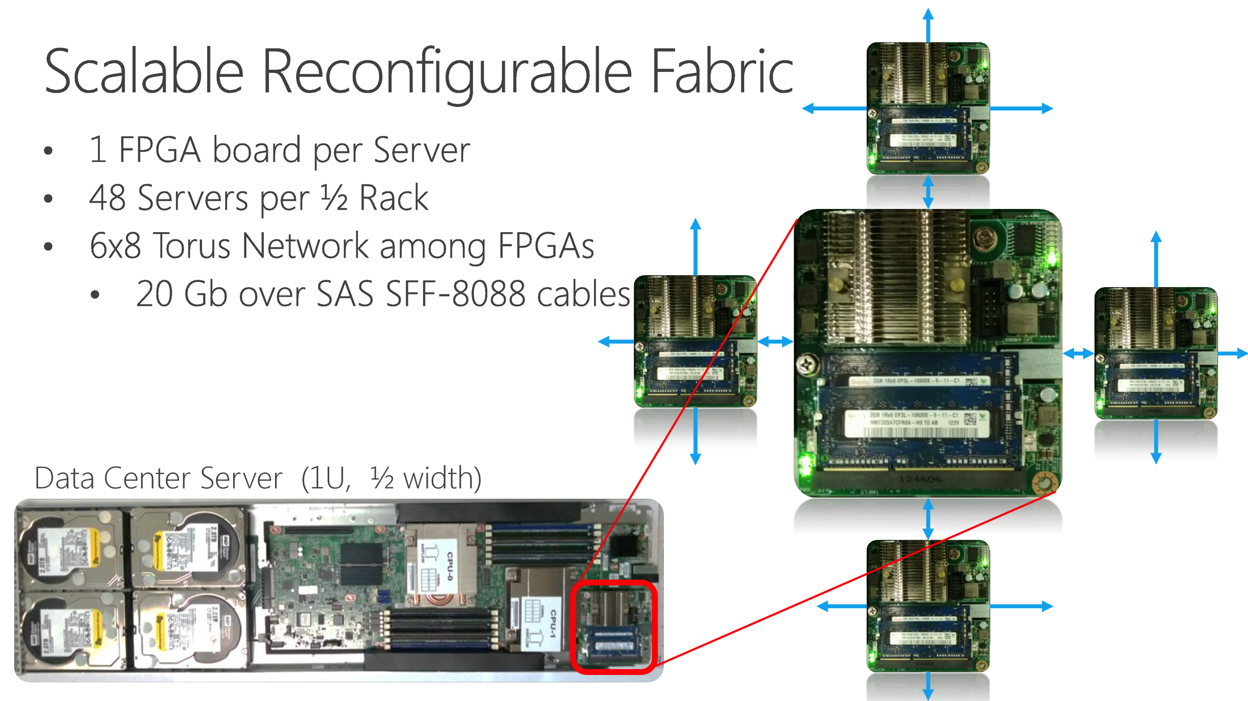

Slide 18
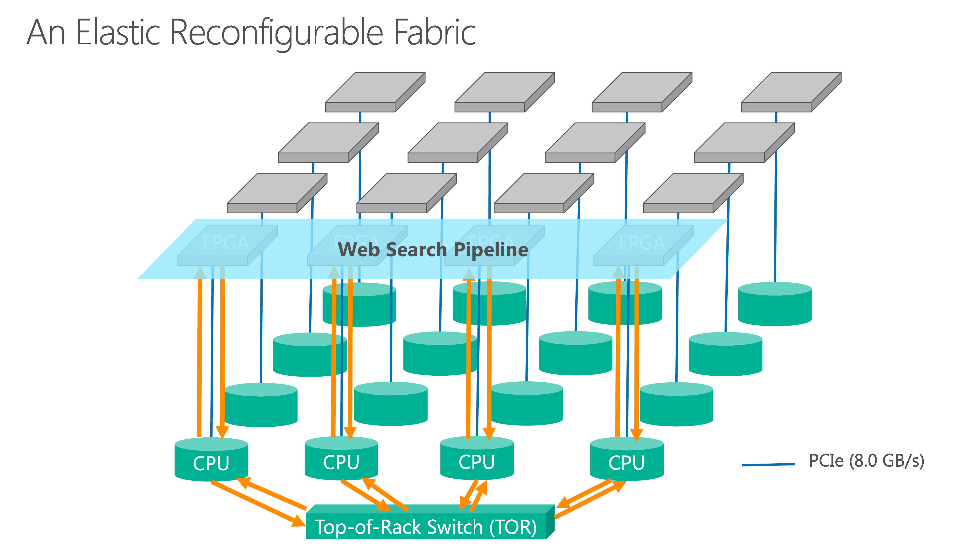

Slide 19
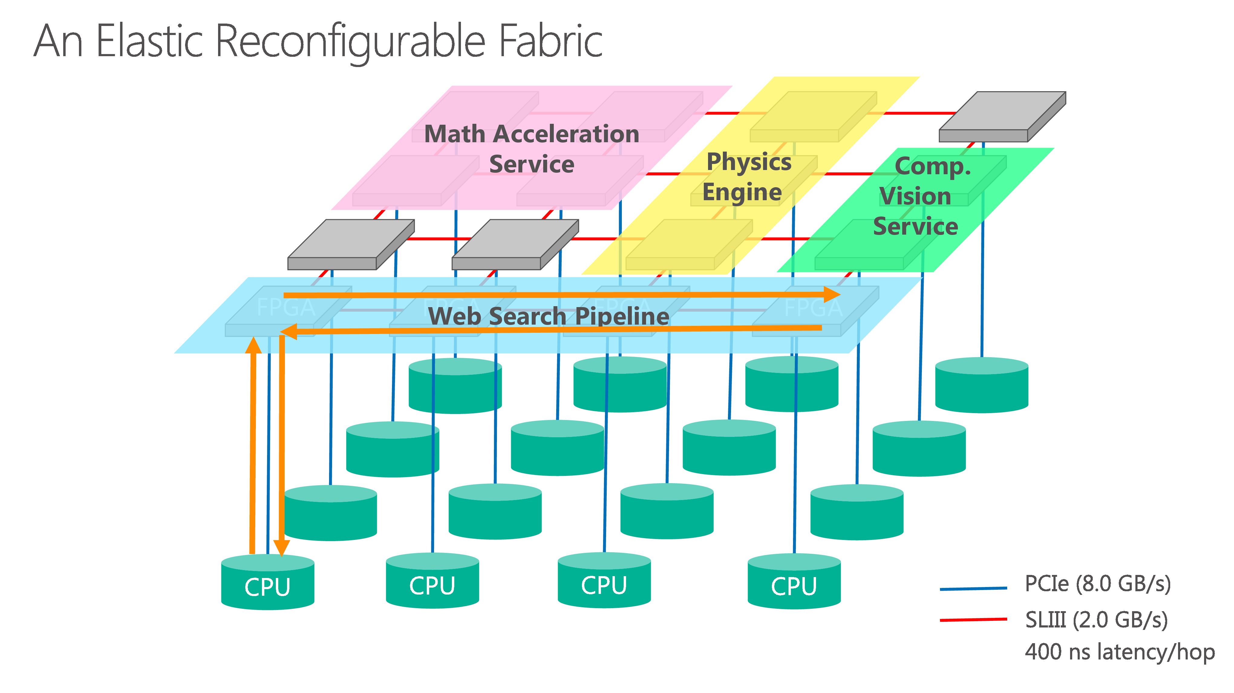

Slide 20
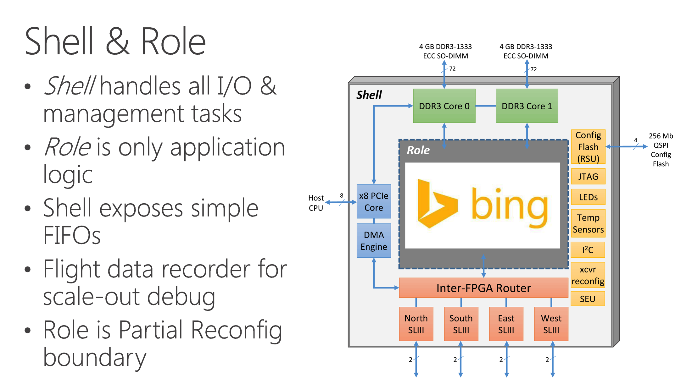

Slide 21
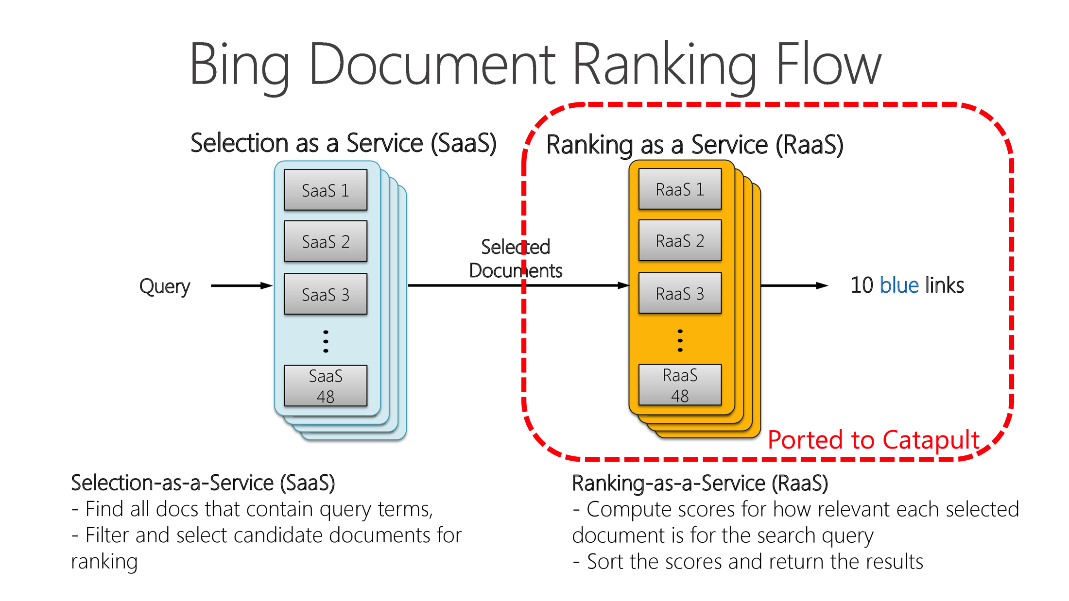

Slide 22
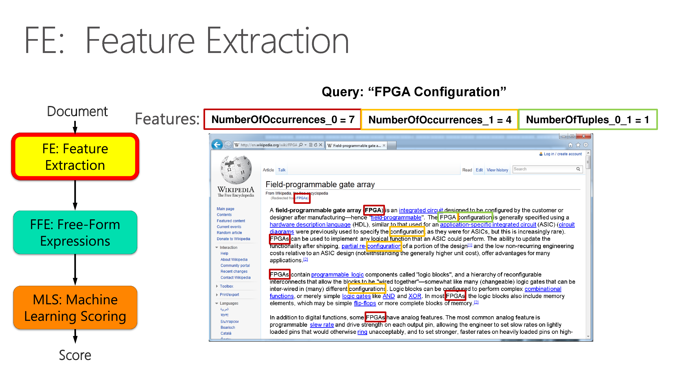

Slide 23
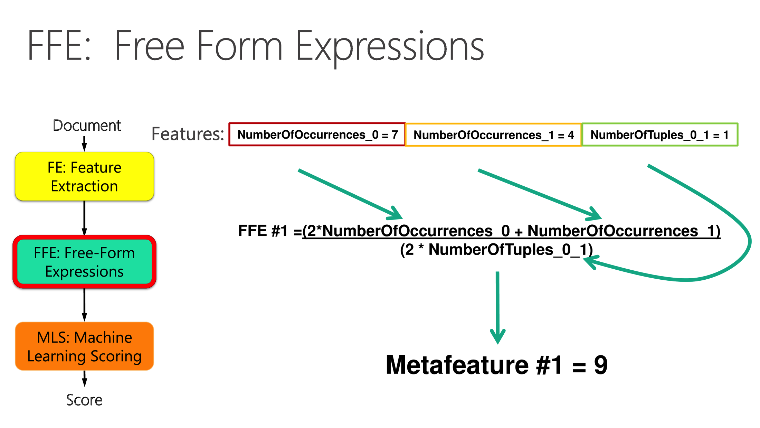

Slide 24
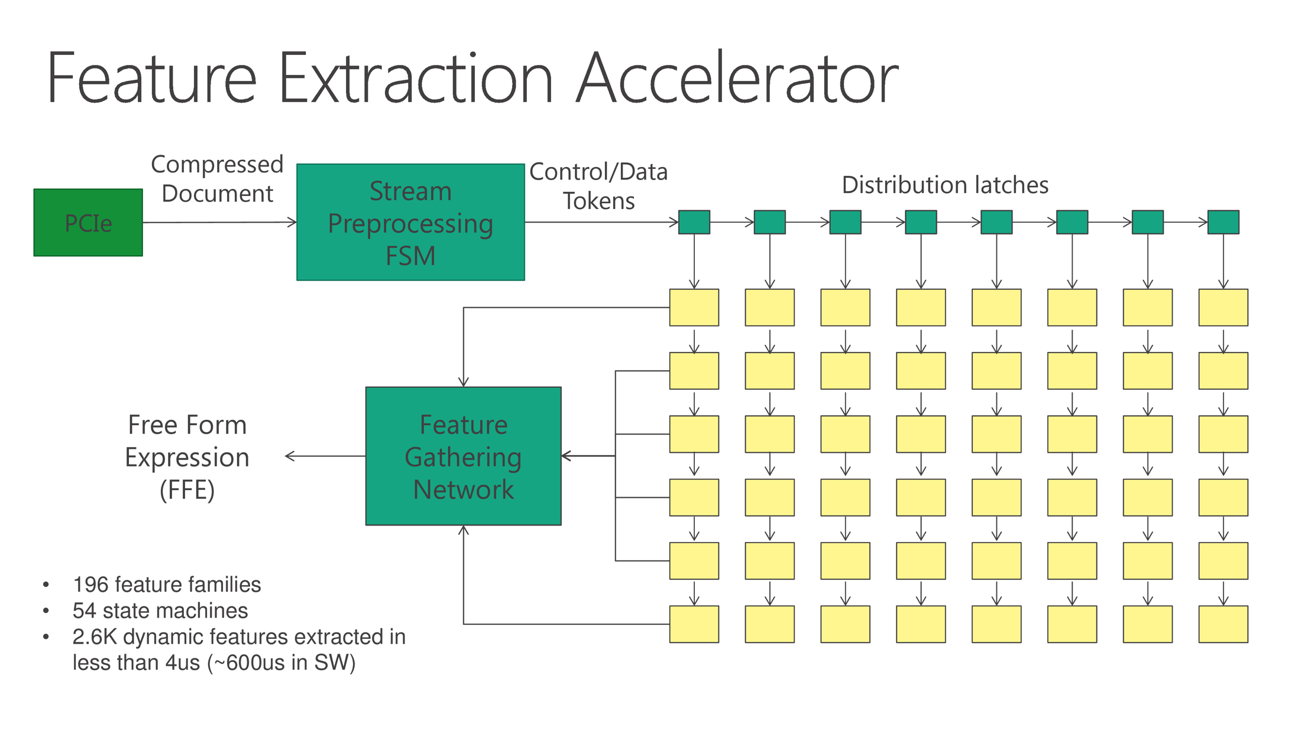

Slide 25
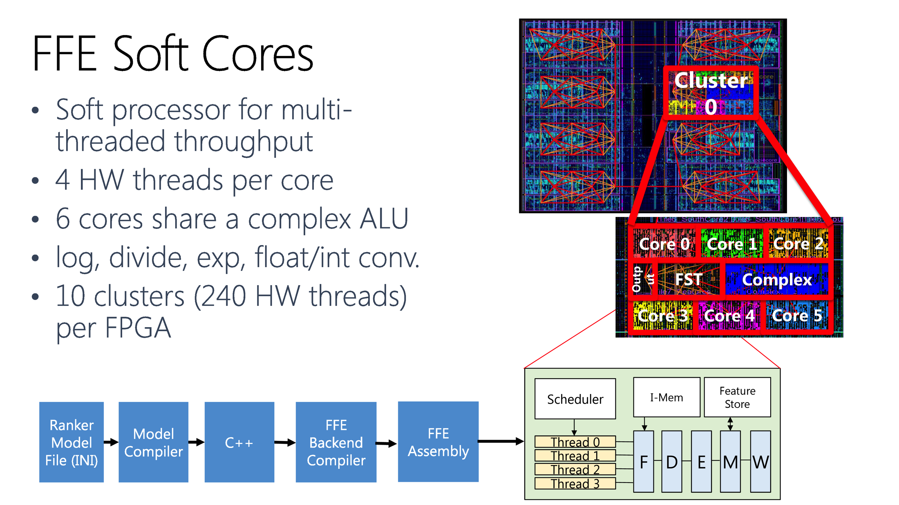

Slide 26
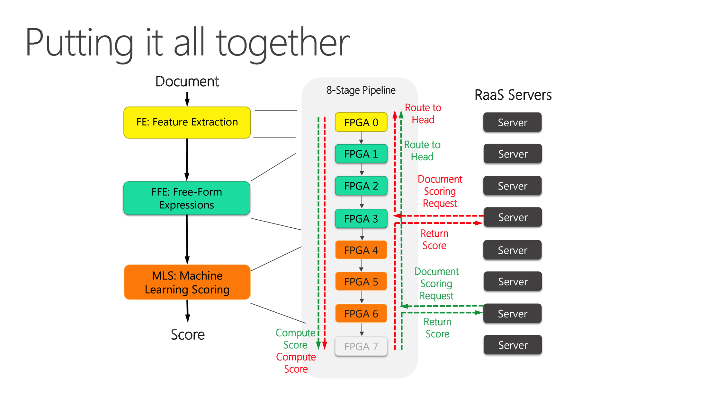

Slide 27
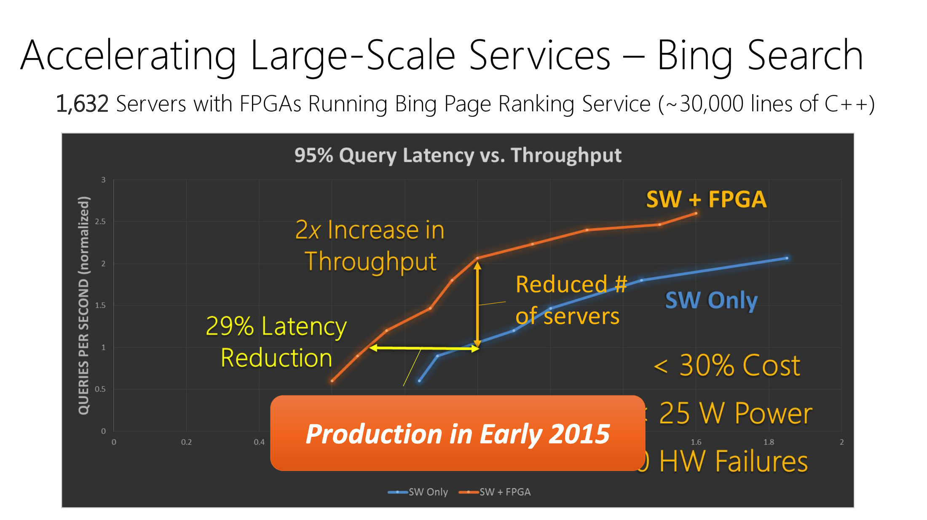

Slide 28
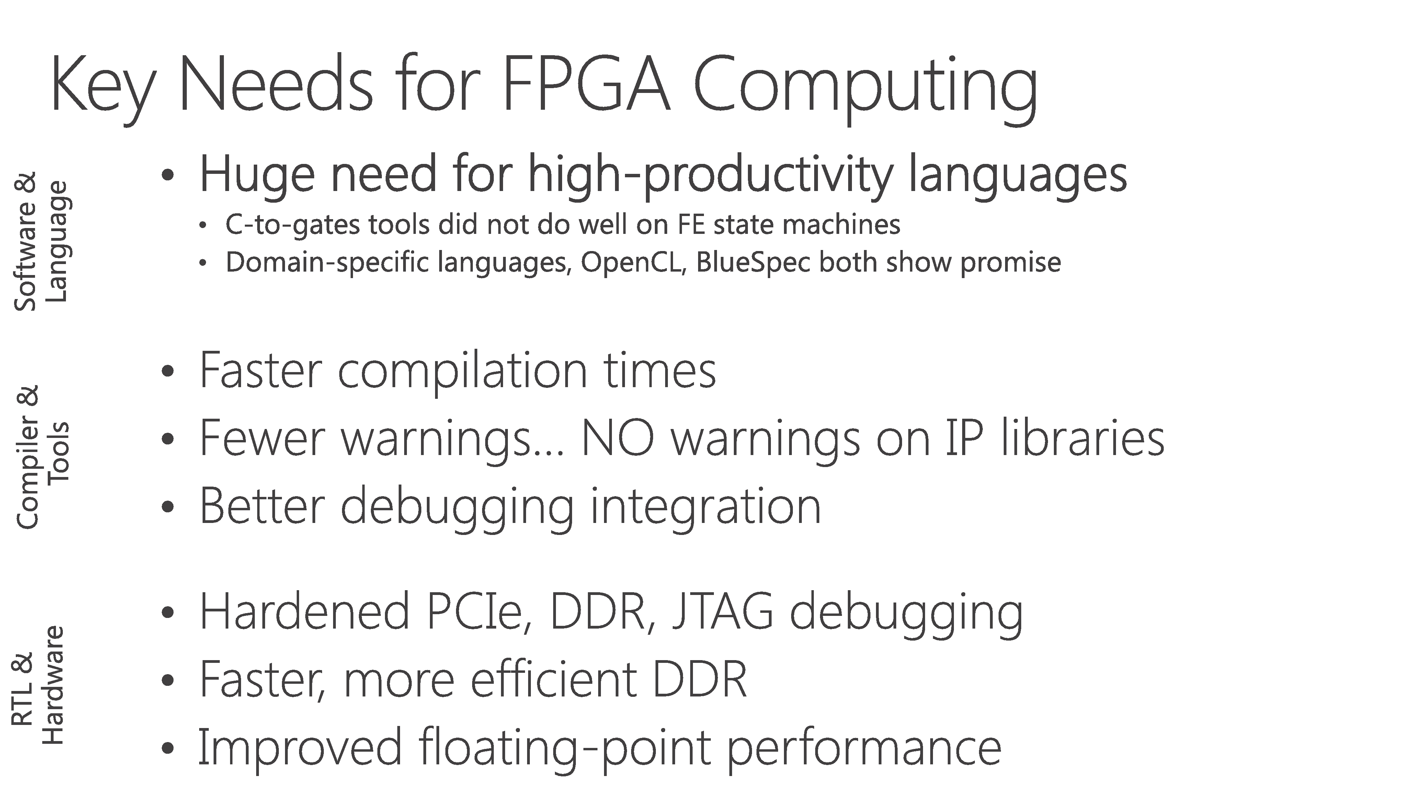

Slide 29


Slide 30
Energy efficiency
(GPGPU, Multi-core, Parallel)

Slide 31
References
Mohammad Abdel-Majeed, Daniel Wong, and Murali Annavaram. 2013. Warped gates: gating aware scheduling and power gating for GPGPUs. In Proceedings of the 46th Annual IEEE/ACM International Symposium on Microarchitecture (MICRO-46).

Slide 32

Supported by
Warped Gates: Gating Aware Scheduling
and Power Gating for GPGPUs
Mohammad Abdel-Majeed* Daniel Wong*
Murali Annavaram
Ming Hsieh Department of Electrical Engineering
University of Southern California
* Equal Contribution
MICRO-2013

Slide 33
Problem Overview
Execution unit accounts for majority of energy consumption in GPGPU,
even more than Mem and Reg!
Leakage energy is becoming a greater concern with technology scaling
Component Energy Breakdown
for GTX480^{[1]}
Traditional microprocessor power gating techniques are ineffective in GPGPUs
[1] J. Leng, T. Hetherington, A. ElTantawy, S. Gilani, N. S. Kim, T. M. Aamodt, and V. J. Reddi, “GPUWattch: enabling energy optimizations in GPGPUs,” presented at the ISCA '13: Proceedings of the 40th Annual International Symposium on Computer Architecture, 2013.
Overview | 33

Slide 34
GPGPU Overview (GTX480)
SM
V | Dec_INST | R
V | Dec_INST | R
V | Dec_INST | R
Instruction Cache
SFU
LD/ST
C
C
C
C
Operands
Fetch and decode
LD/ST
LD/ST
C
C
C
C
INT Unit
FP Unit
I_Buffer
LD/ST
SFU
LD/ST
C
C
C
C
Warp Scheduler
(2-level)
LD/ST
LD/ST
C
C
C
C
Result Queue
LD/ST
SFU
LD/ST
C
C
C
C
Register File
128KB
LD/ST
LD/ST
C
C
C
C
LD/ST
Execution Units
SFU
LD/ST
C
C
C
C
LD/ST
64KB shared Memory/L1 cache
LD/ST
C
C
C
C
LD/ST
SFU LD/ST SP0 SP1
SP accounts for 98% of Execution Unit Leakage Energy
Execution units account for 68% of total on chip area
Overview | 34

Slide 35
Power Gating Overview
Cuts off leakage current that flows through a circuit block
Power gate at SP granularity
Important Parameters:
  Wakeup Delay – Time to return to Vdd (3 cycles)
  Breakeven Time – # of consecutive power gated cycles required to compensate PG energy overhead (9-24 cycles)
  Idle Detect - # of idle cycles before power gating^{[2]}
Cycles>idle_detect
Busy
Static Energy
Cumulative energy savings
Uncompensated
Idle_detect
Cycles>wakeup_delay
Cycle 1
Eoverhead
Wakeup
Overhead to Sleep
Cycle 1+BET
Overhead to sleep
and Wakeup
[2] Z. Hu, et. al. Microarchitectural techniques for power gating of execution units. In ISLPED ’04.
t0
Compensated
t1
t2
t3
t4
Cycles>BET time
Breakeven Time
Time
Overview | 35

Slide 36
Power Gating Challenges in GPGPUs
Challenges | 36

Slide 37
Power Gating Challenges in GPGPUs
Traditional microprocessors experience idle periods many 10s of cycles long^{[3]}
Int. Unit Idle period length distribution for hotspot
  Assume 5 idle detect, 14 BET
Energy Loss or Neutral
Lost Opportunity
Energy Savings
Need to increase idle period length
[3] S. Dropsho, et. al. Managing static leakage energy in microprocessor functional units. In Proceedings of the MICRO 35, 2012
Challenges | 37

Slide 38
Warp Scheduler Effect on Power Gating
Idle periods
interrupted
by instructions
that are greedily
scheduled
INT
Need to coalesce warp issues
by resource type
FP
INT
INT
FP
INT
Ready Warps
Idle Periods
INT
FP
Challenges | 38

Slide 39
GATES:
Gating Aware Two-level Scheduler
Issue warps based on execution unit resource type
GATES | 39

Slide 40
Gating Aware Two-level Scheduler (GATES)
Idle periods
are coalesced
INT
INT
INT
INT
FP
FP
Ready Warps
Idle Period
INT
FP
GATES | 40

Slide 41
Gating Aware Two-level Scheduler (GATES)
Per instruction type active warps subset
Instruction Issue Priority
Dynamic priority switching
  Switch highest priority when it out of ready warps
Two-level
GATES
GATES | 41

Slide 42
Effect of GATES on Idle Period Length
~3x increase in positive power gating events
~2x increase in negative power gating events
Need to further stretch idle periods
Two-level
GATES
GATES | 42

Slide 43
Blackout Power Gating
Forced idleness of execution units to meet BET
Blackout | 43

Slide 44
Blackout Power Gating
Force idleness until break even time has passed
  Even when there are pending instructions
Would this not cause performance loss?
  No, because of GPGPU-specific large heterogeneity of execution units and good mix of instruction types
Cycles>idle_detect
Busy
Uncompensated
Idle_detect
X
Cycles>wakeup_delay
Cycle 1
X
Wakeup
Cycle 1+BET
Compensated
Cycles>BET time
Blackout | 44

Slide 45
Blackout Power Gating
~2.4x increase in positive PG events over GATES
(GATES ~3x w.r.t. baseline)
GATES
GATES + Blackout
Blackout | 45

Slide 46
Blackout Policies
Naïve Blackout
  GATES and Blackout is independent
Can lead to overaggressive
power gating
Idle Detect
Warp Scheduler
(GATES)
C
C
C
C
C
C
C
C
INT
X
C
C
C
C
C
C
C
C
C
C
C
C
C
C
C
C
C
C
C
C
C
C
C
C
SP0 SP1
Blackout | 46

Slide 47
Blackout Policies
Coordinated Blackout
PG only when active warps
count = 0
Idle Detect
Warp Scheduler
(GATES)
C
C
C
C
Active Warp
Count Based
Dynamic priority switching
is Blackout aware
C
C
C
C
✓
C
C
C
C
INT
C
C
C
C
C
C
C
C
C
C
C
C
C
C
C
C
C
C
C
C
SP0 SP1
Blackout | 47

Slide 48
Architectural Support
2-bit type indicator
2 counters keep track of number
of INT/FP instr in active subset.
Used to determine dynamic priority
Architectural Support | 48

Slide 49
Evaluation
Evaluation | 49

Slide 50
Evaluation Methodology
GPGPU-Sim v3.0.2
  Nvidia GTX480
GPUWattch and McPAT for Energy and Area estimation
18 Benchmarks from ISPASS, Rodinia, Parboil
Power Gating parameters
  Wakeup delay – 3 cycles
  Breakeven time – 14 cycles
  Idle detect – 5 cycles
Evaluation | 50

Slide 51
Integer Unit Static Energy Savings
Blackout/Warped Gates is able to save energy when ConvPG cannot
Warped Gates saves ~1.5x static energy w.r.t. ConvPG
Evaluation | 51

Slide 52
FP Unit Static Energy Savings
Warped Gates save ~1.5x static energy w.r.t. ConvPG
  (Ignores Integer only benchmarks)
Evaluation | 52

Slide 53
Performance Impact
Naïve Blackout has high overhead due to aggressive PG
Both ConvPG and Warped Gates has ~1% overhead
Evaluation | 53

Slide 54
Conclusion
Execution units – largest energy usage in GPGPUs
Static energy becoming increasingly important
Traditional microprocessor power gating techniques ineffective in GPGPUs due to short idle periods
GATES – Scheduler level technique to increase idle periods by coalescing instruction type issues
Blackout – Forced idleness of execution unit to avoid negative power gating events
Adaptive Idle Detect – Limit performance impact
Warped Gates able to save 1.5x more static power than traditional microprocessor techniques, with negligible performance loss
Conclusion | 54

Slide 55
Memory architecture

Slide 56
Reference
Akel, Ameen, et al. "Onyx: A Prototype Phase Change Memory Storage Array." HotStorage. 2011.

Slide 71
