Slide 1
CS203 – Advanced Computer Architecture
Warehouse Scale Computing

Slide 2















Slide 3
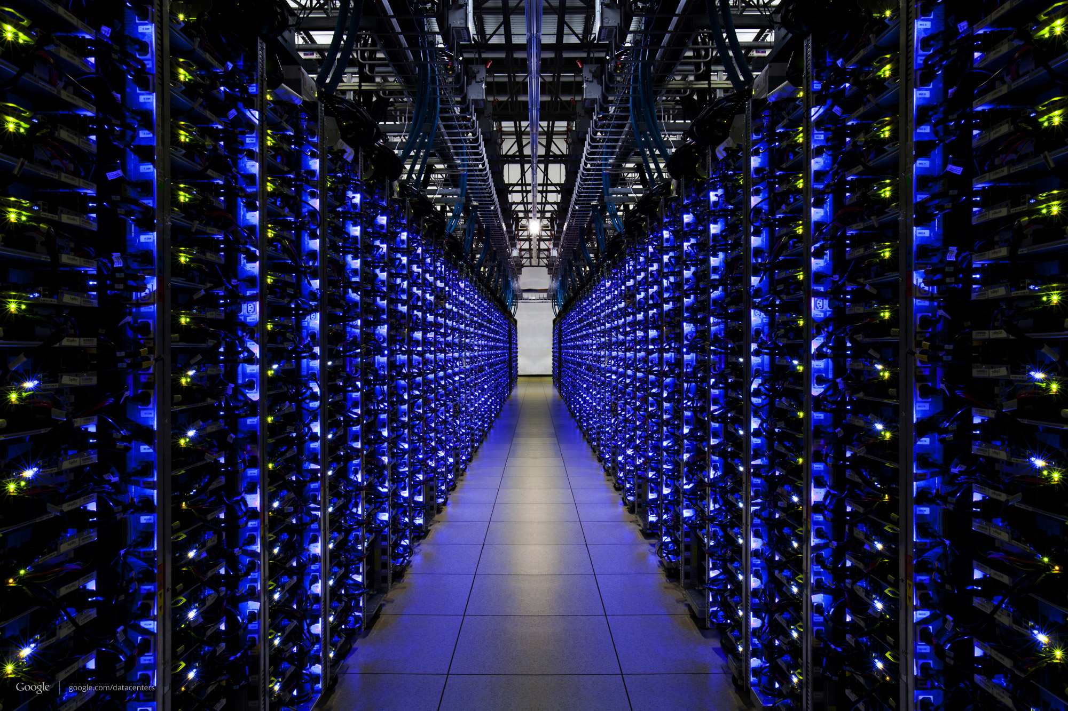
Datacenters are the heart and soul of the cloud

Slide 4
Cloud computing is growing rapidly
$159B
Market Size
$78B
$5.8B
2008
2014
2020
Source: Forrester Research, Inc. “Sizing the Cloud”

Slide 5


But, Datacenters are power hungry
2013
91 Billion KWh
≈ 2x NYC
2020
140 Billion KWh
+16
Source: Natural Resources Defense Council

Slide 6
In order to sustain
cloud computing growth,
datacenter energy efficiency must improve

Slide 7
Servers typically have poor low-mid range energy efficiency
100
← Typical operating →
range
Efficiency (dash)
% Peak power
0
0
Utilization (%)
100

Slide 8
Ideally, we want servers that are
Energy Proportional
100
← Typical operating →
range
Efficiency (dash)
% Peak power
0
0
Utilization (%)
100

Slide 9
Google Datacenter Utilization

Slide 10
Energy proportionality

Slide 11
Measuring energy proportionality
Energy proportionality curve
Actual – empirically measured power usage
Linear – extrapolated from peak to idle power usage
Ideal – utilization and power are perfectly proportional
Server A
Server B

Slide 12
Dynamic range (DR)
DR = 60%
DR = 50%
DR is a course first-order approximation of EP
  …but it is not accurate – only measures two extremes
  Ignores power consumption at intermediate utilizations
Assuming 100W peak and Google datacenter utilization†
  Server A = 68.6W , Server B = 64.6W
† L. Barroso and U. Holzle,“The Case For Energy-proportional Computing,” Computer, Dec 2007.

Slide 13
Energy proportionality (EP)‡
EP = 53%
EP = 57%
EP is a better indicator of energy usage than DR
Why is DR not enough?
  EP = DR + how linear the energy proportionality curve
‡ F. Ryckbosch, S. Polfliet, and L. Eeckhout, “Trends in Server Energy Proportionality,” Computer,2011.

Slide 14
Energy proportionality trends
Analyzed reported SPECpower benchmark results
  Perf. and power characteristics @ 10% intervals
~400 servers
November 2007 – Early 2014

Slide 15
Dynamic range trend
Achieving 100% DR is very difficult
  Power supplies, voltage converters, fans, chipsets, network, etc.

Slide 16
Energy proportionality trend

Slide 17
Proportionality gap trends
As EP improves, PG at high utilization near 0
Large PG at low utilization regardless of EP

Slide 18
The key to achieving ideal EP is to improve linear deviation and to reduce low utilization power consumption

Slide 19
…but energy efficiency efforts has been focused on high utilization
Energy efficiency defined as ops/watt

Slide 20
Solutions
Component Low Power modes
  CPU low power states (DVFS)
  Disk spin down
Server low power modes
  Server sleep/hibernate
Cluster-level techniques
  Workload migration (increase server utilization)
  Dynamic right-sizing
    Pack workload to subset of servers, sleep idle servers

Slide 21


Scheduling
Uniform Load Balancing
  Minimize response time
Util.
Util.
Util.
Util.

Slide 22
Scheduling
Uniform Load Balancing
  Cluster-wide EP tracks server EP
Util.
Util.
Util.
Util.
Server EP Curve
Cluster EP Curve

Slide 23
Scheduling
When server EP is poor, we need to mask the poor EP with Dynamic Capacity Management
  Uses Packing algorithms, to minimize active server
Turn on servers
when capacity needed
Turn off server
when not needed
Util.
Util.
Util.
Util.
Server EP Curve
Cluster EP Curve
Active servers run
at higher utilization

Slide 24
Packing techniques highly effective
Uniform Cluster-wide EP tracks Server EP
When server EP is poor, packing improves Cluster-EP
  Turning off idle servers, higher util. for active servers
Uniform
Packing
Cluster EP
= 0.24
Cluster EP
= 0.69
LowEP (0.24) Server

Slide 25
efficiency

Slide 26
Measuring Efficiency of a WSC
Performance
  Latency is important metric because it is seen by users
  Bing study: users will use search less as response time increases
  Service Level Objectives (SLOs)/Service Level Agreements (SLAs)
    E.g. 99% of requests be below 100 ms

Slide 27



Measuring Efficiency of a WSC
Power Utilization Effectiveness (PEU)
  = Total facility power / IT equipment power
  Median PUE on 2006 study was 1.69
Power
  Switchgear
  UPS
  Battery Backup
  etc.
Cooling
  Chillers
  CRACs
  etc.
IT Equipment
  Servers
  Storage
  Telco
  etc.
Total
Facility
Power
IT Equipment Power

Slide 28
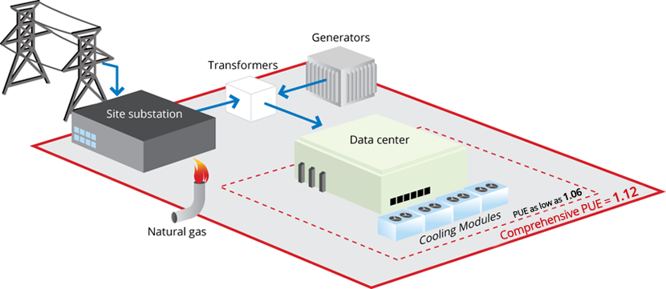
Google PUE

Slide 29
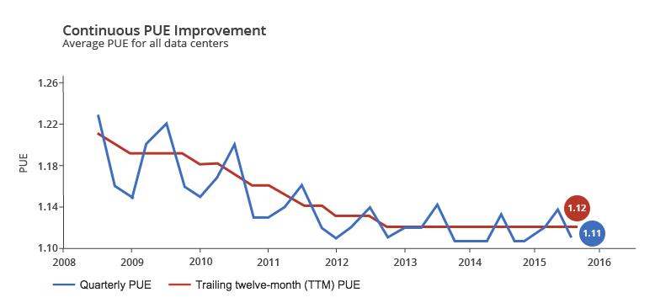
Google PUE

Slide 30
infrastructure

Slide 31
Infrastructure and Costs of WSC
Location of WSC
  Proximity to Internet backbones,
  electricity cost,
  property tax rates,
  low risk from earthquakes, floods, and hurricanes

Slide 32
Infrastructure and Costs of WSC
Power Distribution

Slide 33
Infrastructure and Costs of WSC
Cooling
  Air conditioning used to cool server room
  64 F – 71 F
    Keep temperature higher (closer to 71 F)
  Cooling towers can also be used
    Minimum temperature is “wet bulb temperature”

Slide 34
Infrastructure and Costs of WSC
Cooling system also uses water (evaporation and spills)
  E.g. 70,000 to 200,000 gallons per day for an 8 MW facility
Power cost breakdown:
  Chillers: 30-50% of the power used by the IT equipment
  Air conditioning: 10-20% of the IT power, mostly due to fans
How man servers can a WSC support?
  Each server:
    “Nameplate power rating” gives maximum power consumption
    To get actual, measure power under actual workloads
  Oversubscribe cumulative server power by 40%, but monitor power closely

Slide 35
UPS
Uninterruptible Power Supply
Batteries or flywheel
AC-DC-AC conversion
Conditions the power feed
  Removes spikes or sags
  Removes harmonic distortions
Housed in a separate UPS room
Sizes range from hundreds of kW to 2MW

Slide 36
PDUs
Power Distribution Units
Breaker panels
  Input 200-480V
  Output many 110V or 220V
  75-225kW in 20-30A circuits (max 6 kW)
Redundancy from two independent power sources

Slide 37
Paralleling
Multiple generators or UPSs
  Feed a shared bus
N+1 (one failure)
N+2 (one maintenance, one failure)
2N (redundant pairs)

Slide 38
Cooling

Slide 39
Cooling Steps
12-14 C coolant
16-20 C air at CRAC (Computer Room AC)
18-22 C at server intake
Then back to chiller

Slide 40
“Free Cooling”
Pre-cool coolant before chiller
Water-based cooling towers use evaporation
  Works in moderate climate – freezes if too cold
Glycol-based radiator outside the building
  Works in cold climates

Slide 41
Cooling is Critical
Datacenter would fail in minutes without cooling
  Cooling backed up by generators and UPSs
Adds > 40% critical electrical load

Slide 42
Total cost of ownership
(TCO)

Slide 43
Cost of a WSC
Capital expenditures (CAPEX)
  Cost to build a WSC
    Server and Infrastructure
Operational expenditures (OPEX)
  Cost to operate a WSC
    Power, Maintainence
TCO = datacenter depreciation + datacenter opex +
server depreciation +
server opex

Slide 44
Example:
Dell 2950 III EnergySmart
  16GB of RAM and 4 disks
  300 Watts
  $6K

Slide 45
Assumptions
The cost of electricity is the 2006 average US industrial rate ay 6.2 cents/kWh.
The interest rate a business must pay on their loans is 12%.
The cost of datacenter construction is $15/W amortized over 12 years.
Datacenter opex is $0.03/W/month.
The datacenter has a PUE of 2.0.
Server lifetime is 4 years, and server repair and maintenance is 5% of capex per year.
The server’s average power draw is 75% of peak power.

Slide 46
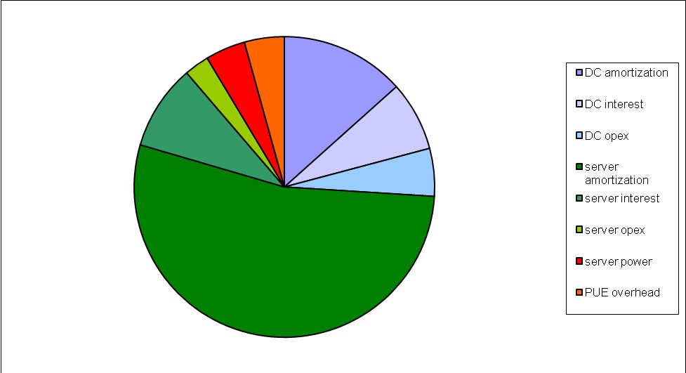
Cost Breakdown A

Slide 47
More cost breakdowns…

Slide 48
TCO Models
http://cseweb.ucsd.edu/~tullsen/DCmodeling.html
http://perspectives.mvdirona.com/2008/11/cost-of-power-in-large-scale-data-centers/
http://www.cs.ucy.ac.cy/carch/xi/cost-et.php
https://aws.amazon.com/tco-calculator/

