Slide 1
CS203 – Advanced Computer Architecture
Vector Machines and
General Purpose Graphical Processing Units (GPGPUs)
- Data-level parallelism

Slide 2
Instruction and Data Streams
Flynn’s Classification
 |  | Data Streams
 |  | Single | Multiple
Instruction Streams | Single | SISD: Intel Pentium 4 | SIMD: Illiac IV, MMX/SSE instructions of x86
 | Multiple | MISD: No examples today | MIMD: Intel Xeon e5345
SPMD: Single Program Multiple Data
  A parallel program on a MIMD computer
  Conditional code for different processors

Slide 3
Single Instruction-stream Multiple Data-stream (SIMD)
SIMD architectures can exploit significant data-level parallelism for:
  matrix-oriented scientific computing
  media-oriented image and sound processors
Operate element-wise on vectors of data
  E.g., MMX and SSE instructions in x86
    Multiple data elements in 128-bit wide registers
All processors execute the same instruction at the same time
  Each with different data address, etc.
  Simplifies synchronization
Reduced instruction control hardware
Works best for highly data-parallel applications
  Highly energy efficient

Slide 4
SIMD Parallelism
Array Processors – True SIMD
Vector architectures
SIMD extensions
Graphics Processor Units (GPUs)
For x86 processors:
  Expect two additional cores per chip per year
  SIMD width to double every four years
  Potential speedup from SIMD to be twice that from MIMD!

Slide 5
Historical Perspective
Mid-60s: performance concerns
SIMD processor arrays
Also fast Scalar machines
  CDC 6600
Texas Instruments ASC, 1972
  Memory to memory vector
Cray Develops CRAY-1, 1978

Slide 6
ILLIAC IV
I/O Proc
CU
PE
PE
PE
PMEM
PMEM
PMEM

Slide 7
Vector Architectures
Basic idea:
  Read one vector instruction, decode and execute – single control unit
  All ALUs execute the same instruction but on different data
  Read sets of data elements into “vector registers” and execute on those registers
  Disperse the results back into memory
Registers are controlled by compiler
  Used to hide memory latency
  Leverage memory bandwidth

Slide 8
Components of Vector Processor
Scalar CPU: registers, datapaths, instruction fetch
Vector Registers:
  Fixed length memory bank holding a single vector reg
  Typically 8-32 Vregs, up to 8Kbits per Vreg
  At least; 2 Read, 1 Write ports
  Can be viewed as an array of N elements
Vector Functional Units:
  Fully pipelined. New op per cycle
  Typically 2 to 8 FUs: integer and FP
  Multiple datapaths to process multiple elements per cycle if needed
Vector Load/Store Units (LSUs):
  Fully pipelined
  Multiple elems fetched/store per cycle
  May have multiple LSUs
Cross-bar:
  Connects FUS, LSUs and registers

Slide 9
CRAY-1 Organization
Simple 16-bit Reg-to-Reg ISA
Use two 16-bit to get Imm
Natural combinations of
scalar and vector
Scalar bit-vectors
match vector length
Gather/Scatter M-R
Cond. Merge

Slide 10
Vector Processors
Highly pipelined arithmetic function units
Stream data from/to vector registers to units
  Data collected from memory into registers
  Results stored from registers to memory
Example: Vector extension to MIPS
  64 × 64-element registers (64-bit elements)
  Vector instructions
    lv, sv: load/store vector
    addv.d: add vectors of double
    addvs.d: add scalar to each element of vector of double
Significantly reduces instruction-fetch bandwidth

Slide 11
VMIPS Instructions
ADDVV.D: add two vectors
ADDVS.D: add vector to a scalar
LV/SV: vector load and vector store from address
Example: DAXPY
  L.D F0,a ; load scalar a
  LV V1,Rx ; load vector X
  MULVS.D V2,V1,F0 ; vector-scalar multiply
  LV V3,Ry ; load vector Y
  ADDVV V4,V2,V3 ; add
  SV Ry,V4 ; store the result
Requires 6 instructions vs. almost 600 for MIPS

Slide 13
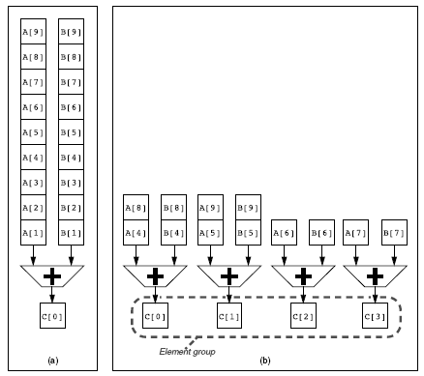
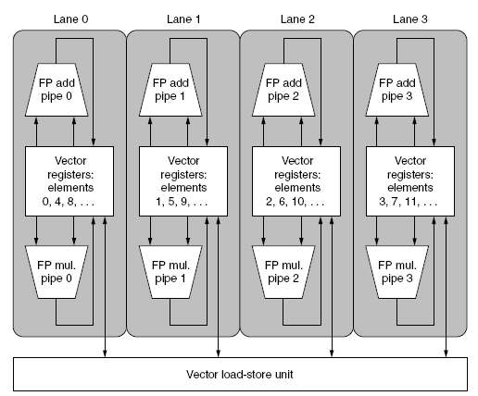
Multiple Lanes
Element n of vector register A is “hardwired” to element n of vector register B
  Allows for multiple hardware lanes

Slide 14
Challenges
Start up time
  Latency of vector functional unit
  Assume the same as Cray-1
    Floating-point add => 6 clock cycles
    Floating-point multiply => 7 clock cycles
    Floating-point divide => 20 clock cycles
    Vector load => 12 clock cycles
Improvements needed:
  > 1 element per clock cycle
  Non-64 wide vectors (What if loops are smaller than 64 iterations?)
    Vector-length register
  IF statements in vector code
    Vector Mask
  Memory system optimizations to support vector processors
    Memory bank interleaved
  Sparse matrices
    Gather Scatter

Slide 15
Vector vs. Scalar
Vector architectures and compilers
  Simplify data-parallel programming
  Explicit statement of absence of loop-carried dependences
    Reduced checking in hardware
  Regular access patterns benefit from interleaved and burst memory
  Avoid control hazards by avoiding loops
More general than ad-hoc media extensions (such as MMX, SSE)
  Better match with compiler technology

Slide 16
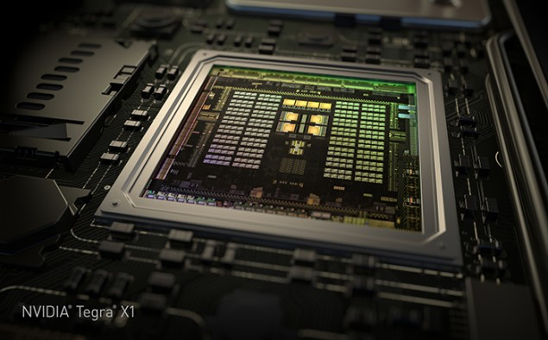
GPU Computing Architecture
/
HiPEAC Summer School, July 2015
Tor M. Aamodt
aamodt@ece.ubc.ca
University of British Columbia
NVIDIA Tegra X1 die photo

Slide 17
What is a GPU?
GPU = Graphics Processing Unit
  Accelerator for raster based graphics (OpenGL, DirectX)
  Highly programmable (Turing complete)
  Commodity hardware
  100’s of ALUs; 10’s of 1000s of concurrent threads

Slide 18
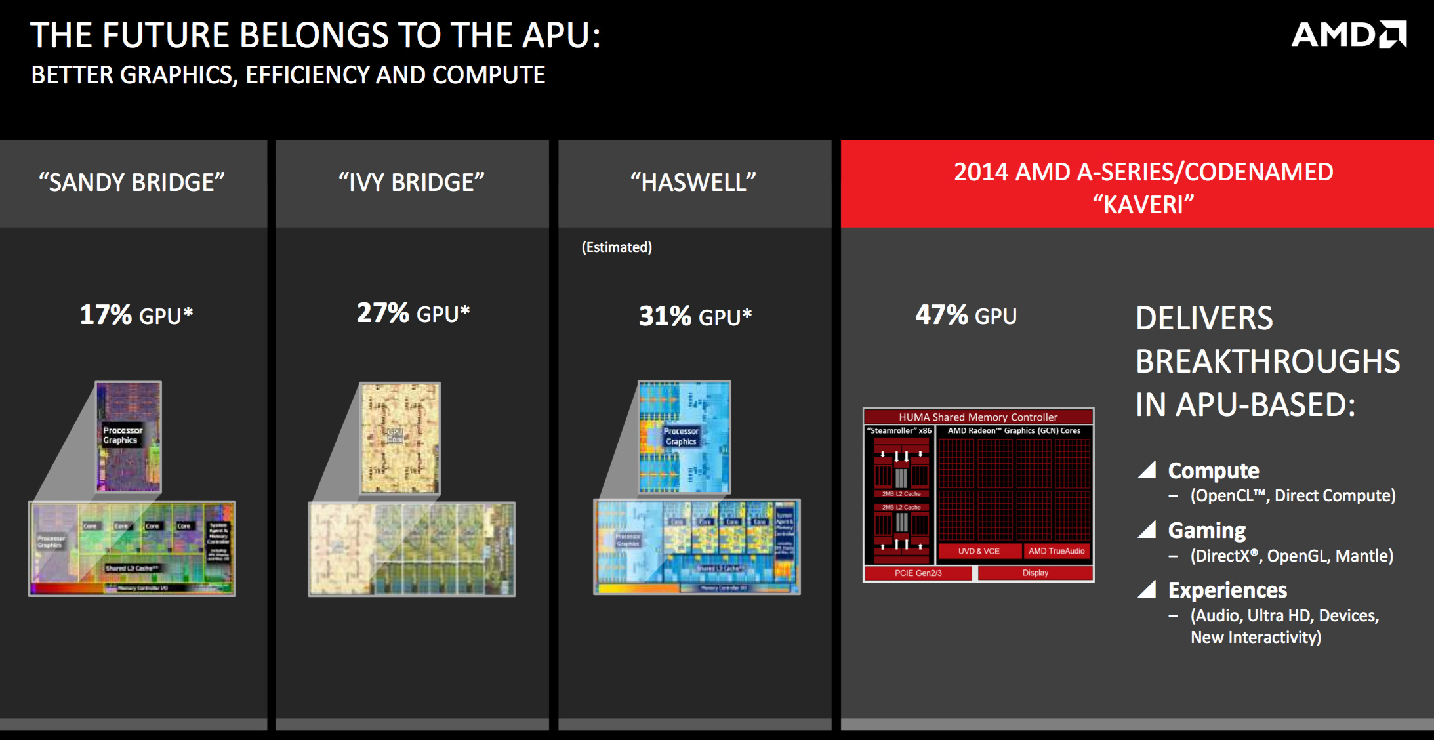
The GPU is Ubiquitous
+
[APU13 keynote]

Slide 19
“Early” GPU History
  1981: IBM PC Monochrome Display Adapter (2D)
  1996: 3D graphics (e.g., 3dfx Voodoo)
  1999: register combiner (NVIDIA GeForce 256)
  2001: programmable shaders (NVIDIA GeForce 3)
  2002: floating-point (ATI Radeon 9700)
  2005: unified shaders (ATI R520 in Xbox 360)
  2006: compute (NVIDIA GeForce 8800)
Notes:
GPGPU
Origins
Use in supercomputing
CUDA => OpenCL => C++AMP, OpenACC, others
Use in Smartphones (e.g., Imagination PowerVR)
Cars (e.g., NVIDIA DRIVE PX)

Slide 20
GPU: The Life of a Triangle
+
process commands
Host
/
Front End
/
Vertex Fetch
transform vertices
Vertex Processing
to screen
-
space
generate per
-
Primitive Assembly
,
Setup
triangle equations
r
e
l
l
generate pixels
o
,
delete pixels
Rasterize
&
Zcull
r
t
that cannot be seen
n
o
C
Pixel Shader
r
e
f
f
u
determine the colors
B
,
transparencies
Texture
e
and depth of the pixel
m
a
r
F
do final hidden surface test,
blend
Pixel Engines
and write out color and new depth
(
ROP
)
[David Kirk / Wen-mei Hwu]

Slide 21

pixel color result of running “shader” program
+
Notes:
Each pixel the result of a single thread run on the GPU

Slide 22
Why use a GPU for computing?
GPU uses larger fraction of silicon for computation than CPU.
At peak performance GPU uses order of magnitude less energy per operation than CPU.
CPU
2nJ/op
GPU
200pJ/op
Rewrite Application
Order of Magnitude More Energy Efficient
However….
Application must perform well

Slide 23
GPU uses larger fraction of silicon for computation than CPU?
+
Control
ALU
ALU
ALU
ALU
Cache
DRAM
DRAM
CPU
GPU
[NVIDIA]

Slide 24
Growing Interest in GPGPU
Supercomputing – Green500.org Nov 2014
  “the top three slots of the Green500 were powered by three different accelerators with number one, L-CSC, being powered by AMD FirePro™ S9150 GPUs; number two, Suiren, powered by PEZY-SC many-core accelerators; and number three, TSUBAME-KFC, powered by NVIDIA K20x GPUs. Beyond these top three, the next 20 supercomputers were also accelerator-based.”
Deep Belief Networks map very well to GPUs (e.g., Google keynote at 2015 GPU Tech Conf.)
http://blogs.nvidia.com/blog/2015/03/18/google-gpu/
http://www.ustream.tv/recorded/60071572

Slide 25
GPGPUs vs. Vector Processors
Similarities at hardware level between GPU and vector processors.
(I like to argue) SIMT programming model moves hardest parallelism detection problem from compiler to programmer.

Slide 26
Part 1: Introduction to GPGPU Programming Model

Slide 27
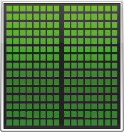

GPU Compute Programming Model
  CPU GPU
How is this system programmed (today)?

Slide 28
GPGPU Programming Model
+
CPU “Off-load” parallel kernels to GPU
  Transfer data to GPU memory
  GPU HW spawns threads
  Need to transfer result data back to CPU main memory
CPU
CPU
CPU
spawn
spawn
done
GPU
GPU
Time
28

Slide 29
CUDA/OpenCL Threading Model
CPU spawns fork-join style “grid” of parallel threads
kernel()
thread block 0
thread block 1
thread block N
thread grid
Spawns more threads than GPU can run (some may wait)
Organize threads into “blocks” (up to 1024 threads per block)
Threads can communicate/synchronize with other threads in block
Threads/Blocks have an identifier (can be 1, 2 or 3 dimensional)
Each kernel spawns a “grid” containing 1 or more thread blocks.
Motivation: Write parallel software once and run on future hardware

Slide 30
SIMT Execution Model
Programmers sees MIMD threads (scalar)
GPU bundles threads into warps (wavefronts) and runs them in lockstep on SIMD hardware
An NVIDIA warp groups 32 consecutive threads together (AMD wavefronts group 64 threads together)
Notes:
MIMD = multiple-instruction, multiple-data

Slide 31
SIMT Execution Model
Challenge: How to handle branch operations when different threads in a warp follow a different path through program?
Solution: Serialize different paths.
foo[] = {4,8,12,16};
A
T1
T2
T3
T4
A: v = foo[threadIdx.x];
B: if (v < 10)
C: v = 0;
else
D: v = 10;
E: w = bar[threadIdx.x]+v;
B
T1
T2
T3
T4
C
Time
T1
T2
D
T3
T4
E
T1
T2
T3
T4
Notes:
MIMD = multiple-instruction, multiple-data

Slide 32
GPU Memory Address Spaces
GPU has three address spaces to support increasing visibility of data between threads: local, shared, global
In addition two more (read-only) address spaces: Constant and texture.

Slide 33
Local (Private) Address Space
Each thread has own “local memory” (CUDA) “private memory” (OpenCL).
0x42
Note: Location at address 100 for thread 0 is different from location at address 100 for thread 1.
Contains local variables private to a thread.

Slide 34
Global Address Spaces
Each thread in the different thread blocks (even from different kernels) can access a region called “global memory” (CUDA/OpenCL).
Commonly in GPGPU workloads threads write their own portion of global memory. Avoids need for synchronization—slow; also unpredictable thread block scheduling.
thread block X
thread block Y
0x42

Slide 35
“Coalescing” global accesses
Not same as CPU write combining/buffering:
Aligned accesses request single 128B cache blk
Memory Divergence:
128
255
ld.global r1,0(r2)
128
256
1024
1152
ld.global r1,0(r2)

Slide 36
History of “shared memory”
Prior to NVIDIA GeForce 8800 and CUDA 1.0, threads could not communicate with each other through on-chip memory.
“Solution”: small (16-48KB) programmer managed scratchpad memory shared between threads within a thread block.

Slide 37
Shared (Local) Address Space
Each thread in the same thread block (work group) can access a memory region called “shared memory” (CUDA) “local memory” (OpenCL).
Shared memory address space is limited in size (16 to 48 KB).
Used as a software managed “cache” to avoid off-chip memory accesses.
Synchronize threads in a thread block using __syncthreads();
thread block
0x42

Slide 38
GPU Instruction Set Architecture (ISA)
NVIDIA defines a virtual ISA, called “PTX” (Parallel Thread eXecution)
PTX is Reduced Instruction Set Architecture (e.g., load/store architecture)
Virtual: infinite set of registers (much like a compiler intermediate representation)
PTX translated to hardware ISA by backend compiler (“ptxas”). Either at compile time (nvcc) or at runtime (GPU driver).

Slide 39
Some Example PTX Syntax
Registers declared with a type:
.reg .pred p, q, r;
.reg .u16 r1, r2;
.reg .f64 f1, f2;
ALU operations
add.u32 x, y, z; // x = y + z
mad.lo.s32 d, a, b, c; // d = a*b + c
Memory operations:
ld.global.f32 f, [a];
ld.shared.u32 g, [b];
st.local.f64 [c], h
Compare and branch operations:
setp.eq.f32 p, y, 0; // is y equal to zero?
@p bra L1 // branch to L1 if y equal to zero

Slide 40
Part 2: Generic GPGPU Architecture

Slide 41
Extra resources
GPGPU-Sim 3.x Manualhttp://gpgpu-sim.org/manual/index.php/GPGPU-Sim_3.x_Manual

Slide 42
GPU Microarchitecture Overview
Single-Instruction, Multiple-Threads
GPU
SIMT Core Cluster
SIMT Core Cluster
SIMT Core Cluster
SIMT
Core
SIMT
Core
SIMT
Core
SIMT
Core
SIMT
Core
SIMT
Core
Interconnection Network
Memory
Partition
Memory
Partition
Memory
Partition
GDDR5
GDDR5
Off-chip DRAM
GDDR5

Slide 43
GPU Microarchitecture
Companies tight lipped about details of GPU microarchitecture.
Several reasons:
  Competitive advantage
  Fear of being sued by “non-practicing entities”
  The people that know the details too busy building the next chip
Model described next, embodied in GPGPU-Sim, developed from: white papers, programming manuals, IEEE Micro articles, patents.

Slide 44
GPGPU-Sim v3.x w/ SASS
Correlation
~0.976
12

Slide 45
GPU Microarchitecture Overview
GPU
SIMT Core Cluster
SIMT Core Cluster
SIMT Core Cluster
SIMT
Core
SIMT
Core
SIMT
Core
SIMT
Core
SIMT
Core
SIMT
Core
Interconnection Network
Memory
Partition
Memory
Partition
Memory
Partition
GDDR3/GDDR5
GDDR3/GDDR5
Off-chip DRAM
GDDR3/GDDR5

Slide 46
Inside a SIMT Core
SIMT
Front End
Reg
File
SIMD Datapath
Fetch
Decode
Memory Subsystem
Icnt.
Network
Schedule
Branch
SMem
L1 D$
Tex $
Const$
SIMT front end / SIMD backend
Fine-grained multithreading
  Interleave warp execution to hide latency
  Register values of all threads stays in core

Slide 47
Inside an “NVIDIA-style” SIMT Core
SIMT Front End
SIMD Datapath
Branch Target PC
Fetch
SIMT-Stack
Scheduler 1
Scheduler 3
ALU
Valid[1:N]
Active
ALU
I-Buffer
Pred.
ALU
Mask
ALU
I-Cache
Decode
Issue
Operand
Scheduler 2
Collector
Score
MEM
Board
Done (WID)
Three decoupled warp schedulers
Scoreboard
Large register file
Multiple SIMD functional units

Slide 48
Fetch + Decode
Arbitrate the I-cache among warps
  Cache miss handled by fetching again later
Fetched instruction is decoded and then stored in the I-Buffer
  1 or more entries / warp
  Only warp with vacant entries are considered in fetch
Score-
PC
Decode
Board
A
1
PC
v
Inst. W1
r
R
2
e
B
PC
3
v
Inst. W2
r
h
c
v
Inst. W3
r
a
C
-
I
o
Selection
T
To
Fetch
Issue
Valid[1:N]
Issue
ARB
Fetch
Valid[1:N]
I-Buffer
I-Cache
Decode

Slide 49
Instruction Issue
Select a warp and issue an instruction from its
I-Buffer for execution
  Scheduling: Greedy-Then-Oldest (GTO)
  GT200/later Fermi/Kepler:
  Allow dual issue (superscalar)
  Fermi: Odd/Even scheduler
  To avoid stalling pipeline might
  keep instruction in I-buffer until
  know it can complete (replay)

Slide 50
Review: In-order Scoreboard
+
Scoreboard: a bit-array, 1-bit for each register
  If the bit is not set: the register has valid data
  If the bit is set: the register has stale data
    i.e., some outstanding instruction is going to change it
Issue in-order: RD ← Fn (RS, RT)
  If SB[RS] or SB[RT] is set → RAW, stall
  If SB[RD] is set → WAW, stall
  Else, dispatch to FU (Fn) and set SB[RD]
Complete out-of-order
  Update GPR[RD], clear SB[RD]
Scoreboard
Register File
0
Regs[R1]
1
Regs[R2]
0
Regs[R3]
0
Regs[R31]
[Gabriel Loh]
Notes:
H&P-style notation

Slide 51
In-Order Scoreboard for GPUs?
+
Problem 1: 32 warps, each with up to 128 (vector) registers per warp means scoreboard is 4096 bits.
Problem 2: Warps waiting in I-buffer needs to have dependency updated every cycle.
Solution?
  Flag instructions with hazards as not ready in I-Buffer so not considered by scheduler
  Track up to 6 registers per warp (out of 128)
  I-buffer 6-entry bitvector: 1b per register dependency
  Lookup source operands, set bitvector in I-buffer. As results written per warp, clear corresponding bit

Slide 52
Example
+
Code
ld r7, [r0]
mul r6, r2, r5
add r8, r6, r7
Scoreboard
Instruction Buffer
Index 0
Index 1
Index 2
Index 3
i0 i1 i2 i3
Warp 0
r7 | - | - | -
- | - | - | -
r7 | r6 | - | -
- | - | - | -
r7 | r6 | r8 | -
- | - | - | -
r7 | r6 | r8 | -
- | - | - | -
r7 | - | r8 | -
- | - | - | -
r7 | - | r8 | -
- | - | - | -
- | - | r8 | -
- | - | - | -
Warp 0
- | - | - | -
- | - | - | -
ld r7, [r0] | 0 | 0 | 0 | 0
ld r7, [r0] | 0 | 0 | 0 | 0
mul r6, r2, r5 | 0 | 0 | 0 | 0
ld r7, [r0] | 0 | 0 | 0 | 0
mul r6, r2, r5 | 0 | 0 | 0 | 0
add r8, r6, r7 | 1 | 1 | 0 | 0
ld r7, [r0] | 0 | 0 | 0 | 0
mul r6, r2, r5 | 0 | 0 | 0 | 0
add r8, r6, r7 | 1 | 1 | 0 | 0
ld r7, [r0] | 0 | 0 | 0 | 0
add r8, r6, r7 | 1 | 0 | 0 | 0
ld r7, [r0] | 0 | 0 | 0 | 0
add r8, r6, r7 | 1 | 0 | 0 | 0
add r8, r6, r7 | 0 | 0 | 0 | 0
Warp 1
Warp 1

Slide 53
SIMT Using a Hardware Stack
Stack approach invented at Lucafilm, Ltd in early 1980’s
Version here from [Fung et al., MICRO 2007]
Stack
A
A/1111
Reconv. PC
Next PC
Active Mask
TOS
TOS
TOS
TOS
-
-
-
-
-
-
-
G
A
E
E
B
E
E
1111
1111
1111
1111
1111
1111
1111
E
E
D
D
0110
TOS
E
D
0110
0110
B
B/1111
TOS
TOS
E
E
C
E
1001
1001
C/1001
D/0110
C
D
F
Thread Warp
Common PC
E
E/1111
Thread
1
Thread
2
Thread
3
Thread
4
G
G/1111
A
B
C
D
E
G
A
Time
SIMT = SIMD Execution of Scalar Threads

Slide 54
SIMT Notes
Execution mask stack implemented with special instructions to push/pop. Descriptions can be found in AMD ISA manual and NVIDIA patents.
In practice augment stack with predication (lower overhead).

Slide 55
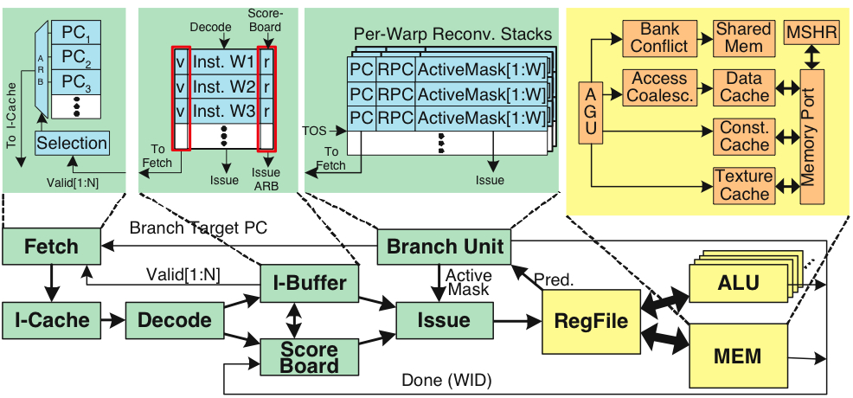
Register File
32 warps, 32 threads per warp, 16 x 32-bit registers per thread = 64KB register file.
Need “4 ports” (e.g., FMA) greatly increase area.
Alternative: banked single ported register file. How to avoid bank conflicts?

Slide 56
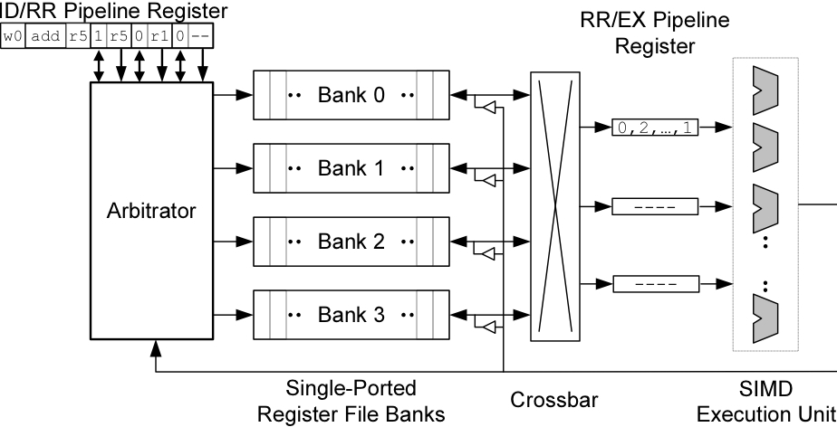
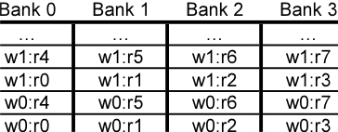
Banked Register File
Strawman microarchitecture:
Register layout:

Slide 57
Operand Collector
Bank 0
Bank 1
Bank 2
Bank 3
R0
R1
R2
R3
R4
R5
R6
R7
R8
R9
R10
R11
…
…
…
…
add.s32 R3, R1, R2;
No Conflict
mul.s32 R3, R0, R4;
Conflict at bank 0
Term “Operand Collector” appears in figure in NVIDIA Fermi Whitepaper
Operand Collector Architecture (US Patent: 7834881)
  Interleave operand fetch from different threads to achieve full utilization

Slide 58
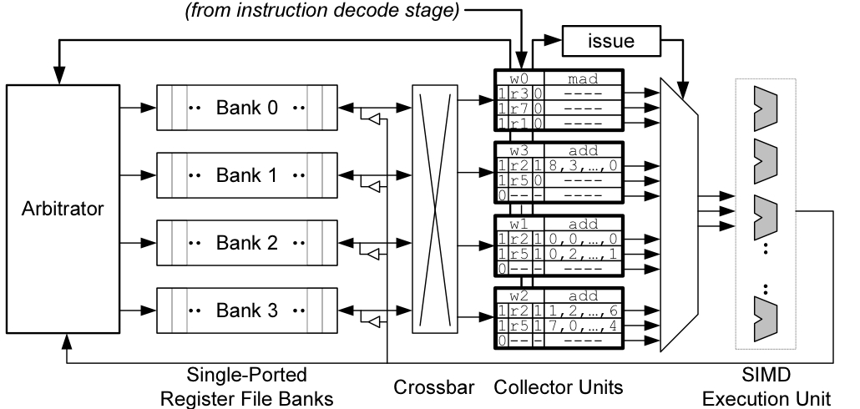
Operand Collector (1)
Issue instruction to collector unit.
Collector unit similar to reservation station in tomasulo’s algorithm.
Stores source register identifiers.
Arbiter selects operand accesses that do not conflict on a given cycle.
Arbiter needs to also consider writeback (or need read+write port)

Slide 59
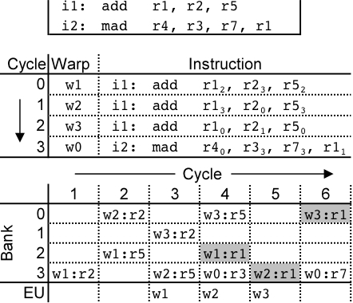
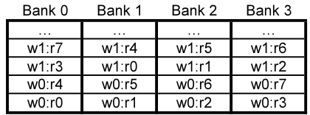
Operand Collector (2)
Combining swizzling and access scheduling can give up to ~ 2x improvement in throughput

Slide 60
AMD Southern Islands
SIMT processing often includes redundant computation across threads.
thread 0…31:
for( i=0; i < runtime_constant_N; i++ {
/* do something with “i” */
}

Slide 61
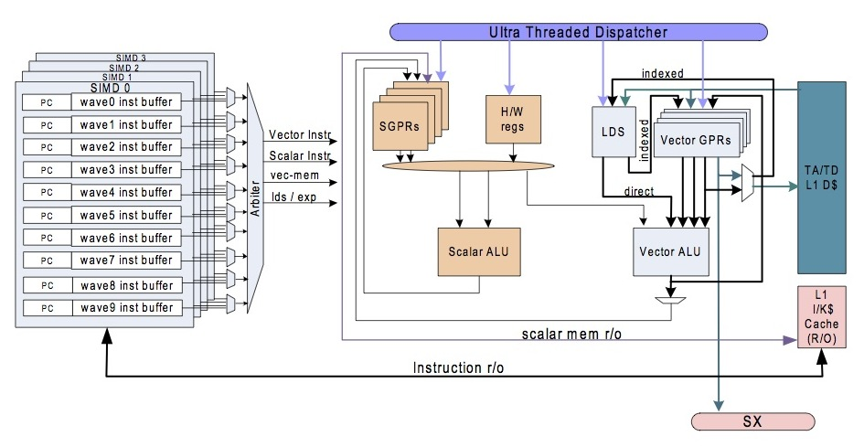
AMD Southern Islands SIMT-Core
ISA visible scalar unit executes computation identical across SIMT threads in a wavefront

