Slide 1
CS203 – Advanced Computer Architecture
TLP –
Multithreaded Architectures

Slide 2
Beyond single thread ILP
ILP is limited by
  window size,
    logic area footprint grows fast
    longer wires, slower clocks
  data dependency and branches
Beyond ILP
  Loop level: Database, Multimedia, Scientific codes
  Data level: SIMD (Vector), SPMD (MPI)
  Thread level
Thread: process with own instructions and data
  thread may be a process, part of a parallel program of multiple processes, or it may be an independent program
  each thread has all the state (instructions, data, PC, register state, and so on) necessary to allow it to execute

Slide 3
Thread Level Parallelism (TLP)
Thread execution
  TLP explicitly represented by the use of multiple threads of execution that are inherently parallel at the program level
To software,
  a dual-threaded processor looks like two distinct CPUs,
  the operating system takes advantage of this by scheduling two threads of execution on it.
Goal: Use multiple instruction streams to improve
  Throughput of computers that run many programs
  Execution time of multi-threaded programs
TLP more cost-effective to exploit than ILP

Slide 4
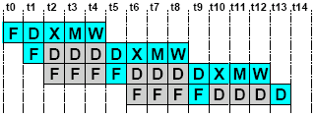
Example: Pipeline Hazards
Each instruction depends on the previous instruction
  LW r1, 0(r2)
  LW r5, 12(r1)
  ADDI r5, r5, #12
  SW 12(r1), r5
How can we guarantee no dependencies between instructions in a pipeline?
One way is to interleave execution of instructions from different program threads on the same pipeline

Slide 5
Multithreading
Interleave 4 threads, T1-T4, on non-bypassed 5-stage pipe
 | t0 | t1 | t2 | t3 | t4 | t5 | t6 | t7 | t8 | t9
T1: LW r1, 0(r2) | F | D | X | M | W
T2: ADD r7, r1, r4 |  | F | D | X | M | W
T3: XORI r5, r4, #12 |  |  | F | D | X | M | W
T4: SW 0(r7), r5 |  |  |  | F | D | X | M | W
T1: LW r5, 12(r1) |  |  |  |  | F | D | X | M | W
Write-back happens before next instruction in same thread reads its registers

Slide 6
Software Multithreading
Used since the 1960’s to hide the latency of I/O operations
  Multiple processes or threads are active
    Virtual memory space allocated
    Process control block allocated
  On an I/O operation
    Process is preempted and removed from ready list
    I/O operation is started
    Another active process is picked from the ready list and run
  When I/O completes, put the preempted process back in the ready list
Context switch
  Trap processor--flush pipeline
  Save process state in process control block
    includes register file, PC, interrupt vector, page table base register, etc.
  Restore process state of a different process
  Start execution--fill pipeline
Also triggered on
  Shared resource conflict (e.g., semaphores)
  Timer interrupts (fairness)
Very high switching overhead (ok, since wait is very long)

Slide 7
Hardware Multithreading
Run multiple threads on the same core concurrently
Run another thread when a thread is blocked on
  L1 or L2 cache misses
  TLB misses
  Exceptions or Unsuccessful synchronization
  Even while waiting for operands (latency of operation)
Minimum hardware support: replicate architectural state
  All running threads must have their own thread context
    Multiple register sets in the processor
    Multiple state registers (ccs, PC, PTBR, IV)
Three types of hardware multithreading:
  Block multithreading or coarse-grain multithreading
  Interleaved multithreading or fine-grain multithreading
  Simultaneous multithreading

Slide 8
Multithreaded Categories
Time (processor cycle)
Superscalar
Fine-Grained
Coarse-Grained
Multiprocessing
Simultaneous Multithreading
Thread 1
Thread 2
Thread 3
Thread 4
Thread 5
Idle slot

Slide 9
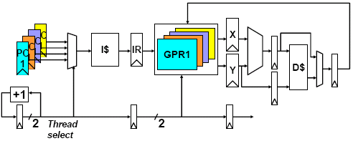
Multithreaded Pipeline
works for both fine & coarse-grain
Have to carry thread select down pipeline to ensure correct state bits read/written at each pipe stage. This is similar to carrying the control bits in a pipelined design across the stages

Slide 10
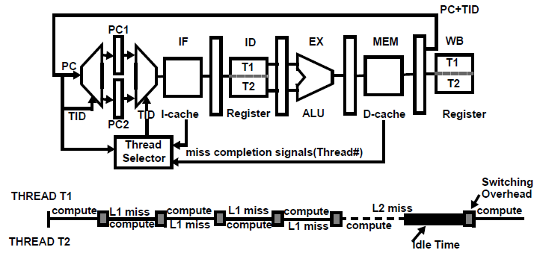
Block (coarse) Multithreading
Each running thread executes in turn until a long latency event
  Similar to software multithreading but at a different scale
Five stage pipeline.
  In the example, each context switch due to l1 miss causes a 25% overhead to flush the pipeline
  Major cost is due to flushing the pipeline

Slide 11
Block MT– 5-stage Pipeline
Both L1 and L2 must be lockup-free
  Must handle two cache accesses (one hit and one miss or two misses)
Use more threads to cover idle times
  More state replication
  More complex thread selection
  Scale up TLB and cache sizes
  Diminishing returns
False timeline
  Cache misses happen at highly variable times
  Latencies are variable
  Overlap is never as perfect as in the example

Slide 12
Block MT - Examples
IBM iSeries SStar
  Called HMT(hardware mt)
  4-way superscalar I/O processor with a 5-stage pipeline
  Designed for commercial workloads
  Two threads: foreground and background
  Switch threads on cache misses + time-out mechanism
Intel’s Montecito
  Two cores with two threads per core, IA-64 (Itanium)
  L3 cache misses, off chip accesses
  Events: L3 cache misses/data return, expiration of quantum, thread switch hint provided by software (instruction that forces the thread to yield the core
  Thread urgency level based on occurrence of events
  Thread switching occurs when the urgency level of suspended thread is higher than that of the running thread
No example of block multithreading in OOO processors

Slide 13
Interleaved Multithreading
Dispatch instructions from different threads/processes in each cycle
  Different ready threads dispatch in turn in every cycle
  Takes advantage of small latencies such as instruction latencies

Slide 14
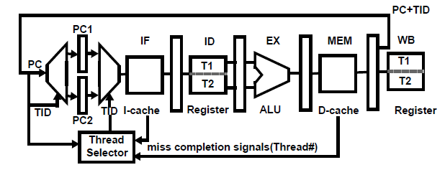
Interleaved Multithreading
Same architecture as for block multithreading except that:
  Data forwarding must be thread aware
  Context id is carried by forwarded values
  Stage flushing must be thread aware
  On an miss exception IF, ID, EX & MEM cannot be flushed indiscriminately
  Same for taken branches and regular software exceptions
  Thread selection algorithm: different thread is selected in each cycle (round-robin)
  On a long latency event the selector puts the thread aside and removes it from selection

Slide 15
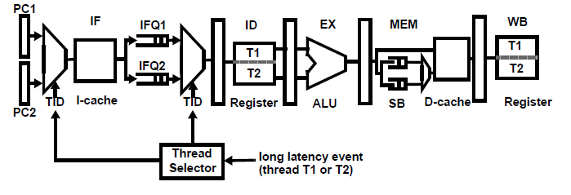
Interleaved Multithreading
SUN Sparc T1 and T2
Thread selection stage; store buffers
The thread selector selects the thread to fetch and decode in every cycle
  Typically round-robin
  If long latency event, the selection of the thread is suspended
  Static branch prediction
  Flushing and forwarding are thread aware

Slide 16
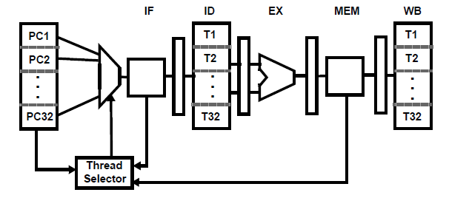
Barrel Processors
Enough threads so that the pipeline is filled with instructions from different threads,
  There is no need to forward or to detect hazards
  There can be so many ready threads that there is no need for a cache
    Or cache can be very large with high hit latency
  No context switch
  Control hazards are also solved by multithreading
  High throughput but low single thread performance
Difference with interleaved MT:
  number of threads >> pipeline depth

Slide 17
Examples Of Barrel Processors
CDC6600 I/O PROCESSORS (1960s)
DENELCOR HEP (EARLY 1980s)
  Up to 16 processors, 8-stage pipeline
  Different threads in the pipeline (needs at least 8 threads)
  No forwarding, no stalling and no flushing
  No cache
  Throughput for eight threads: 10 MIPS
TERA MTA, then Cray XMT
  1987: Tera Computer Company was established by Burton Smith in Seattle,
  1988: Software development starts
  1991: Hardware development starts
  1997: First MTA-1shipment to SDSC (San Diego Supercomputer Center)

Slide 18
TERA MTA
TERA MTA, then Cray XMT
  Multiprocessor with up to 256 processors
    128 i-streams per processor
    128 PCs and 4096 registers
  No hardware support for data hazards
    An instruction in an i-stream can issue if it has no dependencies with previous instructions
    A lookahead field is added to every instruction
    It indicates the number of following instructions that have no dependency with it

Slide 19
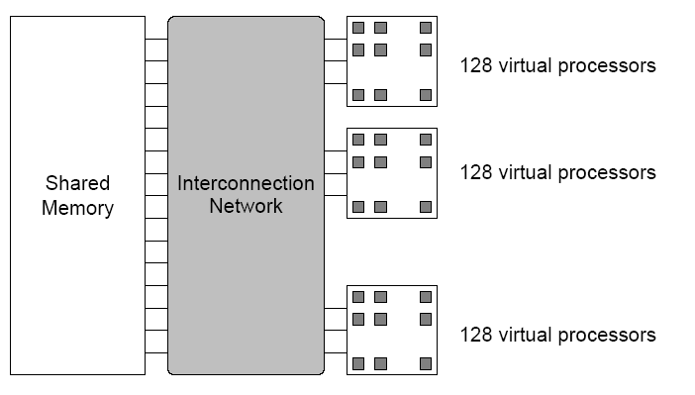
TERA Architecture
    Up to 256 processors running @ 260MHz
    128 active threads per processor
    Up to 256 I/O processors
    Peak Performance of 256 GFlop/sec
    Processors and memory modules populate a sparse 3D torus interconnection network
    4096 interconnection network nodes
    Flat, shared main memory ranging from 16 to 512 GB
    Each MTA processor has 128 “streams” each of which is hardware (including 32 registers and a program counter that is devoted to running single thread of control
    The processor executes instructions from streams, that are not blocked, in a fair round robin fashion
    A stream can issue an instruction every 21 cycles (the length of the instruction pipeline) so at least 21 ready threads are required to keep a processor fully busy
    The processor makes a context switch on each cycle, choosing the next instruction from one of the streams that is ready to execute
    Using ‘rich’ interconnect network guarantees that any potential delays caused by references to data in memory are completely hidden
    Randomized memory mapping and high interconnectivity network provide near-uniform access time from any processor to any memory location.

Slide 20

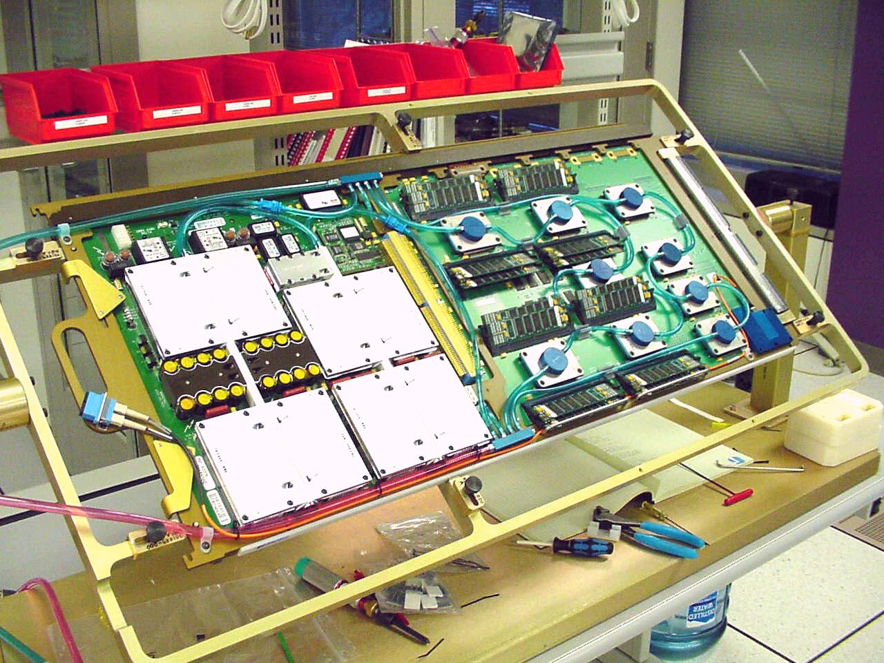
Cray MTA-2
128 Virtual Processors in a CPU module
Up to 1TB Scalable Shared memory
Zero Overhead Thread Switching

Slide 21
MT to Avoid Memory Latency
General processors switch to another context on I/O operation => Software Multithreading, Multiprogramming, etc. An O/S function. Large overhead! Why? Context switch
Why not context switch on a cache miss? => Hardware multithreading.
Can we afford that overhead now? => Need changes in architecture to avoid stack operations. How to achieve it?
Have many contexts CPU resident (not memory resident) by having separate PCs and registers for each thread. No need to store them in stack on context switching.

Slide 22
Sun Niagara 2
Sun T5120 Niagara 2 – Fine-grained multithreading
    8 cores on chip each with 2 pipelines
    4 HW threads/pipeline per core => 64 threads
    4 MB L2, 8-banks, 16-way set-associative
Thread Scheduling: First schedule on different cores in a round-robin manner to avoid resource contention then on different pipeline and finally within the same pipeline
Notes:
22

Slide 23
T2 Core Architecture

Slide 24
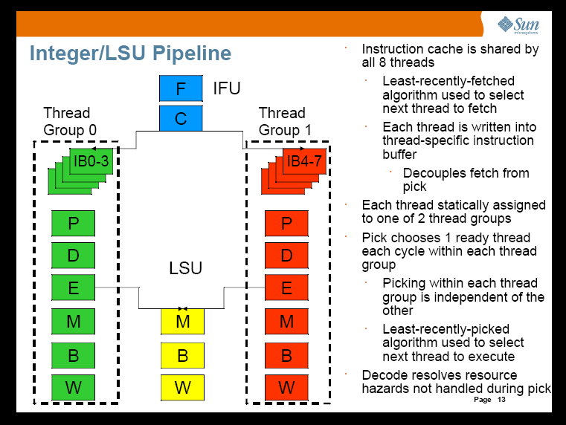

Slide 25
Do both ILP and TLP?
TLP and ILP exploit two different kinds of parallel structure in a program
Could a processor oriented at ILP also exploit TLP?
  functional units are often idle in data path designed for ILP because of either stalls or dependences in the code
Could the TLP be used as a source of independent instructions that might keep the processor busy during stalls?
Could TLP be used to employ the functional units that would otherwise lie idle when insufficient ILP exists?

Slide 26
Simultaneous Multithreading (SMT)
Simultaneous multithreading (SMT): insight that dynamically scheduled processor already has many HW mechanisms to support multithreading
  Large set of virtual registers that can be used to hold the register sets of independent threads
  Register renaming provides unique register identifiers, so instructions from multiple threads can be mixed in datapath without confusing sources and destinations across threads
  Out-of-order completion allows the threads to execute out of order, and get better utilization of the HW
Just adding a per thread renaming table and keeping separate PCs
  Independent commitment can be supported by logically keeping a separate reorder buffer for each thread

Slide 27
Multithreaded Categories
Time (processor cycle)
Superscalar
Fine-Grained
Coarse-Grained
Multiprocessing
Simultaneous Multithreading
Thread 1
Thread 2
Thread 3
Thread 4
Thread 5
Idle slot

Slide 28
Design Challenges in SMT
Since SMT makes sense only with fine-grained implementation, impact of fine-grained scheduling on single thread performance?
  A preferred thread approach sacrifices neither throughput nor single-thread performance?
  Unfortunately, with a preferred thread, the processor is likely to sacrifice some throughput, when preferred thread stalls
Larger register file needed to hold multiple contexts
Not affecting clock cycle time, especially in
  Instruction issue - more candidate instructions need to be considered
  Instruction completion - choosing which instructions to commit may be challenging
Ensuring that cache and TLB conflicts generated by SMT do not degrade performance

Slide 29
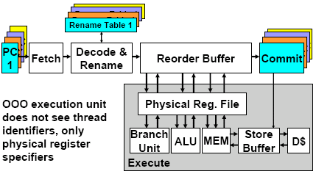
SMT Processor

Slide 30
Intel Pentium-4 Xeon Processor
Hyperthreading == SMT
Dual physical processors, each 2-way SMT
Logical processors share nearly all resources of the physical processor
  Caches, execution units, branch predictors
Die area overhead of hyperthreading ~5 %
When one logical processor is stalled, the other can make progress
  No logical processor can use all entries in queues when two threads are active
A processor running only one active software thread to run at the same speed with or without hyperthreading

Slide 31
Intel Pentium-4 Xeon Processor

Slide 32
Intel Xeon Performance

Slide 33
Initial Performance of SMT
Pentium 4 Extreme SMT yields 1.01 speedup for SPECint_rate benchmark and 1.07 for SPECfp_rate
  Pentium 4 is dual threaded SMT
  SPEC rate requires that each SPEC benchmark be run against a vendor-selected number of copies of the same benchmark
Running on Pentium 4 each of 26 SPEC benchmarks paired with every other (26² runs) speed-ups from 0.90 to 1.58; average was 1.20
Power 5, 8 processor server 1.23 faster for SPECint_rate with SMT, 1.16 faster for SPECfp_rate
Power 5 running 2 copies of each app speedup between 0.89 and 1.41
  Most gained some
  Fl.Pt. apps had most cache conflicts and least gains

Slide 34
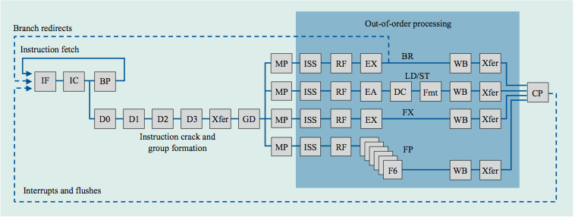
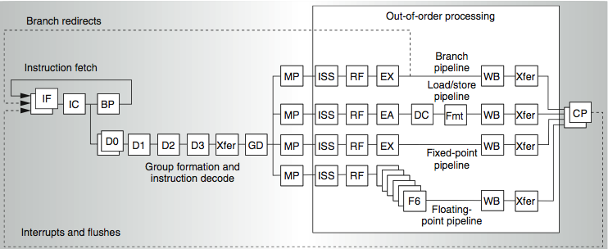
IBM Power Architecture
Power 4
2 commits(architected registers)
Power 5
2 fetch (PC),
2 initial decodes

Slide 35
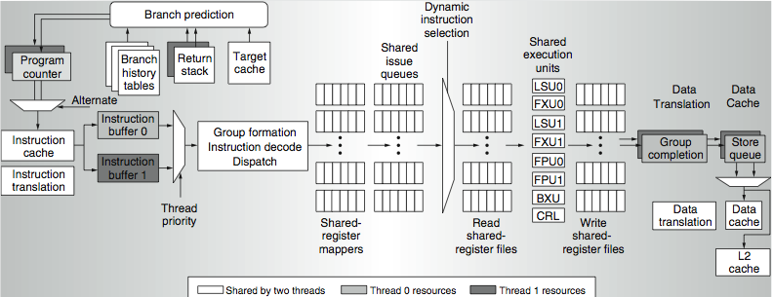
Power 5 data flow ...
Why only 2 threads? With 4, one of the shared resources (physical registers, cache, memory bandwidth) would be prone to bottleneck

Slide 36
Changes in Power 5 to support SMT
Increased associativity of L1 instruction cache and the instruction address translation buffers
Added per thread load and store queues
Increased size of the L2 (1.92 vs. 1.44 MB) and L3 caches
Added separate instruction pre-fetch and buffering per thread
Increased the number of virtual registers from 152 to 240
Increased the size of several issue queues
The Power5 core is about 24% larger than the Power4 core because of the addition of SMT support

Slide 37
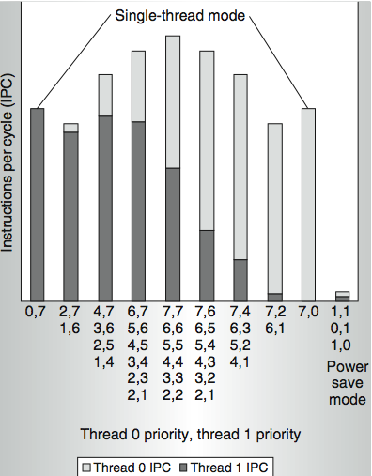
Power 5 thread performance ...
Relative priority of each thread controllable in hardware.
For balanced operation, both threads run slower than if they “owned” the machine.

Slide 38
Head to Head ILP competition
Processor | Micro architecture | Fetch / Issue / Execute | FU | Clock Rate (GHz) | Transis-tors Die size | Power
Intel Pentium 4 Extreme | Speculative dynamically scheduled; deeply pipelined; SMT | 3/3/4 | 7 int. 1 FP | 3.8 | 125 M 122 mm² | 115 W
AMD Athlon 64 FX-57 | Speculative dynamically scheduled | 3/3/4 | 6 int. 3 FP | 2.8 | 114 M 115 mm² | 104 W
IBM Power5 (1 CPU only) | Speculative dynamically scheduled; SMT; 2 CPU cores/chip | 8/4/8 | 6 int. 2 FP | 1.9 | 200 M 300 mm² (est.) | 80W (est.)
Intel Itanium 2 | Statically scheduled VLIW-style | 6/5/11 | 9 int. 2 FP | 1.6 | 592 M 423 mm² | 130 W

Slide 39
Performance on SPECint2000

Slide 40
Performance on SPECfp2000

Slide 41
Normalized Performance: Efficiency
Rank | I tanium2 | Pen t I um4 | A t h l on | Powe r 5
Int/Trans | 4 | 2 | 1 | 3
FP/Trans | 4 | 2 | 1 | 3
Int/area | 4 | 2 | 1 | 3
FP/area | 4 | 2 | 1 | 3
Int/Watt | 4 | 3 | 1 | 2
FP/Watt | 2 | 4 | 3 | 1

Slide 42
No Silver Bullet for ILP
No obvious overall leader in performance
The AMD Athlon leads on SPECInt performance followed by the Pentium 4, Itanium 2, and Power5
Itanium 2 and Power5, which perform similarly on SPECFP, clearly dominate the Athlon and Pentium 4 on SPECFP
Itanium 2 is the most inefficient processor both for Fl. Pt. and integer code for all but one efficiency measure (SPECFP/Watt)
Athlon and Pentium 4 both make good use of transistors and area in terms of efficiency,
IBM Power5 is the most effective user of energy on SPECFP and essentially tied on SPECINT

Slide 43
Limits to ILP
Doubling issue rates above today’s 3-6 instructions per clock, say to 6 to 12 instructions, probably requires a processor to
  issue 3 or 4 data memory accesses per cycle,
  resolve 2 or 3 branches per cycle,
  rename and access more than 20 registers per cycle, and
  fetch 12 to 24 instructions per cycle.
The complexities of implementing these capabilities is likely to mean sacrifices in the maximum clock rate
  E.g, widest issue processor is the Itanium 2, but it also has the slowest clock rate, despite the fact that it consumes the most power!

Slide 44
Limits to ILP
Most techniques for increasing performance increase power consumption
The key question is whether a technique is energy efficient: does it increase power consumption faster than it increases performance?
Multiple issue processors techniques all are energy inefficient:
  Issuing multiple instructions incurs some overhead in logic that grows faster than the issue rate grows
  Growing gap between peak issue rates and sustained performance
Number of transistors switching = f(peak issue rate), and performance = f( sustained rate),
growing gap between peak and sustained performance
⇒ increasing energy per unit of performance

Slide 45
Commentary
Itanium architecture does not represent a significant breakthrough in scaling ILP or in avoiding the problems of complexity and power consumption
Instead of pursuing more ILP, architects are increasingly focusing on TLP implemented with single-chip multiprocessors
In 2000, IBM announced the 1st commercial single-chip, general-purpose multiprocessor, the Power4, which contains 2 Power3 processors and an integrated L2 cache
  Since then, Sun Microsystems, AMD, and Intel have switch to a focus on single-chip multiprocessors rather than more aggressive uniprocessors.
Right balance of ILP and TLP is unclear today
  Perhaps right choice for server market, which can exploit more TLP, may differ from desktop, where single-thread performance may continue to be a primary requirement

Slide 46
And in conclusion …
Limits to ILP (power efficiency, compilers, dependencies …) seem to limit to 3 to 6 issue for practical options
Explicitly parallel (Data level parallelism or Thread level parallelism) is next step to performance
Coarse grain vs. Fine grained multihreading
  Only on big stall vs. every clock cycle
Simultaneous Multithreading if fine grained multithreading based on OOO superscalar microarchitecture
  Instead of replicating registers, reuse rename registers
Itanium/EPIC/VLIW is not a breakthrough in ILP
Balance of ILP and TLP decided in marketplace

