Slide 1
CS203 – Advanced Computer Architecture
Virtual Memory

Slide 2
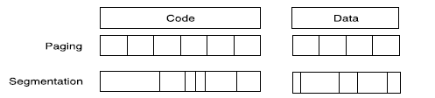
Why Virtual memory?
Allows applications to be bigger than main memory size
Helps with multiple process management
  Each process gets its own chunk of memory
  Protection of processes against each other
  Mapping of multiple processes to memory
  Relocation
  Application and CPU run in virtual space
  Mapping of virtual to physical space is invisible to the application
Management between main memory and disk
  Miss in main memory is a page fault or address fault
  Block is a page or segment

Slide 3
Mapping Virtual to Physical Memory
Virtual Memory
Divide memory into equal sized “chunks” or pages (typically 4KB each)
Any chunk of Virtual Memory can be assigned to any chunk of Physical Memory
∞
Stack
Physical Memory
Single
Process
64 MB
Heap
Static
Code
0
0

Slide 4
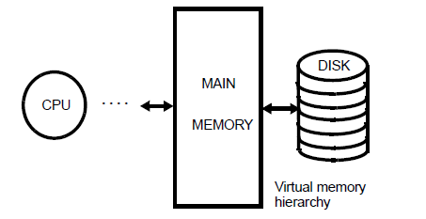
Paged Virtual Memory
Virtual address space divided into pages
Physical address space divided into pageframes
Page missing in MM = page fault
  Pages not in MM are on disk: swap-in/swap-out
  Or have never been allocated
  New page may be placed anywhere in MM (fully associative map)
Dynamic address translation
  Effective address is virtual
  Must be translated to physical for every access
  Virtual to physical translation through page table in MM

Slide 5
Cache vs VM
Cache Virtual Memory
Block or Line Page
Miss Page Fault
Block Size: 32-64B Page Size: 4K-16KB
Placement:
Direct Mapped, Fully Associative
N-way Set Associative
Replacement:
LRU or Random LRU approximation
Write Thru or Back Write Back
How Managed:
Hardware Hardware + Software
(Operating System)

Slide 6
Handling Page Faults
A page fault is like a cache miss
  Must find page in lower level of hierarchy
If valid bit is zero, the Physical Page Number points to a page on disk
When OS starts new process, it creates space on disk for all the pages of the process, sets all valid bits in page table to zero, and all Physical Page Numbers to point to disk
  called Demand Paging - pages of the process are loaded from disk only as needed
  Create “swap” space for all virtual pages on disk

Slide 7
Performing Address Translation
VM divides memory into equal sized pages
Address translation relocates entire pages
  offsets within the pages do not change
  if page size is a power of two, the virtual address separates into two fields:
  (like cache index, offset fields)
Virtual Page Number
Page Offset
virtual address

Slide 8
Mapping Virtual to Physical Address

Slide 9
Address Translation
Want fully associative page placement
How to locate the physical page?
  Search impractical (too many pages)
A page table is a data structure which contains the mapping of virtual pages to physical pages
  There are several different ways, all up to the operating system, to keep this data around
Each process running in the system has its own page table

Slide 10
Page Table and Address Translation

Slide 11
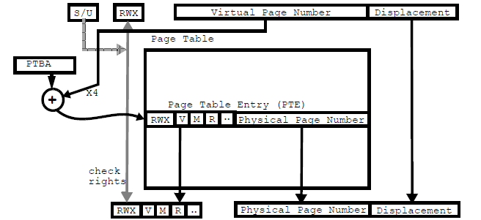
Page Table
Page table translates address, enforces protection
Page replacement
  FIFO, LRU, etc…
  APPROXIMATE LRU (working set)
    Reference bit (r) per page is periodically reset by o/s
Write strategy is write back using modify (m) bit
  M and r bits are easily maintained by software using traps
Valid bit – 1 = in memory, 0 = in disk

Slide 12
Protection and Sharing in VM

Slide 13
Optimizing VM
Page Table too big!
  4GB Virtual address space / 4 KB page
    2²⁰ page table entries. Assume 4B per entry.
    4MB just for Page Table of single process
  With 100 process, 400MB of memory is required!
Virtual Memory too slow!
  Requires two memory accesses.
    One to access page table to get the memory address
    Another to get the real data

Slide 14
Multi-level Page Table
To reduce the size of the page table
  1-level page table is too expensive for large virtual address Space
Solution: Multi-level page table, Paging page tables, etc.
  To create small page tables for virtual memory
  The virtual address is now split into multiple chunks to index a page table “tree”
Example
  X86 paging
  AMD Opteron: Text book Append. B

Slide 15
Multi-level Page Table
Virtual page number broken into fields to index each level of multi-level page table

Slide 16
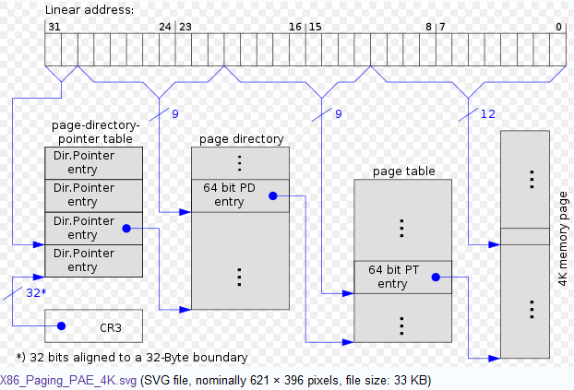
x86 Hierarchical Paging
Control Registers CR0 to CR 4 in X86 architecture. CR3 enables the processor to translate linear addresses into physical addresses by locating the page directory and page tables for the current task.

Slide 17
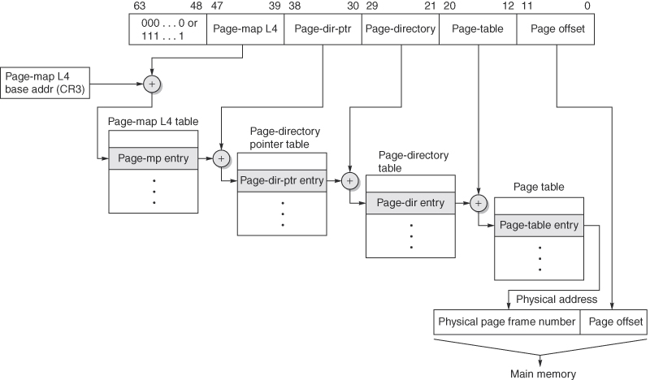
AMD Opteron Paging
Figure B.27 The mapping of an Opteron virtual address. The Opteron virtual memory implementation with four page table levels supports an effective physical address size of 40 bits. Each page table has 512 entries, so each level field is 9 bits wide. The AMD64 architecture document allows the virtual address size to grow from the current 48 bits to 64 bits, and the physical address size to grow from the current 40 bits to 52 bits.

Slide 18
Fast Address Translation
Problem: Virtual Memory requires two memory accesses!
  one to translate Virtual Address into Physical Address (page table lookup)
  one to transfer the actual data (cache hit)
  But Page Table is in physical memory! => 2 main memory accesses!
Observation: since there is locality in pages of data, must be locality in virtual addresses of those pages!
Why not create a cache of virtual to physical address translations to make translation fast? (smaller is faster)
For historical reasons, such a “page table cache” is called a Translation Lookaside Buffer, or TLB

Slide 19
Translation Lookaside Buffer
Page table entry is cached in TLB
  TLB is organized as a cache accessed with the VPN
    PID added to deal with homonyms (2 process with same virtual page number)
  TLBs are much smaller than caches because of coverage
  Usually two TLB: i-TLB and d-TLB
  TLB miss can be handled in a hardwared MMU or by a software trap handler
    “Table walking”

Slide 20
TLB Translation
Virtual-to-physical address translation by a TLB and how the resulting physical address is used to access the cache memory.

Slide 21
TLB and Cache Addressing
Cache review
  Set or block field indexes LUT holding tags
  2 steps to determine hit:
    Index (lookup) to find tags (using block or set bits)
    Compare tags to determine hit
    Sequential connection between indexing and tag comparison
Rather than waiting for address translation and then performing this two step hit process, can we overlap the translation and portions of the hit sequence?
  Yes if we choose page size, block size, and set/direct mapping carefully

Slide 22
Cache Index/Tag Options
Physically indexed, physically tagged (PIPT)
  Wait for full address translation
  Then use physical address for both indexing and tag comparison
Virtually indexed, physically tagged (VIPT)
  Use portion of the virtual address for indexing then wait for address translation and use physical address for tag comparisons
  Easiest when index portion of virtual address w/in offset (page size) address bits, otherwise aliasing may occur
Virtually indexed, virtually tagged (VIVT)
  Use virtual address for both indexing and tagging…No TLB access unless cache miss
  Requires invalidation of cache lines on context switch or use of process ID as part of tags

Slide 23
Virtually Index Physically Tagged

Slide 24
Summary
Virtual Memory overcomes main memory size limitations
VM supported through Page Tables
Multi-level Page Tables enables smaller page tables in memory
TLB enables fast address translation

