Slide 1
CS203 – Advanced Computer Architecture
Cache

Slide 2
Memory Hierarchy Design
Memory hierarchy design becomes more crucial with recent multi-core processors:
  Aggregate peak bandwidth grows with # cores:
    Intel Core i7 can generate two references per core per clock
    Four cores and 3.2 GHz clock
      25.6 billion 64-bit data references/second +
      12.8 billion 128-bit instruction references
      = 409.6 GB/s!
    DRAM bandwidth is only 6% of this (25 GB/s)

Slide 3
Performance and Power
Requires:
  Multi-port, pipelined caches
  Two levels of cache per core
  Shared third-level cache on chip
High-end microprocessors have >10 MB on-chip cache
  Consumes large amount of area and power budget

Slide 4
Typical Memory Hierarchy
Principle of locality:
A program accesses a relatively small portion of the address space at a time
Two different types of locality:
  Temporal locality: if an item is referenced, it will tend to be referenced again soon
  Spatial locality: if an item is referenced, items whose addresses are close tend to be referenced soon

Slide 5
Typical Memory Hierarchy

Slide 6
Cache basics

Slide 7
Memory Hierarchy Basics
When a word is not found in the cache, a miss occurs:
  Fetch word from lower level in hierarchy, requiring a higher latency reference
  Lower level may be another cache or the main memory
  Also fetch the other words contained within the block
    Takes advantage of spatial locality
  Place block into cache in any location within its set, determined by address

Slide 8
Cache Sets and Ways
Ways: Block can go anywhere
Sets:
Block
mapped
by
addr
block/line
n-way set associative
(4-way set associative)
Example: Cache size = 16 blocks

Slide 9
Direct-mapped Cache
1-way
block/line
Direct mapped cache
Each block maps to only one cache line
aka
1-way set associative
16 Sets

Slide 10
Set Associative Cache
4-way
block/line
4 Sets
n-way set associative
Each block can be mapped to a set of n-lines
Set number is based on block address
(4-way set associative)

Slide 11
Fully Associative Cache
16-ways
1 Sets
block /line
Fully associative
Each block can be mapped to any cache line
aka
m-way set associative
where m = size of cache in blocks

Slide 12
Cache Addressing
n-Ways: Block can go anywhere
s-Sets:
Block
mapped
by
addr
block/line
Address
Tag (remainder) bits = 32-s-b | Index (sets) bits = log₂s | Offset (block size) bits = log₂b
m = size of cache in blocks
n = number of ways
b = block size in bytes
Cache size = s * n * b
# of Sets (s) = m / n

Slide 13
Cache Addressing
Ex. 64KB cache, direct mapped, 16 byte block
Address
Tag (remainder) bits = 32-s-b | Index (sets) bits = log₂s | Offset (block size) bits = log₂b
16 | 12 | 4
m = size of cache in blocks
n = number of ways
b = block size in bytes
Cache size = s * n * b
# of Sets (s) = m / n
Notes:
4k sets = 2^12

Slide 14
Cache Addressing
Ex. 64KB cache, 2-way assoc., 16 byte block
Address
Tag (remainder) bits = 32-s-b | Index (sets) bits = log₂s | Offset (block size) bits = log₂b
17 | 11 | 4
m = size of cache in blocks
n = number of ways
b = block size in bytes
Cache size = s * n * b
# of Sets (s) = m / n
Notes:
2k sets = 2^11

Slide 15
Cache Addressing
Ex. 64KB cache, fully assoc., 16 byte block
Address
Tag (remainder) bits = 32-s-b | Index (sets) bits = log₂s | Offset (block size) bits = log₂b
28 | 0 | 4
m = size of cache in blocks
n = number of ways
b = block size in bytes
Cache size = s * n * b
# of Sets (s) = m / n
Notes:
1 set = 2^0

Slide 16
Cache Replacement Policies
Picks which block to replace within the set
Ex. - Random, First In First Out (FIFO),
Least Recently Used (LRU), Psuedo-LRU
Example: LRU
Line 0 | 10
Line 1 | 01
Line 2 | 11
Line 3 | 00
Line 0 | 01
Line 1 | 00
Line 2 | 11
Line 3 | 10
Hit on Line 3
Line 0 | 10
Line 1 | 01
Line 2 | 00
Line 3 | 11
Miss

Slide 17
Cache Write Policies
Writing to cache: two strategies
  Write-through
    Immediately update lower levels of hierarchy
  Write-back
    Only update lower levels of hierarchy when an updated block is replaced
  Both strategies use write buffer to make writes asynchronous

Slide 18
Cache Performance
Miss rate
  Fraction of cache access that result in a miss
Causes of misses
  Compulsory (cold)
    First reference to a block
  Capacity
    Space is not sufficient to host data or code
  Conflict
    When two memory blocks map on the same cache block in direct-mapped or set-associative caches

Slide 19
Measuring/Classifying Misses
How to find out?
  Cold misses: Simulate a fully associative infinite cache size
  Capacity misses: Simulate fully associative cache, then deduct cold misses
  Conflict misses: Simulate target cache configuration then deduct cold and capacity misses
Classification is useful to understand how to eliminate misses
High conflict misses → need higher associativity
High capacity misses → need larger cache

Slide 20
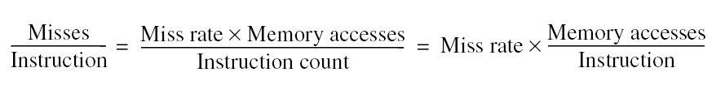
Cache Performance
Note that speculative and multithreaded processors may execute other instructions during a miss
  Reduces performance impact of misses

Slide 21
Cache optimizations

Slide 22
Cache Optimizations Basics
Six basic cache optimizations:
  Larger block size
    Reduces compulsory misses
    Increases capacity and conflict misses, increases miss penalty
  Larger total cache capacity to reduce miss rate
    Increases hit time, increases power consumption
  Higher associativity
    Reduces conflict misses
    Increases hit time, increases power consumption
  Higher number of cache levels
    Reduces overall memory access time
  Giving priority to read misses over writes
    Reduces miss penalty
  Avoiding address translation in cache indexing
    Reduces hit time

Slide 23
Ten Advanced Optimizations
Small and simple first level caches
  Critical timing path:
    addressing tag memory, then
    comparing tags, then
    selecting correct set
  Direct-mapped caches can overlap tag compare and transmission of data
  Lower associativity reduces power because fewer cache lines are accessed

Slide 24
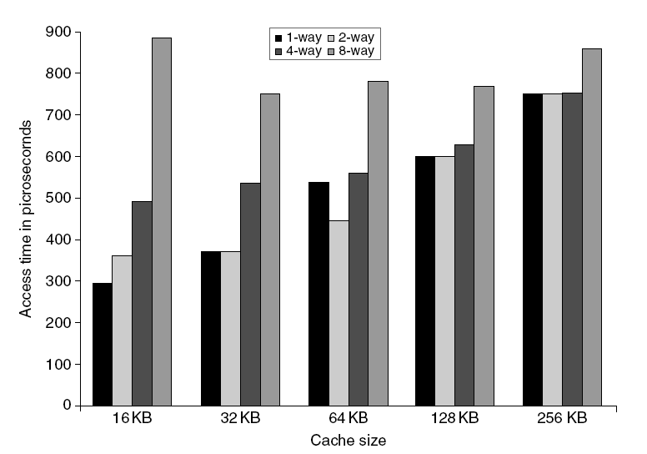
L1 Size and Associativity
Access time vs. size and associativity

Slide 25
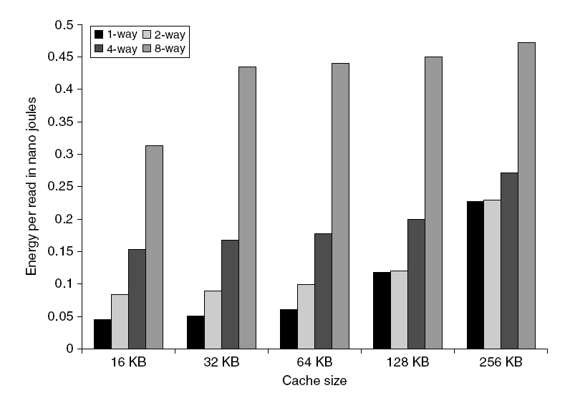
L1 Size and Associativity
Energy per read vs. size and associativity

Slide 26
Way Prediction
To improve hit time, predict the way to pre-set mux
  Mis-prediction gives longer hit time
  Prediction accuracy
    > 90% for two-way
    > 80% for four-way
    I-cache has better accuracy than D-cache
  First used on MIPS R10000 in mid-90s
  Used on ARM Cortex-A8
Extend to predict block as well
  “Way selection”
  Increases mis-prediction penalty

Slide 27
Pipelining Cache
Pipeline cache access to improve bandwidth
  Examples:
    Pentium: 1 cycle
    Pentium Pro – Pentium III: 2 cycles
    Pentium 4 – Core i7: 4 cycles
Increases branch mis-prediction penalty
Makes it easier to increase associativity

Slide 28
Non-blocking Caches
Cache is a 2-ported device: memory & processor
If a lockup-free cache misses, it does not block
It handles the miss and keeps accepting accesses from the processor
  Allows for the concurrent processing of multiple misses and hits
Cache has to bookkeep all pending misses
  MSHRs (miss status handling registers) contain the address of pending miss, the destination block in cache, and the destination register
  Number of MSHRs limits the number of pending misses
Data dependencies eventually block the processor
Non-blocking caches are required in dynamically scheduled processor and to support prefetching

Slide 29
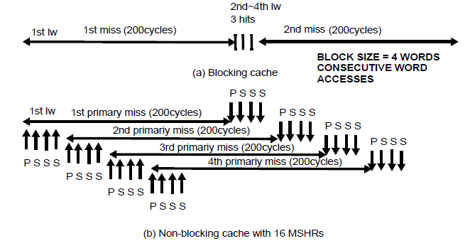
Primary/Secondary Misses
Primary: the first miss to a block
Secondary: following accesses to blocks pending due to primary miss
  Lot more misses (blocking cache only has primary misses)
  Needs MSHRs for both primary and secondary misses
  Misses are overlapped with computation and other misses

Slide 30
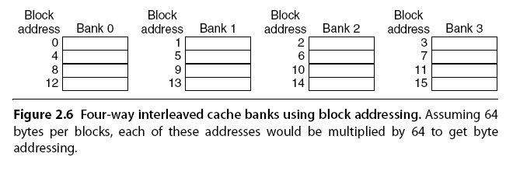
Multibanked Caches
Organize cache as independent banks to support simultaneous access
  ARM Cortex-A8 supports 1-4 banks for L2
  Intel i7 supports 4 banks for L1 and 8 banks for L2
Interleave banks according to block address

Slide 31
Critical Word First, Early Restart
Critical word first
  Request missed word from memory first
  Send it to the processor as soon as it arrives
Early restart
  Request words in normal order
  Send missed word to the processor as soon as it arrives
Effectiveness of these strategies depends on block size and likelihood of another access to the portion of the block that has not yet been fetched

Slide 32
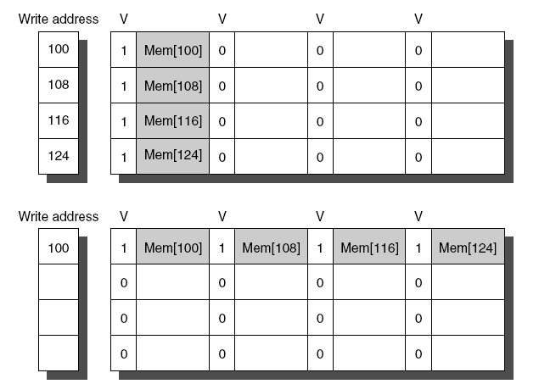
Merging Write Buffer
When storing to a block that is already pending in the write buffer, update write buffer
Reduces stalls due to full write buffer
Do not apply to I/O addresses
No write buffering
Write buffering

Slide 33
Compiler Optimizations
Loop Interchange
  Swap nested loops to access memory in sequential order
Blocking
  Instead of accessing entire rows or columns, subdivide matrices into blocks
  Requires more memory accesses but improves locality of accesses

Slide 34
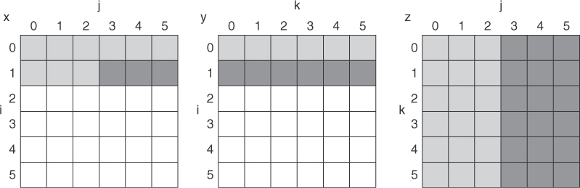
Blocking (1)
Figure 2.8 A snapshot of the three arrays x, y, and z when N = 6 and i = 1. The age of accesses to the array elements is indicated by shade: white means not yet touched, light means older accesses, and dark means newer accesses. Compared to Figure 2.9, elements of y and z are read repeatedly to calculate new elements of x. The variables i, j, and k are shown along the rows or columns used to access the arrays.
/* Before */
for (i=0; i<N; i++)
for(j=0; j<N; j++)
{r=0;
for (k=0; k<N; k++)
r = r + Y[i][k]*Z[k][j];
X[i][j] = r;
};
2N³ + N² memory words accessed

Slide 35
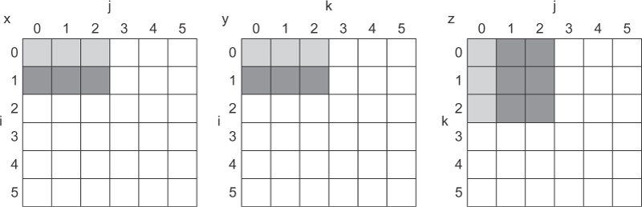
Blocking (2)
/* After*/
for (jj=0; jj<N; jj = jj+B)
for(kk=0; kk<N; kk = kk+B)
for (i=0; i<N; i++)
for (j=jj; j < min(jj+B,N); j++)
{r=0;
for (k=kk; k < min(kk+B,N); k++)
r = r + Y[i][k]*Z[k][j];
X[i][j] = X[i][j] + r;
};
2N³/B + N²
Figure 2.9 The age of accesses to the arrays x, y, and z when B = 3. Note that, in contrast to Figure 2.8, a smaller number of elements is accessed.

Slide 36
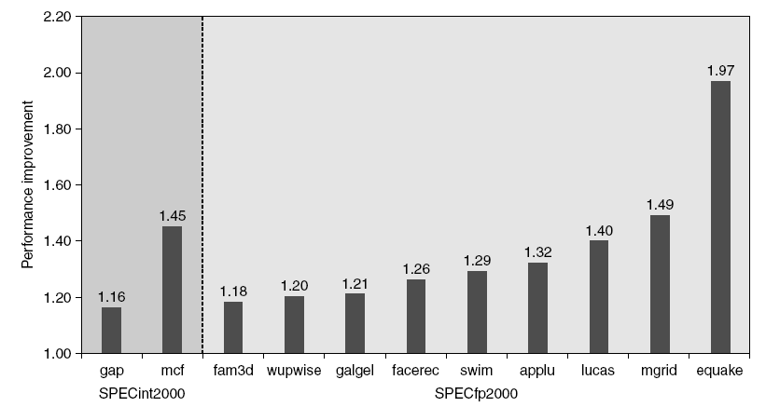
Hardware Prefetching
Fetch two blocks on miss (include next sequential block)
Pentium 4 Pre-fetching

Slide 37
Compiler Prefetching
Insert prefetch instructions before data is needed
Non-faulting: prefetch doesn’t cause exceptions
Register prefetch
  Loads data into register
Cache prefetch
  Loads data into cache
Combine with loop unrolling and software pipelining

Slide 38
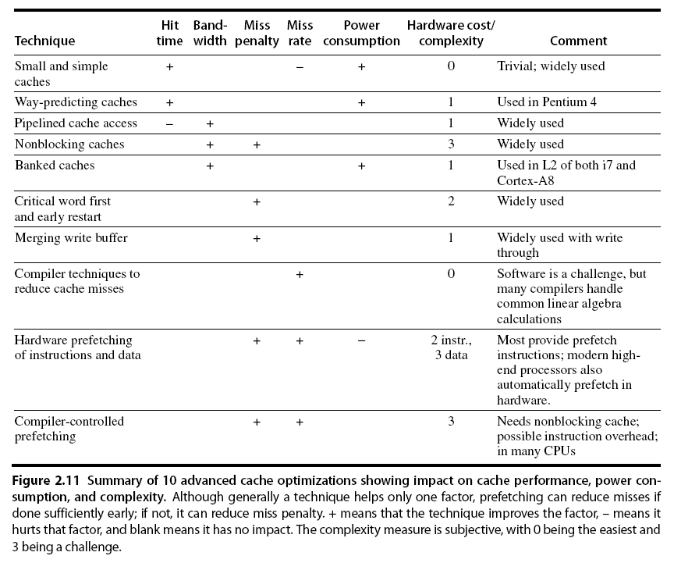
Summary

